Slide 1
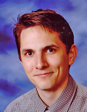
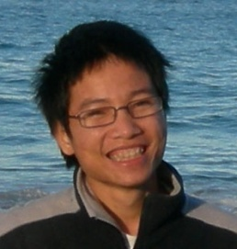

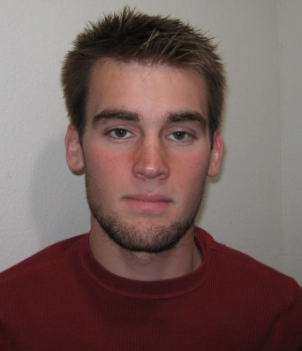


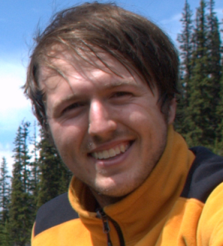
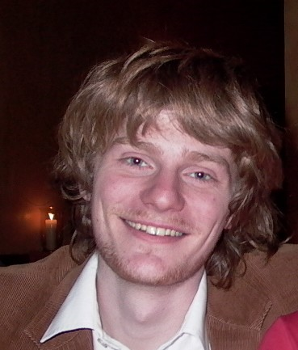
Unsupervised Feature Learning
and Deep Learning
Andrew Ng
Thanks to:
Adam Coates Quoc Le Honglak Lee Andrew Maas Chris Manning Jiquan Ngiam Andrew Saxe Richard Socher

Slide 2
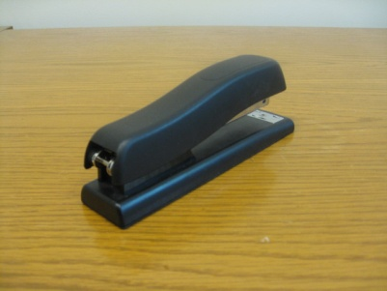
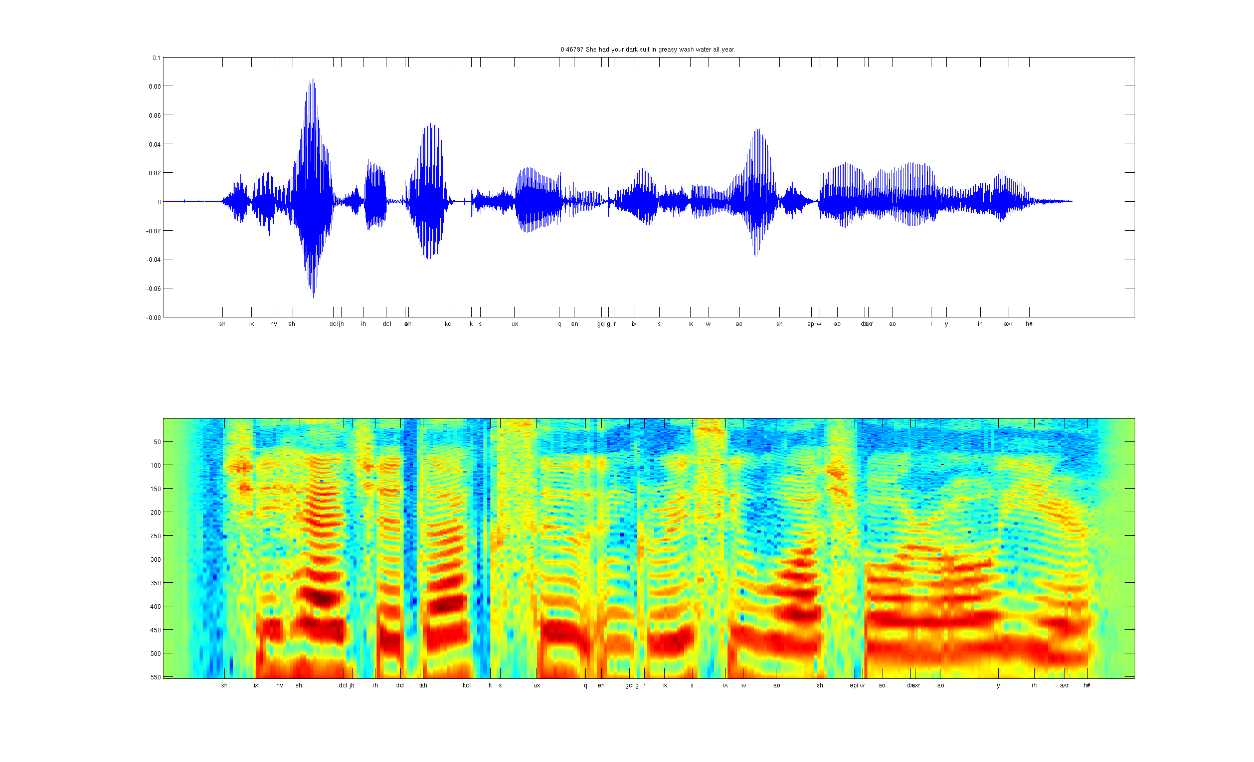
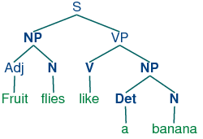
Develop ideas using…
Computer vision
Audio
Text

Slide 3
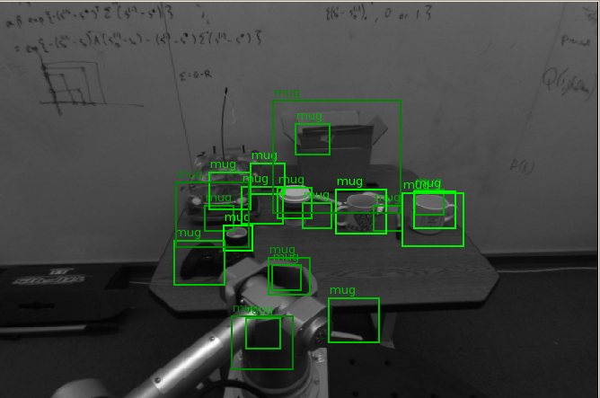
Computer vision is hard!
Notes:
Good faith effort to implement state-of-the-art.
Cluttered scenes.

Slide 4

Machine learning and feature representations
pixel 1
Learning
algorithm
pixel 2
Input
Motorbikes
Input space
“Non”-Motorbikes
pixel 2
pixel 1

Slide 5
Machine learning and feature representations
Learning
algorithm
Input
Motorbikes
Input space
“Non”-Motorbikes
pixel 2
pixel 1

Slide 6
Machine learning and feature representations
handle
Feature representation
Learning
algorithm
wheel
Input
Motorbikes
Input space
Feature space
“Non”-Motorbikes
“handle”
pixel 2
pixel 1
“wheel”

Slide 7
Object classification
handlebars
Feature representation
Learning
algorithm
wheel
Input
Feature space
Motorbikes
“Non”-Motorbikes
“handlebars”
“wheel”

Slide 8
Feature representations
Learning
algorithm
Input
Notes:
Where do we get these low-level representations from?

Slide 9
Feature representations
Feature Representation
Learning
algorithm
Input
E.g., SIFT, HoG, etc.
Notes:
Where do we get these low-level representations from?

Slide 10
Feature representations
Input
Feature Representation
Learning
algorithm
Notes:
Where do we get these low-level representations from?

Slide 11
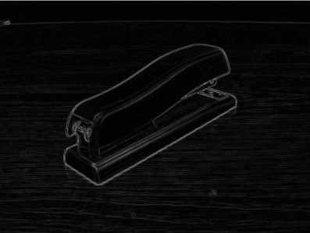


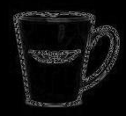

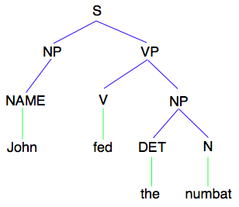
How is computer perception done?
Object detection
Image
Vision features
Detection
Audio classification
Image
Low-level features
Grasp point
Audio
Audio features
Speaker ID
Text classification, Machine translation, Information retrieval, etc.
NLP
Text
Text features

Slide 12
Feature representations
Input
Feature Representation
Learning
algorithm
Notes:
Where do we get these low-level representations from?

Slide 13
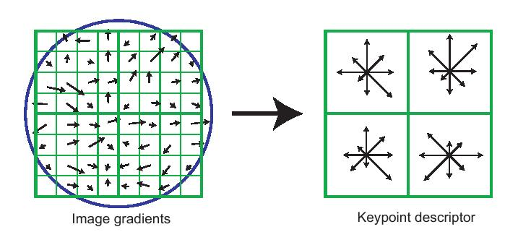
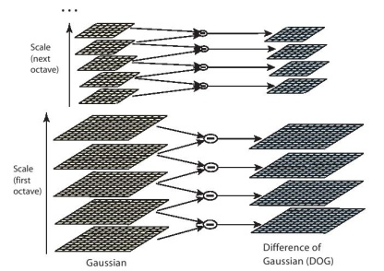
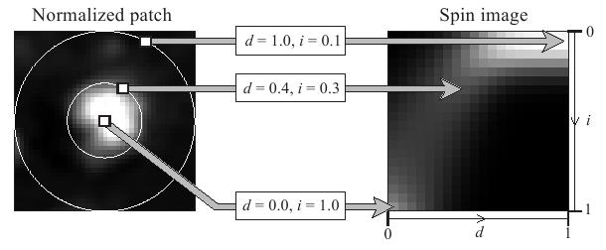
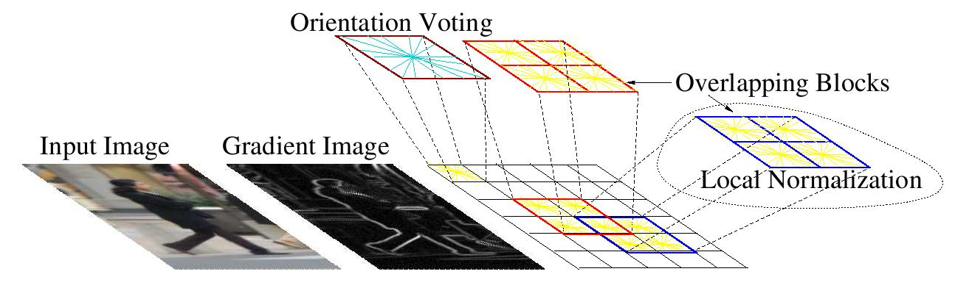
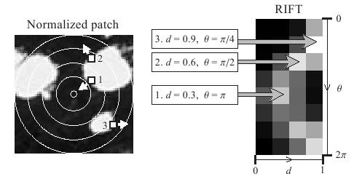
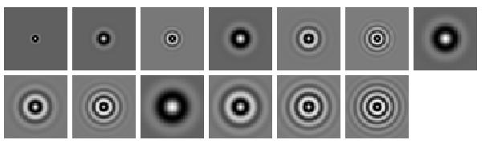
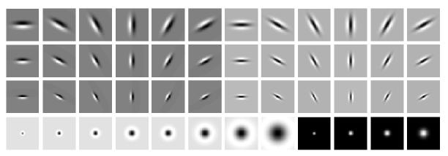
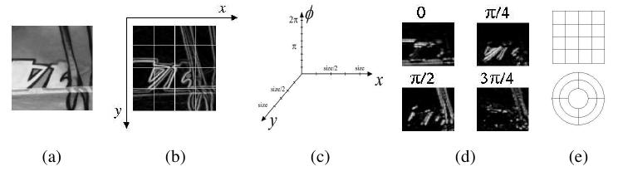
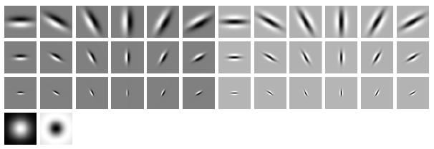
Computer vision features
SIFT
Spin image
HoG
RIFT
Textons
GLOH

Slide 14
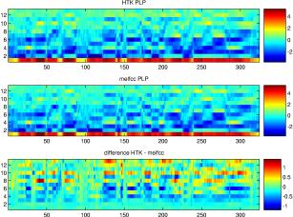
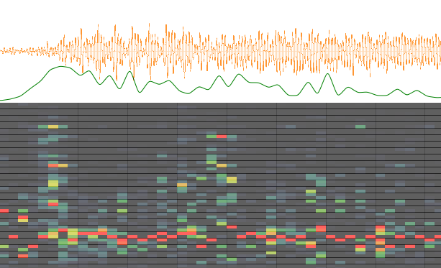
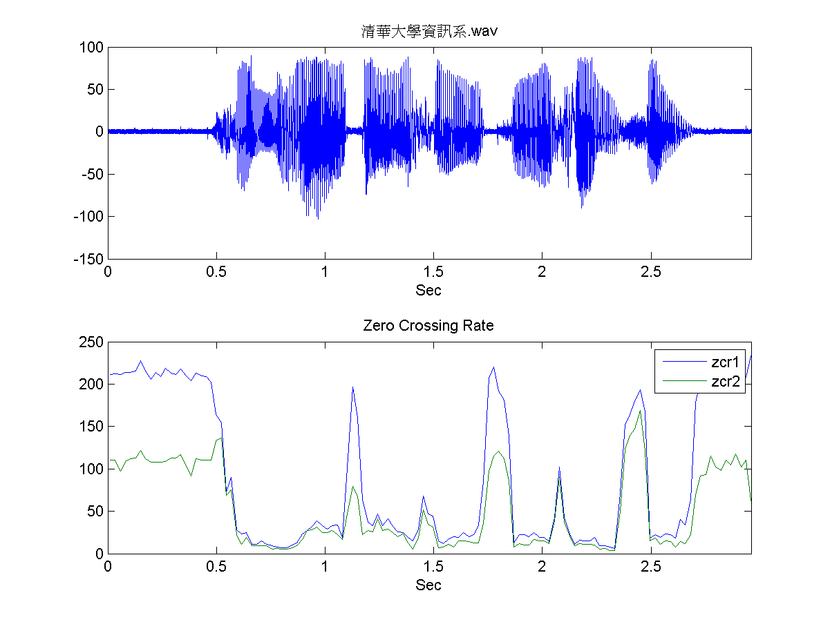
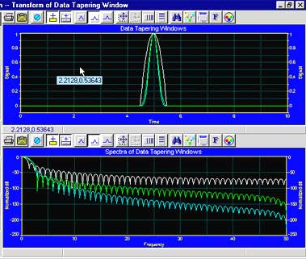
Audio features
Spectrogram
MFCC
Flux
ZCR
Rolloff

Slide 15
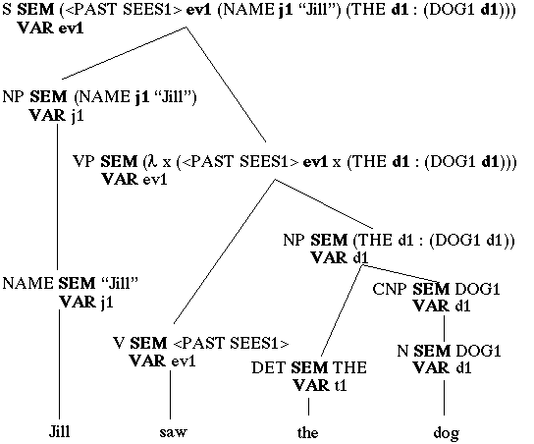
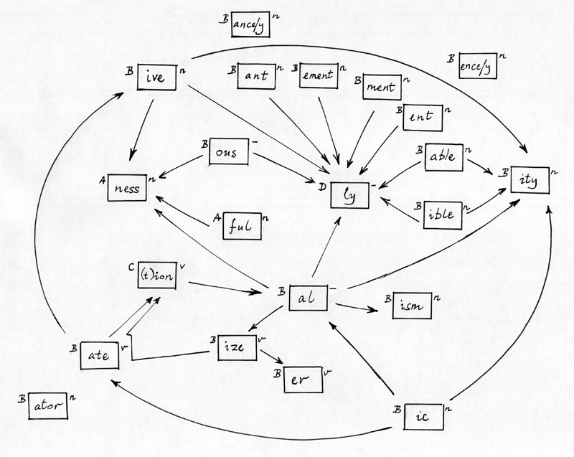
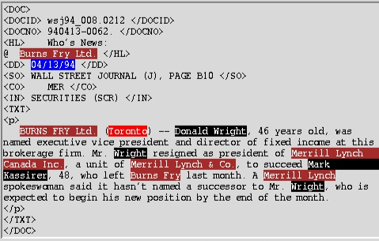
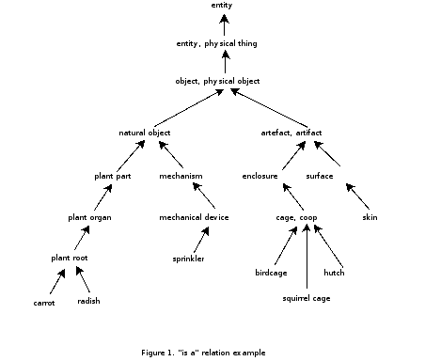
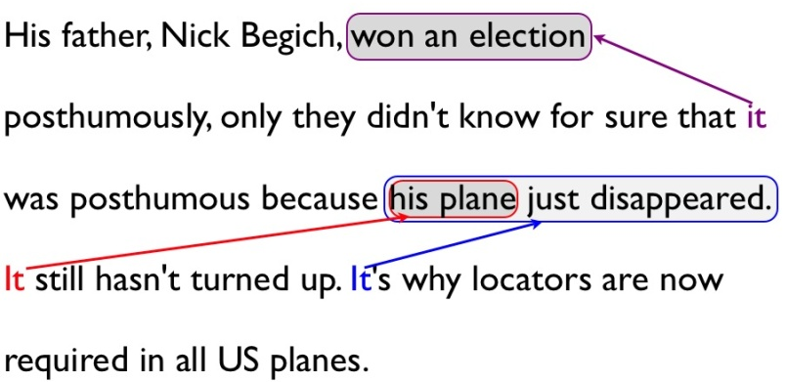
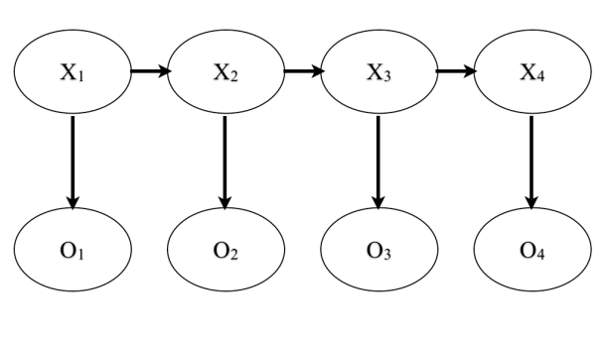
NLP features
NER/SRL
Stemming
Parser features
Anaphora
POS tagging
WordNet features

Slide 16
Feature representations
Input
Feature Representation
Learning
algorithm
Notes:
Where do we get these low-level representations from?

Slide 17
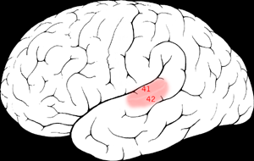
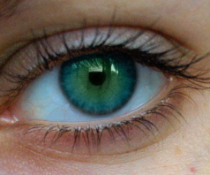
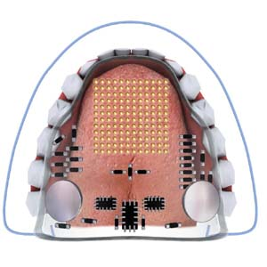

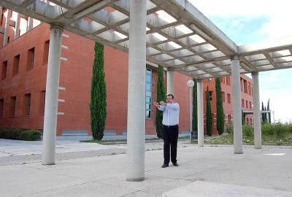
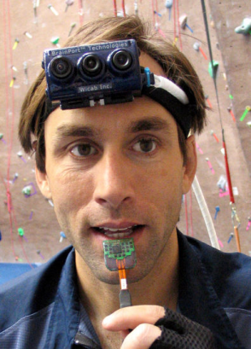
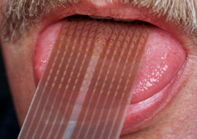
Sensor representation in the brain
Auditory cortex learns to see.
(Same rewiring process also works for touch/ somatosensory cortex.)
Auditory
Cortex
Seeing with your tongue
Human echolocation (sonar)
[Roe et al., 1992; BrainPort; Welsh & Blasch, 1997]

Slide 18
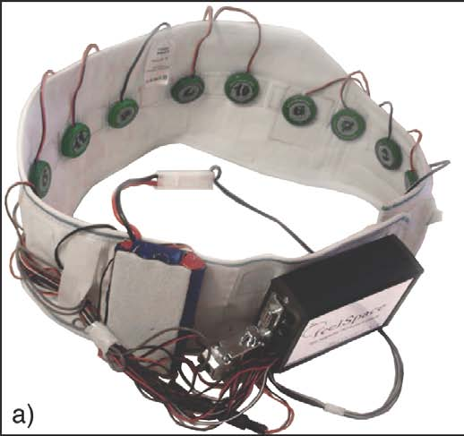
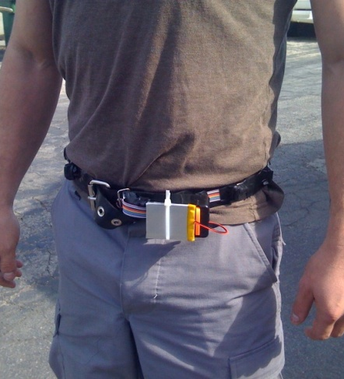
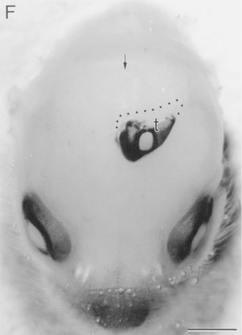
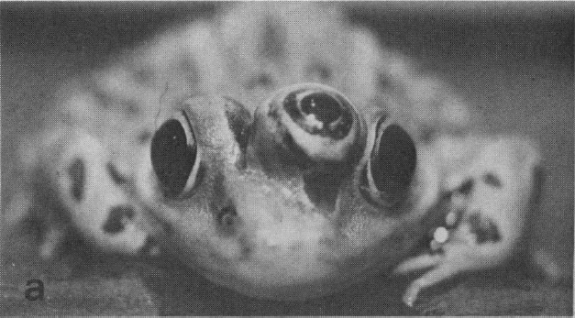
Other sensory remapping examples
Haptic compass belt. North facing motor vibrates. Gives you a “direction” sense.
Implanting a 3rd eye.
[Nagel et al., 2005 and Wired Magazine; Constantine-Paton & Law, 2009]
Dunlop et al., 2006

Slide 19
On two approaches to computer perception
The adult visual (or audio) system is incredibly complicated.
We can try to directly implement what the adult visual (or audio) system is doing. (E.g., implement features that capture different types of invariance, 2d and 3d context, relations between object parts, …).
Or, if there is a more general computational principal/algorithm that underlies most of perception, can we instead try to discover and implement that?

Slide 20
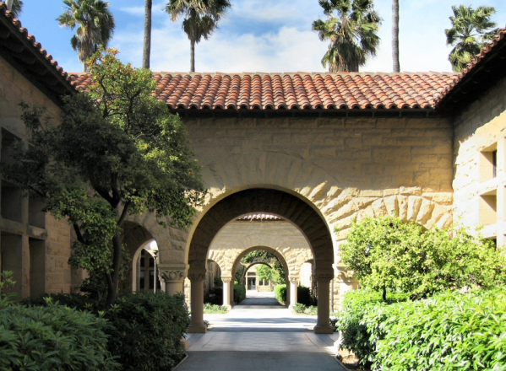
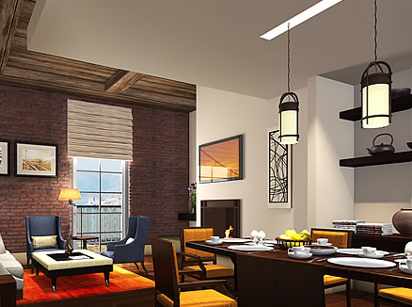
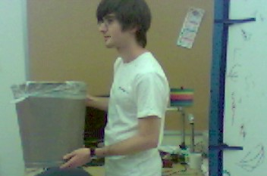
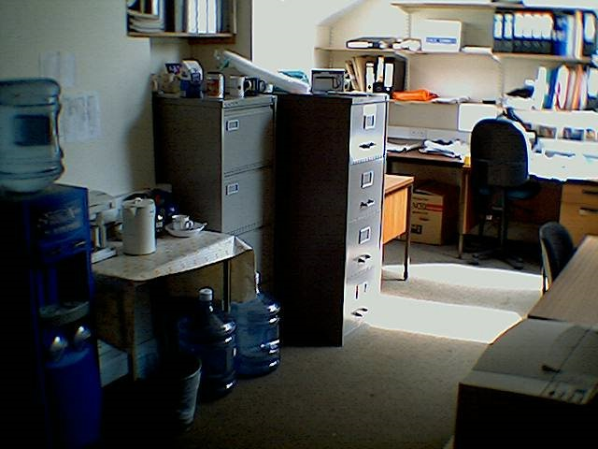
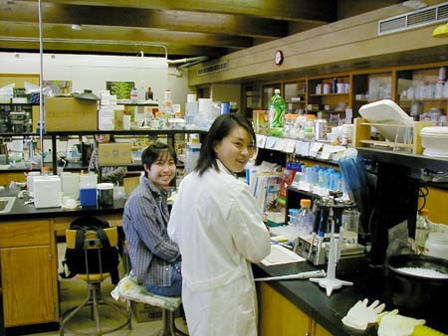
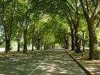
Learning input representations
Find a better way to represent images than pixels.

Slide 21
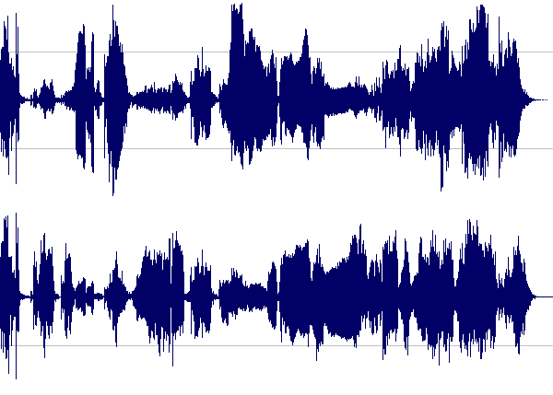
Learning input representations
Find a better way to represent audio.

Slide 22
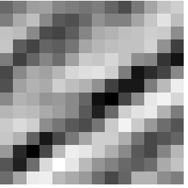
Feature learning problem
Given a 14x14 image patch x, can represent it using 196 real numbers.
Problem: Can we find a learn a better feature vector to represent this?
255
98
93
87
89
91
48
…

Slide 23
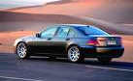












Supervised Learning: Recognizing motorcycles
Motorcycles
Labeled Motorcycles
Labeled Cars
Not motorcycles
Testing:
What is this?
[Lee, Raina and Ng, 2006; Raina, Lee, Battle, Packer & Ng, 2007]

Slide 24














Self-taught learning (Feature learning problem)
Motorcycles
Not motorcycles
Testing:
What is this?
…
Unlabeled images
[Lee, Raina and Ng, 2006; Raina, Lee, Battle, Packer & Ng, 2007]
[This uses unlabeled data. One can learn the features from labeled data too.]

Slide 25

First stage of visual processing: V1
V1 is the first stage of visual processing in the brain.
Neurons in V1 typically modeled as edge detectors:
Neuron #1 of visual cortex
(model)
Neuron #2 of visual cortex
(model)
Notes:
http://www.ldeo.columbia.edu/4d4/wavelets/dm.html

Slide 26

Learning sensor representations
Sparse coding (Olshausen & Field,1996)
Input: Images x⁽¹⁾, x⁽²⁾, …, x^{(m)} (each in R^{n x n})
Learn: Dictionary of bases φ₁, φ₂, …, φ_{k} (also R^{n x n}), so that each input x can be approximately decomposed as:
x ∑ a_{j} φ_{j}
s.t. a_{j}’s are mostly zero (“sparse”)
Use to represent 14x14 image patch succinctly, as [a₇=0.8, a₃₆=0.3, a₄₁ = 0.5]. I.e., this indicates which “basic edges” make up the image.
^{k}
^{j=1}
[NIPS 2006, 2007]

Slide 27
Feature Learning via Sparse Coding
Sparse coding (Olshausen & Field,1996). Originally developed to explain early visual processing in the brain (edge detection).
Input: Images x⁽¹⁾, x⁽²⁾, …, x^{(m)} (each in R^{n x n})
Learn: Dictionary of bases φ₁, φ₂, …, φ_{k} (also R^{n x n}), so that each input x can be approximately decomposed as:
x ∑ a_{j} φ_{j}
s.t. a_{j}’s are mostly zero (“sparse”)
^{k}
^{j=1}
[NIPS 2006, 2007]

Slide 28







Sparse coding illustration
Natural Images
Learned bases (φ_{1 , …,} φ₆₄): “Edges”
Test example
≈ 0.8 * + 0.3 * + 0.5 *
x ≈ 0.8 * φ₃₆ + 0.3 * φ₄₂ + 0.5 * φ₆₃
[a₁, …, a₆₄] = [0, 0, …, 0, 0.8, 0, …, 0, 0.3, 0, …, 0, 0.5, 0]
(feature representation)
Compact & easily
interpretable

Slide 29








More examples
Represent as: [a₁₅=0.6, a₂₈=0.8, a₃₇ = 0.4].
Represent as: [a₅=1.3, a₁₈=0.9, a₂₉ = 0.3].
0.6 * + 0.8 * + 0.4 *
φ₁₅ φ₂₈ φ₃₇
1.3 * + 0.9 * + 0.3 *
φ₅ φ₁₈ φ₂₉
Method “invents” edge detection.
Automatically learns to represent an image in terms of the edges that appear in it. Gives a more succinct, higher-level representation than the raw pixels.
Quantitatively similar to primary visual cortex (area V1) in brain.

Slide 30
Sparse coding applied to audio
Image shows 20 basis functions learned from unlabeled audio.
[Evan Smith & Mike Lewicki, 2006]

Slide 31
Sparse coding applied to audio
Image shows 20 basis functions learned from unlabeled audio.
[Evan Smith & Mike Lewicki, 2006]

Slide 32



Sparse coding applied to touch data
Collect touch data using a glove, following distribution of grasps used by animals in the wild.
Grasps used by animals
[Macfarlane & Graziano, 2009]
Example learned representations
Biological data
Learning Algorithm
[Saxe, Bhand, Mudur, Suresh & Ng, 2011]

Slide 33

Learning feature hierarchies
Higher layer
(Combinations of edges;
cf. V2)
“Sparse coding”
(edges; cf. V1)
Input image (pixels)
[Technical details: Sparse autoencoder or sparse version of Hinton’s DBN.]
[Lee, Ranganath & Ng, 2007]

Slide 34
Learning feature hierarchies
Higher layer
(Model V3?)
Higher layer
(Model V2?)
Model V1
Input image
[Technical details: Sparse autoencoder or sparse version of Hinton’s DBN.]
[Lee, Ranganath & Ng, 2007]

Slide 35


Sparse DBN: Training on face images
object models
object parts
(combination
of edges)
edges
Note: Sparsity important for these results.
pixels
[Lee, Grosse, Ranganath & Ng, 2009]

Slide 36
Sparse DBN
Features learned from different object classes.
Faces
Cars
Elephants
Chairs
[Lee, Grosse, Ranganath & Ng, 2009]

Slide 37
Training on multiple objects
Features learned by training on 4 classes (cars, faces, motorbikes, airplanes).
Third layer bases learned from 4 object categories.
Object specific features
Features shared across object classes
Second layer bases learned from 4 object categories.
Edges
[Lee, Grosse, Ranganath & Ng, 2009]

Slide 38

Training on multiple objects
Trained on 4 classes (cars, faces, motorbikes, airplanes).
Second layer: Shared-features and object-specific features.
Third layer: More specific features.
Third layer bases learned from 4 object categories.
Plot of H(class|neuron active)
Second layer bases learned from 4 object categories.

Slide 39

Hierarchical probabilistic inference
Generating posterior samples from faces by “filling in” experiments
(cf. Lee and Mumford, 2003). Combine bottom-up and top-down inference.
Input images
Samples from
feedforward
Inference (control)
Samples from
Full posterior
inference
Notes:
Aglioti et al., 1994; Halligan et al., 1993; Weinstein, 1969; Ramachandran, 1998; Halligan et al., 1993; Sadato et al., 1996; Halligan et al., 1999

Slide 40
Machine learning applications

Slide 41



Traditional machine learning
Cars
Motorcycles
Testing:
What is this?

Slide 42
Unsupervised feature learning (Self-taught learning)
Unlabeled data
Testing:
What is this?
Car
Motorcycle
[Lee, Raina and Ng, 2007; Raina, Lee, Battle, Packer & Ng, 2008]

Slide 43


Unsupervised feature learning (Self taught learning)
Natural scenes
Testing:
What is this?
Segway
[NIPS 2006, ICML 2007]

Slide 44



Unsupervised feature learning (Self-taught learning)
Unlabeled data
Image
Learned bases φ_{i}
Learned representation [a₁, ... , a₆₄]
Off-the-shelf classifier (SVM)
In NLP:
Distributional representations and vector space model ideas. (Brown et al., 1992; Pereira, Tishby & Lee, 1993; Salton et al., 1975; Pantel & Lin, 2002; Rapp, 2003; Turney et al., 2003).
Latent Semantic Analysis (Deerwester et al.,1990)
Structural Learning (Ando & Zhang, 2005)
….

Slide 45

Activity recognition (Hollywood 2 benchmark)
Method | Accuracy
Hessian + ESURF [Williems et al 2008] | 38%
Harris3D + HOG/HOF [Laptev et al 2003, 2004] | 45%
Cuboids + HOG/HOF [Dollar et al 2005, Laptev 2004] | 46%
Hessian + HOG/HOF [Laptev 2004, Williems et al 2008] | 46%
Dense + HOG / HOF [Laptev 2004] | 47%
Cuboids + HOG3D [Klaser 2008, Dollar et al 2005] | 46%
Unsupervised feature learning (our method) | 52%
Unsupervised feature learning significantly improves on the previous state-of-the-art.
[Le, Zhou & Ng, 2011]

Slide 46



Self-taught learning: Example applications
Handwritten character classification
Speaker identification
Digits
Alphabets
Spectrogram | 38.5%
MFCCs | 43.8%
Sparse coding | 48.7%
Raw | 54.8%
PCA | 54.8%
Sparse coding | 58.5%
8.7% error reduction
8.2% error reduction
Music genre classification
Text classification
Newswire
Webpages
Spectrogram | 48.4%
MFCCs | 54.0%
Music-specific model | 49.3%
Sparse coding | 56.6%
# examples | 4 | 10 | 20
Raw words | 70.4% | 75.7% | 81.6%
LDA | 66.8% | 75.3% | 82.4%
Exp. Fam. Sparse coding | 75.0% | 81.4% | 85.1%
5.7% error reduction
15-23% error reduction
[Lee, Battle, Raina, & Ng, 2006; Raina, Battle, Lee, Packer & Ng, 2007, Grosse, Raina, Kwong & Ng, 2007]

Slide 47

CDBN for audio
Max pooling unit
Detection units
Spectrogram
[ICML 2009, NIPS 2009]

Slide 48

Sparse coding on audio
Spectrogram
≈ 0.9 * + 0.7 * + 0.2 *
x φ₃₆ φ₄₂ φ₆₃
[Lee, Pham and Ng, 2009]

Slide 49
Probabilistic max pooling
Convolutional DBN:
Convolutional Neural net:
max {x₁, x₂, x₃, x₄}
max {x₁, x₂, x₃, x₄}
X₁
X₂
X₃
X₄
Where x_{i} are {0,1}, and mutually exclusive. Thus, 5 possible cases:
X₁
X₂
X₃
X₄
Where x_{i} are real numbers.
Collapse 2^{n} configurations into n+1 configurations. Permits bottom up and top down inference.

Slide 50
Dictionary of bases φ_{i} learned for speech
Many bases seem to correspond to phonemes.
[Lee, Pham and Ng, 2009]
Notes:
Visual bases: Look at them and see if make sense/correspond to Gabors. Try to perform similar analysis on audio bases.

Slide 51








Many bases seem to be detecting phonemes
“oy”
“el”
“s”
Phoneme
First layer bases
[Lee, Pham and Ng, 2009]
Notes:
We select the bases that have the highest average activation for each phoneme.
Visual inspection shows bases capture patterns relevant to the phoneme.

Slide 52






Comparison of bases to gender (“ae” phoneme)
Phonemes
First layer bases
Second layer bases
Female
Male
[Lee, Pham and Ng, 2009]
Notes:
Female speech is characterized by clear horizontal banding patterns whereas male speech is characterized by intensity spread across lower frequencies.
Both first and second CRBM layers found these patterns even though they were trained in an unsupervised manner.

Slide 53
Sparse DBN for audio
Spectrogram
[Lee, Pham and Ng, 2009]
Notes:
Time-invariant features

Slide 54
Sparse DBN for audio
Spectrogram
[Lee, Pham and Ng, 2009]
Notes:
Time-invariant features

Slide 55
Sparse DBN for audio
Spectrogram
[Lee, Pham and Ng, 2009]

Slide 56

Convolutional DBN for audio
Max pooling
Second CDBN
layer
Detection units
Max pooling
One CDBN
layer
Detection units
[ICML 2009, NIPS 2009]

Slide 57
Sparse DBN for audio
[Lee, Pham and Ng, 2009]

Slide 58
Application to speech recognition tasks
Speaker identification
Phone classification
Gender classification
Music classification
Use same set of learned features for all three tasks.
Notes:
Basic idea: compute CDBN activations and use them as features for supervised learning algorithms. We used the same CDBN for all three tasks.

Slide 59
Phoneme Classification (TIMIT benchmark)
Method | Accuracy
Clarkson and Moreno (1999) | 77.6%
Gunawardana et al. (2005) | 78.3%
Sung et al. (2007) | 78.5%
Petrov et al. (2007) | 78.6%
Sha and Saul (2006) | 78.9%
Yu et al. (2006) | 79.2%
Unsupervised feature learning (our method) | 80.3%
Clarkson and Moreno (1999): 77.6%
Gunawardana et al. (2005): 78.3%
Sung et al. (2007): 78.5%
Petrov et al. (2007): 78.6%
Sha and Saul (2006): 78.9%
Yu et al. (2009): 79.2%
Unsupervised feature learning significantly improves on the previous state-of-the-art.
[Lee, Pham and Ng, 2009]

Slide 60



Audio problems
Gender classification:
Music genre classification:
Music artist classification:
Outperforms MFCC baselines. Having a deeper network generally does better.

Slide 61

Speaker Identification
Test set accuracy:
[16] D. A. Reynolds. Speech Commun,1995.
The CDBN features outperform the MFCC features, especially when the number of training examples is small.

Slide 62
Technical challenge: Scaling up

Slide 63

Scaling and classification accuracy (CIFAR-10)
Large numbers of features is critical. Algorithms that can scale to many features have a big advantage.
[Coates, Lee and Ng, 2010]

Slide 64

Approaches to scaling up
Efficient sparse coding algorithms. (Lee et al., NIPS 2006)
Parallel implementations via Map-Reduce (Chu et al., NIPS 2006)
GPUs for deep learning. (Raina et al., ICML 2008)
Tiled Convolutional Networks (Le et al., NIPS 2010)
  The scaling advantage of convolutional networks, but without hard-coding translation invariance.
Efficient optimization algorithms (Le et al., ICML 2011)
Simple, fast feature decoders (Coates et al., AISTATS 2011)
[Raina, Madhavan and Ng, 2008]

Slide 65
Scaling up using GPU hardware
Use GPU (Graphics Processor Unit) hardware.
You already have this in your desktop, and it runs 10-100x faster than your CPU.
[Raina, Madhavan and Ng, 2008]

Slide 66
Tiled Convolutional Networks
We want to learn invariant features.
Convolutional networks uses weight tying to:
  1. Reduce number of weights that need to be learned. → Allows scaling to larger images/models.
  2. Hard code translation invariance. Makes it harder to learn more complex types of invariances.
Goal: Preserve computational scaling advantage of convolutional nets, but learn more complex invariances.

Slide 67

Fully Connected Network (Topographical ICA)
Pooling Units
(Sqrt)
Simple Units
(Square)
Input
Doesn’t scale to large images.

Slide 68
Fully Connected Network (Topographical ICA)
Pooling Units
(Sqrt)
Simple Units
(Square)
Input
Doesn’t scale to large images.

Slide 69
Local Receptive Fields
Pooling Units
(Sqrt)
Simple Units
(Square)
Input

Slide 70
Convolution Neural Networks (Weight Tying)
Pooling Units
(Sqrt)
Simple Units
(Square)
Input

Slide 71
Tiled Networks (Partial Weight Tying)
Pooling Units
(Sqrt)
Tile Size (k) = 2
Simple Units
(Square)
Input
Local pooling can capture complex invariances (not just translation); but total number of parameters is small.

Slide 72
Tiled Networks (Partial Weight Tying)
Pooling Units
(Sqrt)
Tile Size (k) = 2
Simple Units
(Square)
Input

Slide 73
Tiled Networks (Partial Weight Tying)
Pooling Units
(Sqrt)
Tile Size (k) = 2
Number of Maps (l)
= 3
Simple Units
(Square)
Input

Slide 74
Tiled Networks (Partial Weight Tying)
Pooling Units
(Sqrt)
Tile Size (k) = 2
Number of Maps (l)
= 3
Simple Units
(Square)
Local
Orthogonalization
Input

Slide 75
State-of-the-art Unsupervised feature learning

Slide 76
Audio
TIMIT Phone classification | Accuracy
Prior art (Clarkson et al.,1999) | 79.6%
Stanford Feature learning | 80.3%
TIMIT Speaker identification | Accuracy
Prior art (Reynolds, 1995) | 99.7%
Stanford Feature learning | 100.0%
Images
CIFAR Object classification | Accuracy
Prior art (Krizhevsky, 2010) | 78.9%
Stanford Feature learning | 81.5%
NORB Object classification | Accuracy
Prior art (Ranzato et al., 2009) | 94.4%
Stanford Feature learning | 97.3%
Galaxy
Video
Hollywood2 Classification | Accuracy
Prior art (Laptev et al., 2004) | 48%
Stanford Feature learning | 53%
YouTube | Accuracy
Prior art (Liu et al., 2009) | 71.2%
Stanford Feature learning | 75.8%
KTH | Accuracy
Prior art (Wang et al., 2010) | 92.1%
Stanford Feature learning | 93.9%
UCF | Accuracy
Prior art (Wang et al., 2010) | 85.6%
Stanford Feature learning | 86.5%
Multimodal (audio/video)
AVLetters Lip reading | Accuracy
Prior art (Zhao et al., 2009) | 58.9%
Stanford Feature learning | 65.8%
Other unsupervised feature learning records:
Pedestrian detection (Yann LeCun)
Different phone recognition task (Geoff Hinton) PASCAL VOC object classification (Kai Yu)
Notes:
Other SOTA performance records held by Kai Yu, Geoff Hinton.

Slide 77


Kai Yu’s PASCAL VOC (Object recognition) result (2009)
Class
Feature
Learning
Best of
Other Teams
Difference
Sparse coding to learn features.
Unsupervised feature learning beat all the other approaches by a significant margin.
[Courtesy of Kai Yu]

Slide 78
Learning Recursive Representations

Slide 79
Feature representations of words
Imagine taking each word, and embedding it in an n-dimensional space. (cf. distributional representations, or Bengio et al., 2003; Collobert & Weston, 2008).
2-d embedding example below, but in practice use ~100-d embeddings.
5
4
3
2
1
On
8
5
0
0
0
0
1
0
0
0
0
1
0
0
0
0
0
0
2
4
Monday
x₂
Tuesday
2.1
3.3
Britain
9
2
France
9.5
1.5
Monday Britain
0 1 2 3 4 5 6 7 8 9 10
x₁
On Monday, Britain ….
Representation:
8
5
2
4
9
2
E.g., LSA (Landauer & Dumais, 1997); Distributional clustering (Brown et al., 1992; Pereira et al., 1993);

Slide 80
“Generic” hierarchy on text doesn’t make sense
Node has to represent sentence fragment “cat sat on.” Doesn’t make sense.
9
1
5
3
7
1
8
5
9
1
4
3
The cat sat
The cat on the mat.
Feature representation for words

Slide 81
What we want (illustration)
S
This node’s job is to represent
“on the mat.”
VP
PP
NP
NP
9
1
5
3
7
1
8
5
9
1
4
3
The cat sat
The cat on the mat.

Slide 82
What we want (illustration)
5
4
S
This node’s job is to represent
“on the mat.”
7
3
VP
8
3
PP
5
2
NP
3
3
NP
9
1
5
3
7
1
8
5
9
1
4
3
The cat sat
The cat on the mat.

Slide 83
What we want (illustration)
5
4
3
2
1
The day after my birthday
x₂
Monday
Tuesday
The country of my birth
Britain
France
0 1 2 3 4 5 6 7 8 9 10
x₁
3
5
9
3
8
3
9
2
5
2
3
3
2
8
3
2
g
9
2
3
2
g
9
9
3
2
8
5
2
4
9
2
8
5
9
2
2
2
The day after my birthday, …
The country of my birth…

Slide 84
Learning recursive representations
5
4
S
This node’s job is to represent
“on the mat.”
7
3
VP
8
3
PP
5
2
NP
3
3
NP
9
1
5
3
7
1
8
5
9
1
4
3
The cat sat
The cat on the mat.

Slide 85
Learning recursive representations
This node’s job is to represent
“on the mat.”
8
3
3
3
8
5
9
1
4
3
The cat on the mat.

Slide 86
Learning recursive representations
This node’s job is to represent
“on the mat.”
8
3
3
3
8
5
9
1
4
3
The cat on the mat.

Slide 87
Learning recursive representations
This node’s job is to represent
“on the mat.”
Basic computational unit: Recursive Neural Network that inputs two children nodes’ feature representations, and outputs the representation of the parent node.
8
3
8
3
3
3
Neural
Network
8
5
9
1
4
3
The cat on the mat.
8
5
3
3

Slide 88
Parsing a sentence
5
2
0
1
0
1
0
0
3
3
Yes
No
No
No
Yes
Neural
Network
Neural
Network
Neural
Network
Neural
Network
Neural
Network
9
1
5
3
7
1
8
5
9
1
4
3
The cat sat
The cat on the mat.
[Socher, Manning & Ng]

Slide 89
Parsing a sentence
0
1
0
1
8
3
No
No
Yes
Neural
Network
Neural
Network
Neural
Network
5
2
3
3
9
1
5
3
7
1
8
5
9
1
4
3
The cat sat
The cat on the mat.
[Socher, Manning & Ng]

Slide 90
Parsing a sentence
0
1
8
3
No
Yes
Neural
Network
Neural
Network
5
2
3
3
9
1
5
3
8
5
9
1
4
3
The cat on the mat.
[Socher, Manning & Ng]

Slide 91
Parsing a sentence
5
4
7
3
8
3
5
2
3
3
9
1
5
3
7
1
8
5
9
1
4
3
The cat sat
The cat on the mat.
[Socher, Manning & Ng]

Slide 92
Finding Similar Sentences
Each sentence has a feature vector representation.
Pick a sentence (“center sentence”) and list nearest neighbor sentences.
Often either semantically or syntactically similar. (Digits all mapped to 2.)
Similarities | Center Sentence | Nearest Neighbor Sentences (most similar feature vector)
Bad News | Both took further hits yesterday | We 're in for a lot of turbulence ... BSN currently has 2.2 million common shares outstanding This is panic buying We have a couple or three tough weeks coming
Something said | I had calls all night long from the States, he said | Our intent is to promote the best alternative, he says We have sufficient cash flow to handle that, he said Currently, average pay for machinists is 22.22 an hour, Boeing said Profit from trading for its own account dropped, the securities firm said
Gains and good news | Fujisawa gained 22 to 2,222 | Mochida advanced 22 to 2,222 Commerzbank gained 2 to 222.2 Paris loved her at first sight Profits improved across Hess's businesses
Unknown words which are cities | Columbia , S.C | Greenville , Miss UNK , Md UNK , Miss UNK , Calif

Slide 93
Finding Similar Sentences
Similarities | Center Sentence | Nearest Neighbor Sentences (most similar feature vector)
Declining to comment = not disclosing | Hess declined to comment | PaineWebber declined to comment Phoenix declined to comment Campeau declined to comment Coastal wouldn't disclose the terms
Large changes in sales or revenue | Sales grew almost 2 % to 222.2 million from 222.2 million | Sales surged 22 % to 222.22 billion yen from 222.22 billion Revenue fell 2 % to 2.22 billion from 2.22 billion Sales rose more than 2 % to 22.2 million from 22.2 million Volume was 222.2 million shares , more than triple recent levels
Negation of different types | There's nothing unusual about business groups pushing for more government spending | We don't think at this point anything needs to be said It therefore makes no sense for each market to adopt different circuit breakers You can't say the same with black and white I don't think anyone left the place UNK UNK
People in bad situations | We were lucky | It was chaotic We were wrong People had died They still are

Slide 94
Experiments
No linguistic features. Train only using the structure and words of WSJ training trees, and word embeddings from (Collobert & Weston, 2008).
Parser evaluation dataset: Wall Street Journal (standard splits for training and development testing).
Method | Unlabeled F1
Greedy Recursive Neural Network (RNN) | 76.55
Greedy, context-sensitive RNN | 83.36
Greedy, context-sensitive RNN + category classifier | 87.05
Left Corner PCFG, (Manning and Carpenter, '97) | 90.64
CKY, context-sensitive, RNN + category classifier (our work) | 92.06
Current Stanford Parser, (Klein and Manning, '03) | 93.98

Slide 95

Parsing sentences and parsing images
A small crowd quietly enters the historic church.
Each node in the hierarchy has a “feature vector” representation.

Slide 96

Nearest neighbor examples for image patches
Each node (e.g., set of merged superpixels) in the hierarchy has a feature vector.
Select a node (“center patch”) and list nearest neighbor nodes.
I.e., what image patches/superpixels get mapped to similar features?
Selected patch
Nearest Neighbors

Slide 97





Multi-class segmentation (Stanford background dataset)
Method | Accuracy
Pixel CRF (Gould et al., ICCV 2009) | 74.3
Classifier on superpixel features | 75.9
Region-based energy (Gould et al., ICCV 2009) | 76.4
Local labelling (Tighe & Lazebnik, ECCV 2010) | 76.9
Superpixel MRF (Tighe & Lazebnik, ECCV 2010) | 77.5
Simultaneous MRF (Tighe & Lazebnik, ECCV 2010) | 77.5
Feature learning (our method) | 78.1
Clarkson and Moreno (1999): 77.6%
Gunawardana et al. (2005): 78.3%
Sung et al. (2007): 78.5%
Petrov et al. (2007): 78.6%
Sha and Saul (2006): 78.9%
Yu et al. (2009): 79.2%

Slide 98








Multi-class Segmentation MSRC dataset: 21 Classes
Methods | Accuracy
TextonBoost (Shotton et al., ECCV 2006) | 72.2
Framework over mean-shift patches (Yang et al., CVPR 2007) | 75.1
Pixel CRF (Gould et al., ICCV 2009) | 75.3
Region-based energy (Gould et al., IJCV 2008) | 76.5
Feature learning (out method) | 76.7
Notes:
Unpublished !!!!!!!!!!!!!!!!!!!!

Slide 99
Weaknesses & Criticisms

Slide 100
Weaknesses & Criticisms
You’re learning everything. It’s better to encode prior knowledge about structure of images (or audio, or text).
A: Wasn’t there a similar machine learning vs. linguists debate in NLP ~20 years ago….
Unsupervised feature learning cannot currently do X, where X is:
  Go beyond Gabor (1 layer) features.
  Work on temporal data (video).
  Learn hierarchical representations (compositional semantics).
  Get state-of-the-art in activity recognition.
  Get state-of-the-art on image classification.
  Get state-of-the-art on object detection.
  Learn variable-size representations.
  A: Many of these were true, but not anymore (were not fundamental weaknesses). There’s still work to be done though!
We don’t understand the learned features.
A: True. Though many vision features are also not really human-understandable (e.g, concatenations/combinations of different features).
Notes:
Q1: Encode translation, rotational invariance.
Q2: Kai Yu’s result.

Slide 101
Conclusion

Slide 102












Unsupervised feature learning summary
Unsupervised feature learning.
Lets learn rather than manually design our features.
Discover the fundamental computational principles that underlie perception?
Sparse coding and deep versions very successful on vision and audio tasks. Other variants for learning recursive representations.
Online tutorial for applying algorithms:
http://ufldl.stanford.edu/wiki, or email me.
Thanks to:
Car
Motorcycle
Natural scenes
Adam Coates Quoc Le Honglak Lee Andrew Maas Chris Manning Jiquan Ngiam Andrew Saxe Richard Socher

