Slide 1


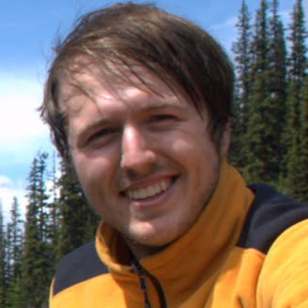
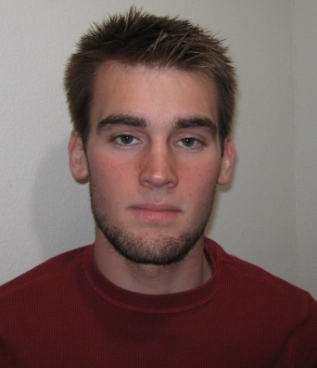



Unsupervised Feature Learning
and Deep Learning
Andrew Ng
Thanks to:
Quoc Le Honglak Lee Andrew Saxe Andrew Maas Chris Manning Jiquan Ngiam Richard Socher

Slide 2
Introduction

Slide 3
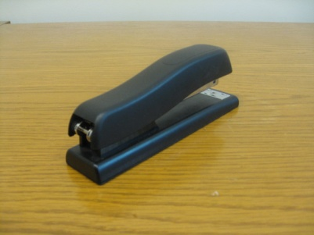
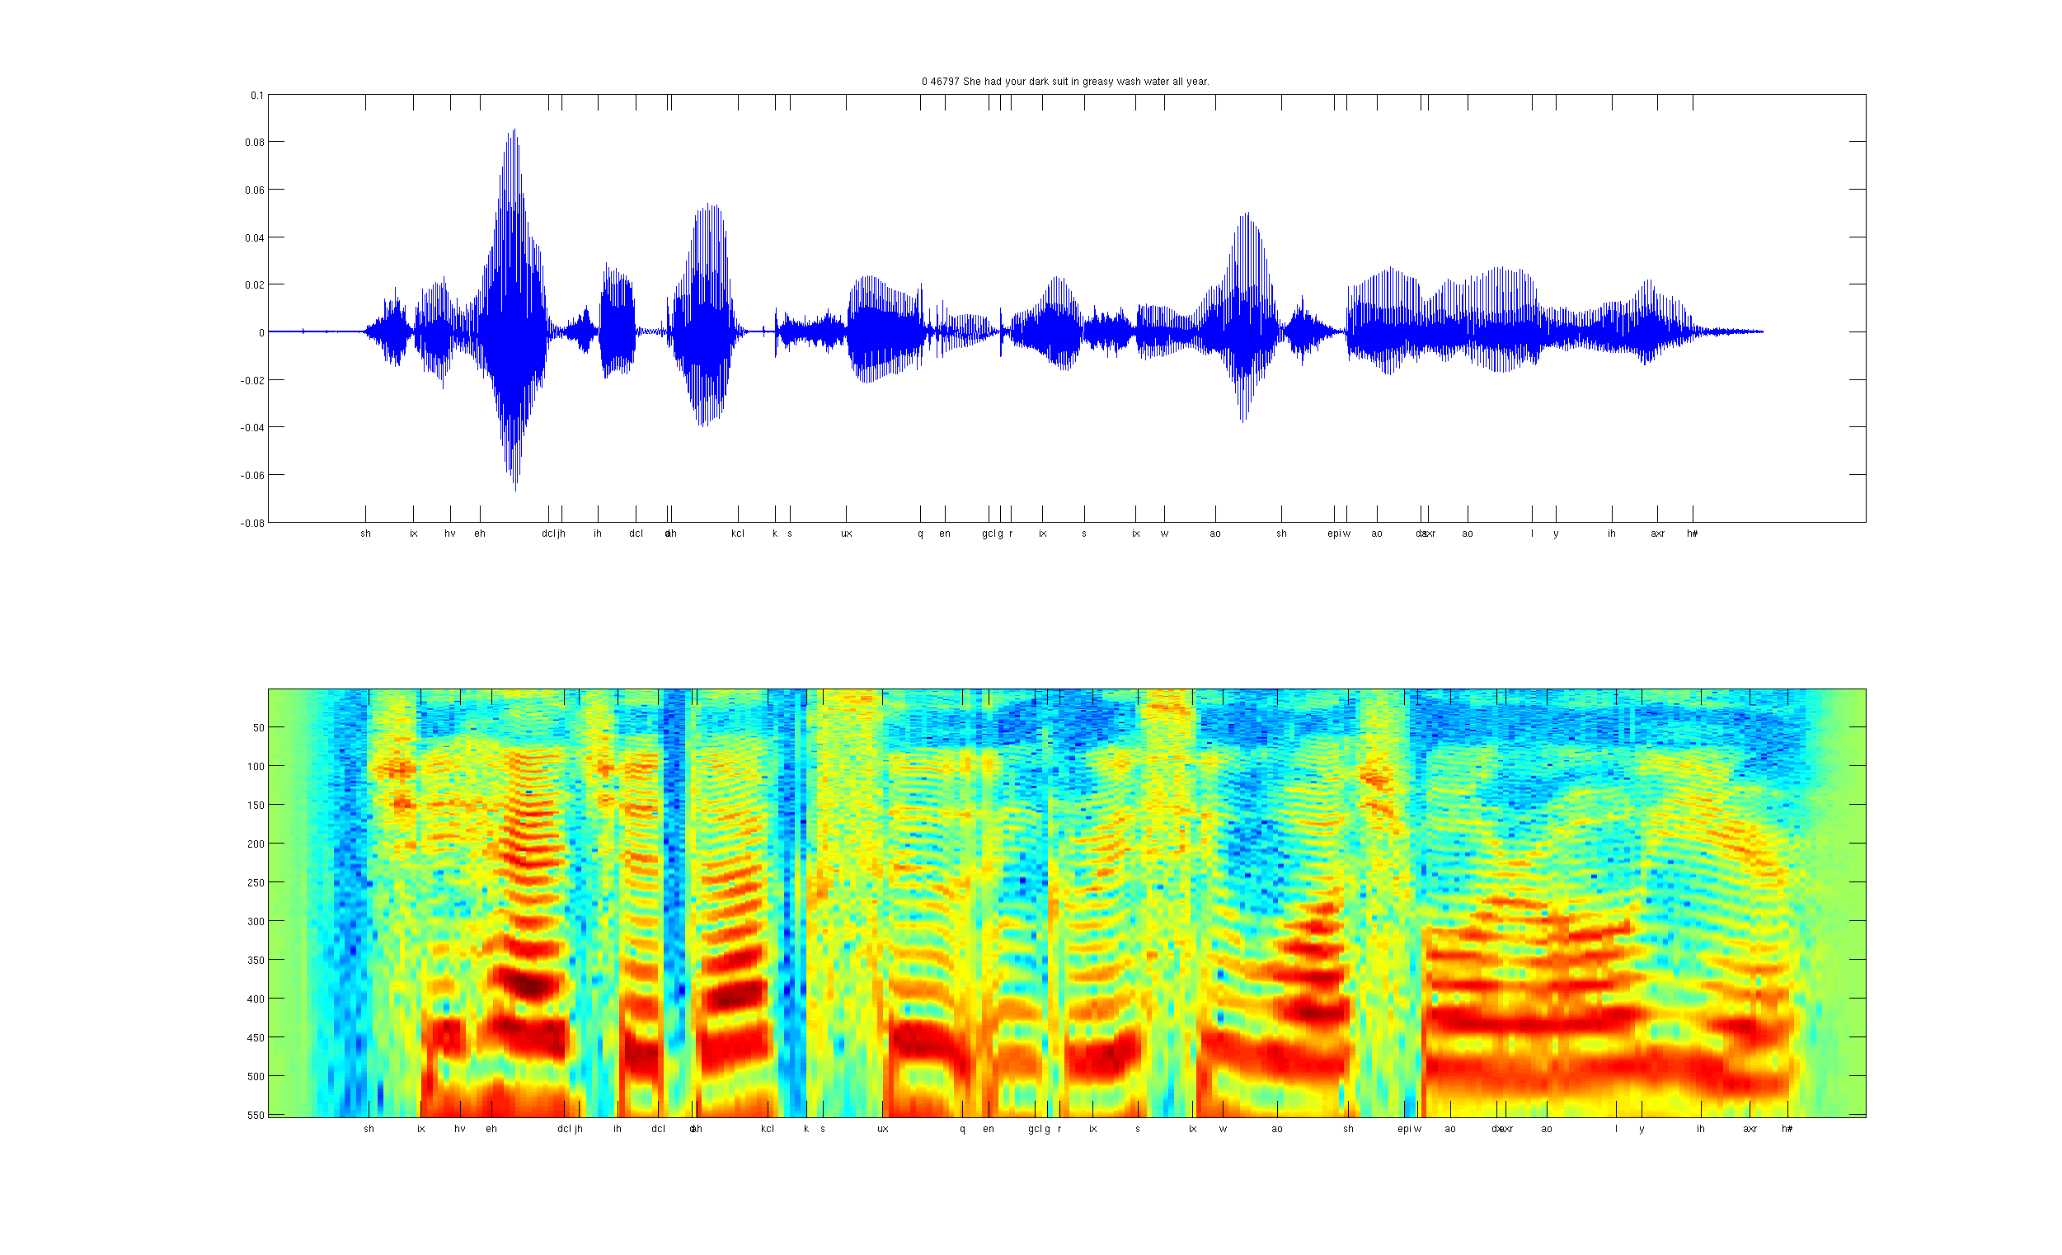
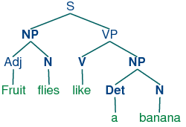
Develop ideas using…
Computer vision
Audio
Text

Slide 4
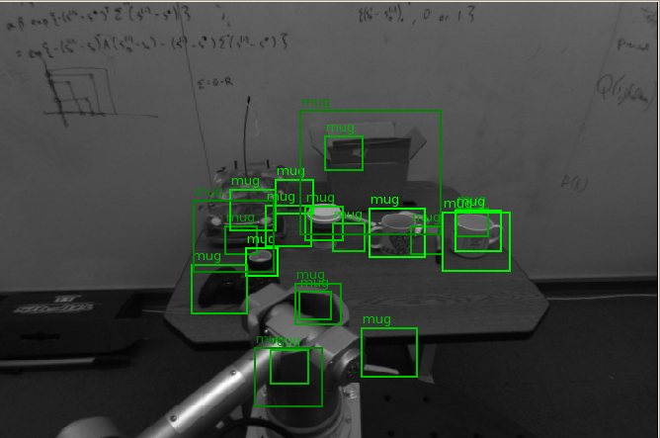
Computer vision is hard!
Notes:
Good faith effort to implement state-of-the-art.
Cluttered scenes.

Slide 5

Machine learning and feature representations
pixel 1
Learning
algorithm
pixel 2
Input
Motorbikes
Input space
“Non”-Motorbikes
pixel 2
pixel 1

Slide 6
Machine learning and feature representations
Learning
algorithm
Input

Slide 7
Machine learning and feature representations
handle
Feature representation
Learning
algorithm
wheel
Input
Feature space
Motorbikes
“Non”-Motorbikes
“handle”
“wheel”

Slide 8
Machine learning and feature representations
Learning
algorithm
Input
Motorbikes
Input space
“Non”-Motorbikes
pixel 2
pixel 1

Slide 9
Machine learning and feature representations
handle
Feature representation
Learning
algorithm
wheel
Input
Motorbikes
Input space
Feature space
“Non”-Motorbikes
“handle”
pixel 2
pixel 1
“wheel”

Slide 10
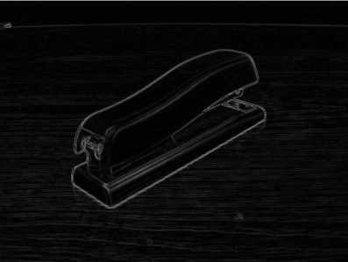




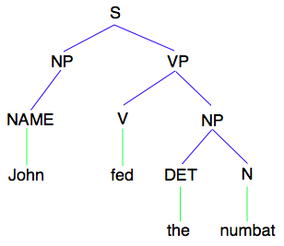
How is computer perception done?
Object detection
Image
Vision features
Recognition
Audio classification
Image
Low-level features
Grasp point
Audio
Audio features
Speaker ID
Text classification, MT, IR, etc.
NLP
Text
Text features

Slide 11
Learning representations
Input
Low-level features
Learning
algorithm
Notes:
Where do we get these low-level representations from?

Slide 12
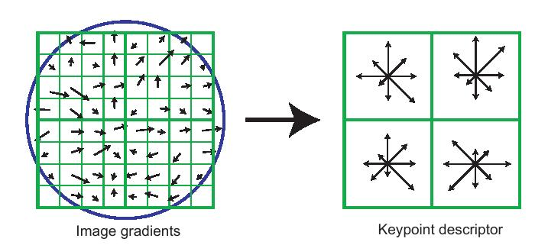
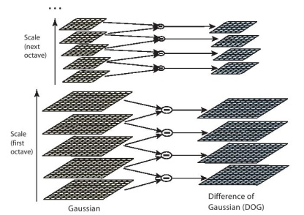
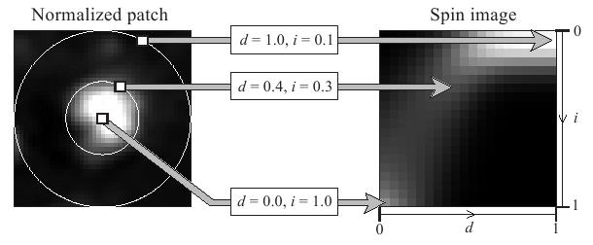
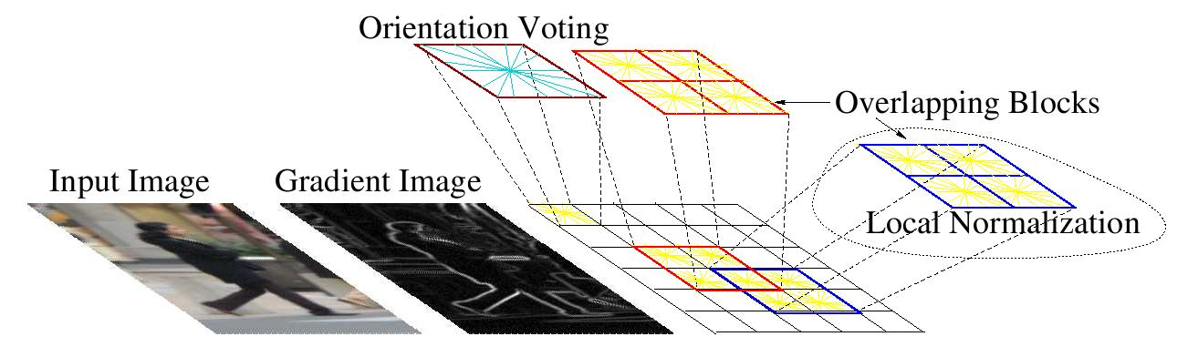
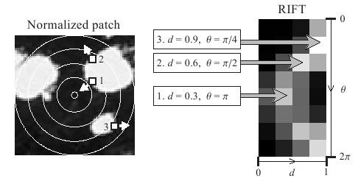
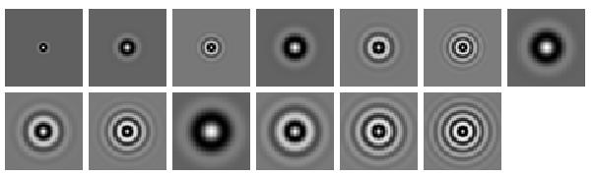
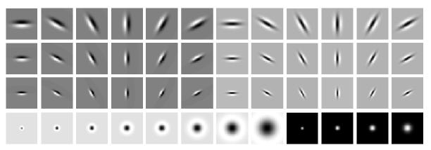
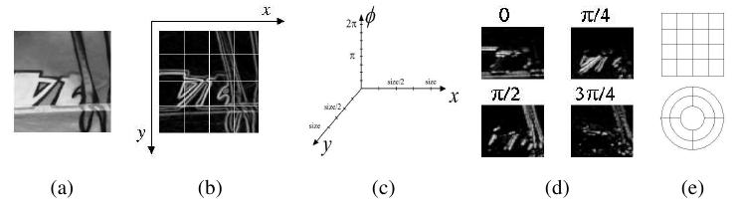
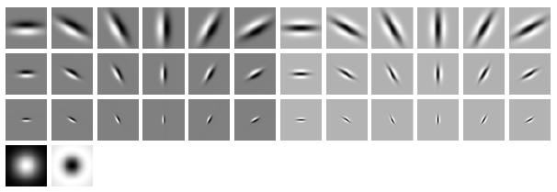
Computer vision features
SIFT
Spin image
HoG
RIFT
Textons
GLOH

Slide 13
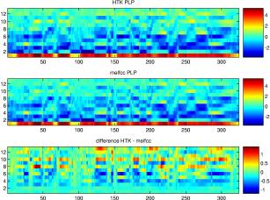
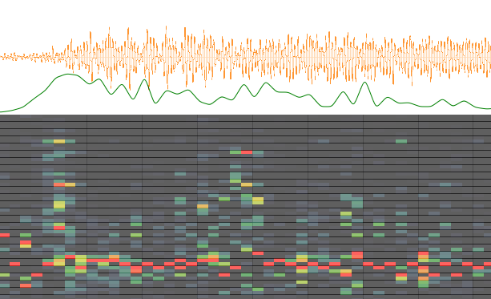
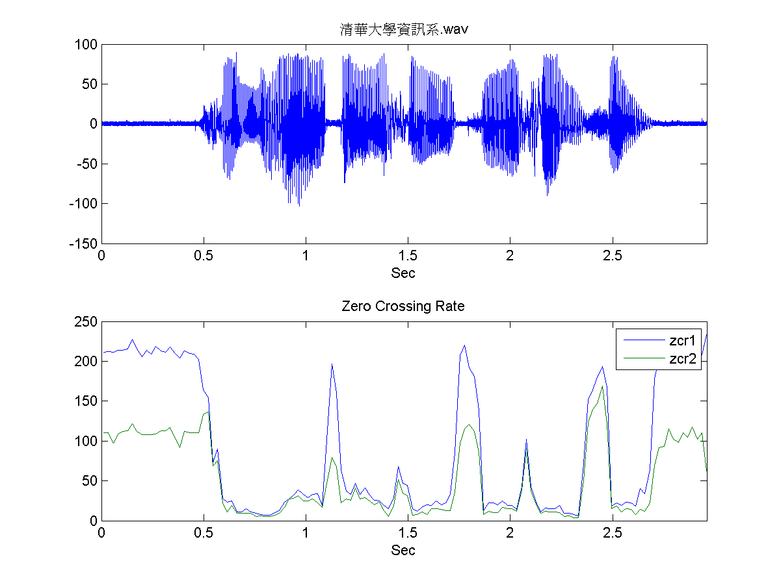
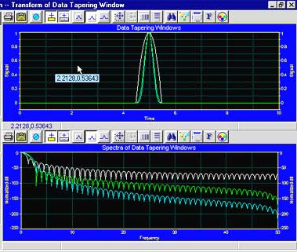
Audio features
Spectrogram
MFCC
Flux
ZCR
Rolloff

Slide 14
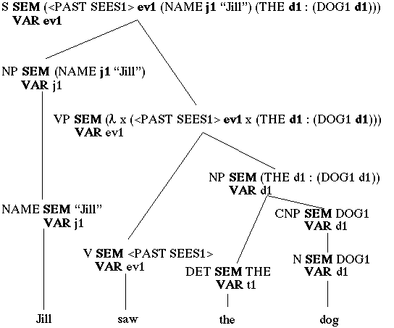
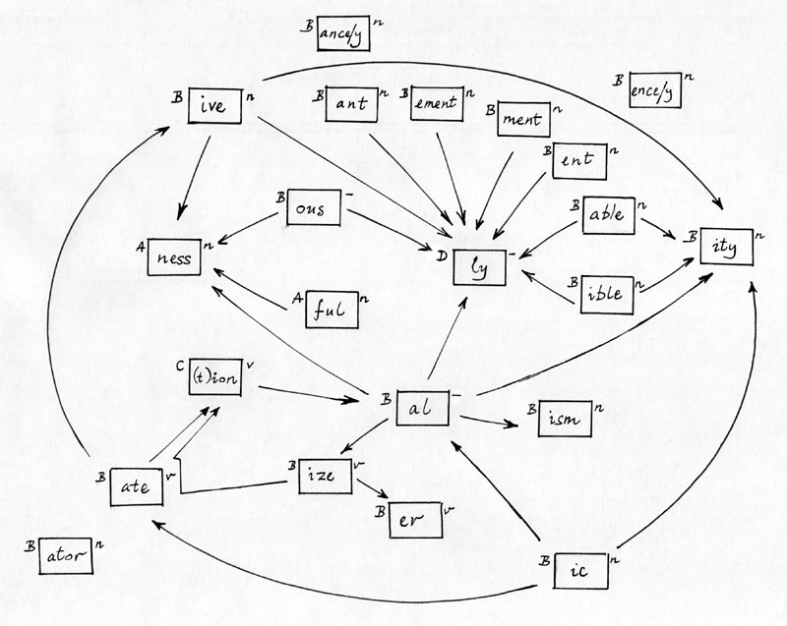
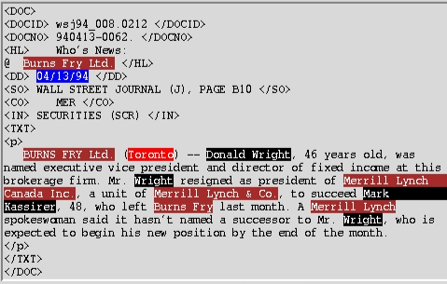
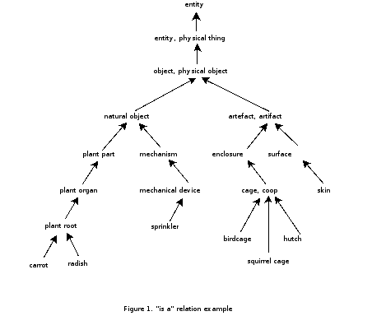
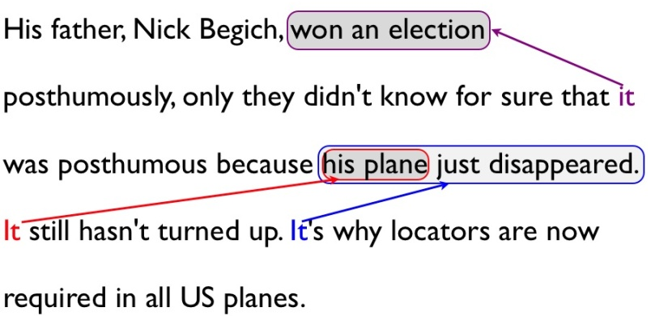
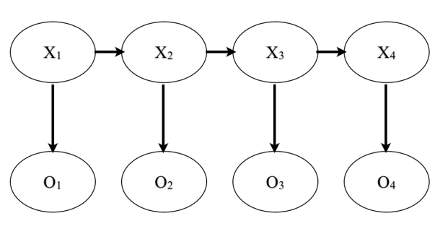
NLP features
NER/SRL
Stemming
Parser features
Anaphora
POS tagging
WordNet features

Slide 15
Learning representations
Input
Low-level features
Learning
algorithm
Notes:
Where do we get these low-level representations from?

Slide 16
This talk
Develop unsupervised feature learning ideas using images and audio.
Then talk about adaptation of ideas to text.
NLP has been doing unsupervised feature learning for a long time. But new learning algorithms may give a more systematic way to go about it.

Slide 17
Learning representations
Input
Low-level features
Learning
algorithm
Notes:
Where do we get these low-level representations from?

Slide 18
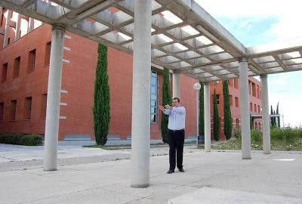
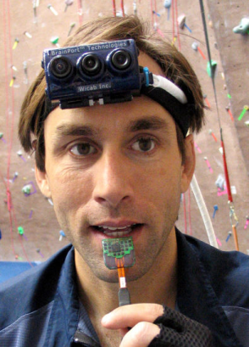
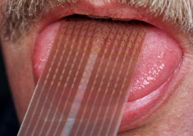
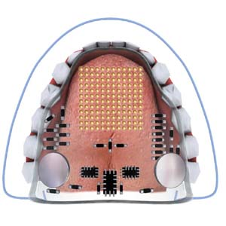
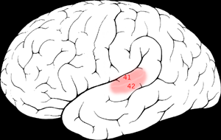
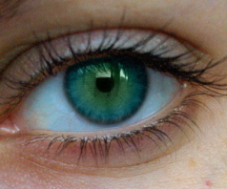

Sensor representation in the brain
Seeing with your tongue
Human echolocation (sonar)
Auditory cortex learns to see.
Auditory
Cortex
[BrainPort; Martinez et al; Roe et al.]

Slide 19
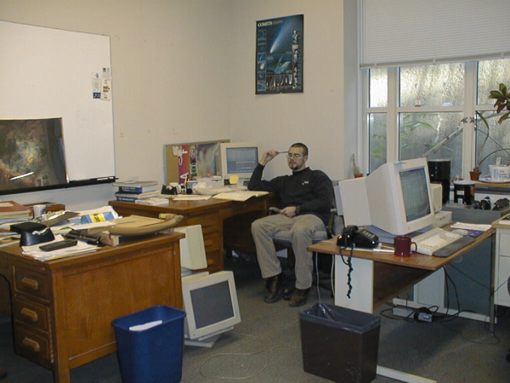
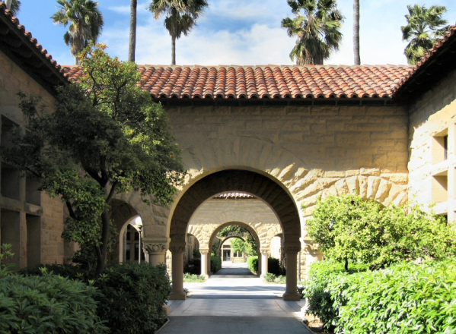
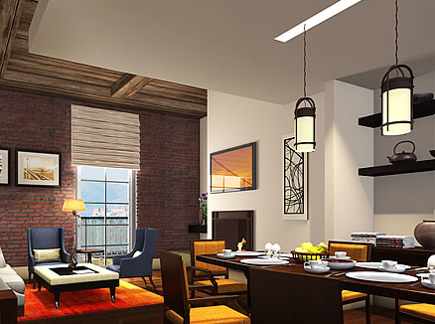
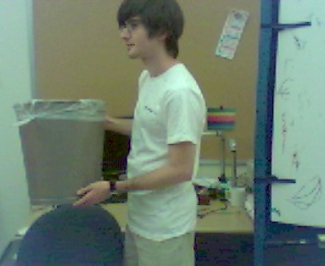

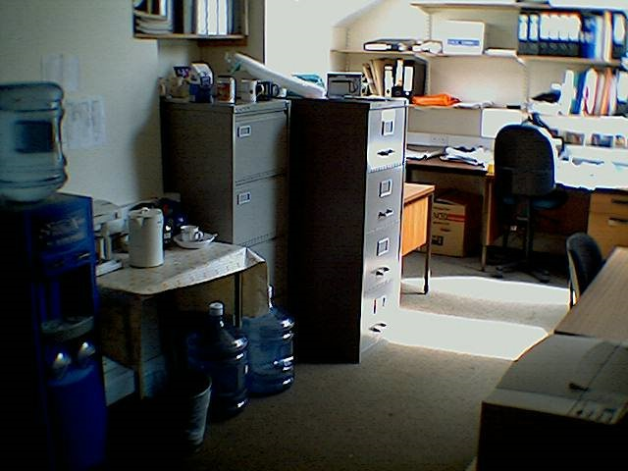
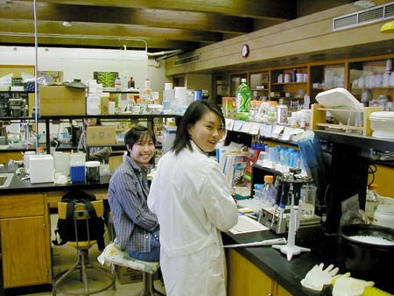
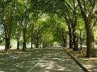
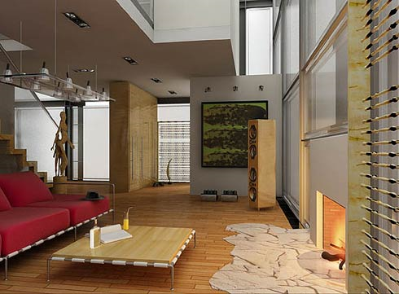
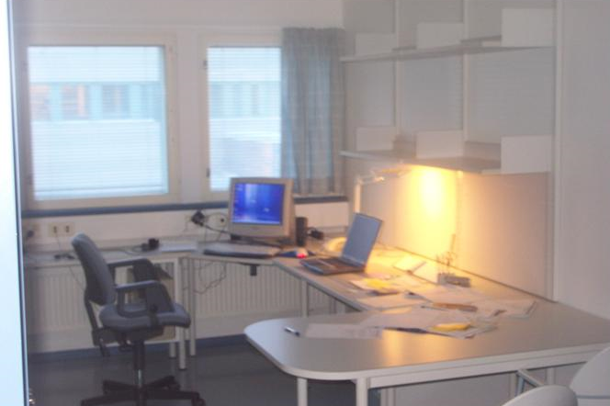
Learning input representations
Find a better way to represent images than pixels.

Slide 20
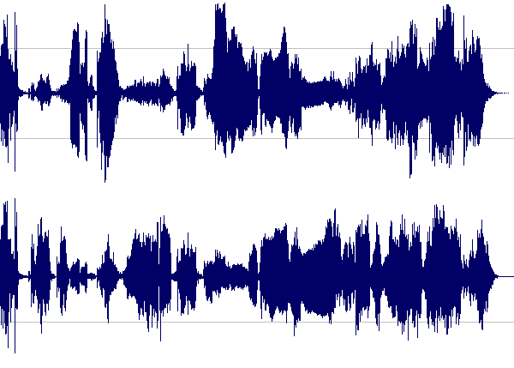
Learning input representations
Find a better way to represent audio.

Slide 21
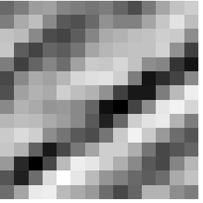
Feature learning problem
Given a 14x14 image patch x, can represent it using 196 real numbers.
Problem: Can we find a learn a better representation for this?
255
98
93
87
89
91
48
…

Slide 22
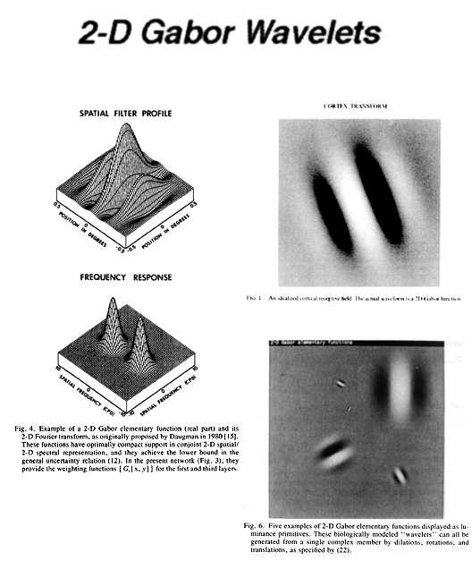
First stage of visual processing: V1
V1 is the first stage of visual processing in the brain.
Neurons in V1 typically modeled as edge detectors:
Neuron #1 of visual cortex
(model)
Neuron #2 of visual cortex
(model)
Notes:
http://www.ldeo.columbia.edu/4d4/wavelets/dm.html

Slide 23

Learning sensor representations
Sparse coding (Olshausen & Field,1996)
Model developed to explain visual perception in the brain.
Input: Images x⁽¹⁾, x⁽²⁾, …, x^{(m)} (each in R^{n x n})
Learn: Dictionary of bases φ₁, φ₂, …, φ_{k} (also R^{n x n}), so that each input x can be approximately decomposed as:
x ∑ a_{j} φ_{j}
s.t. a_{j}’s are mostly zero (“sparse”)
^{k}
^{j=1}
[NIPS 2006, 2007]

Slide 24
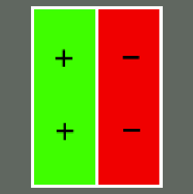
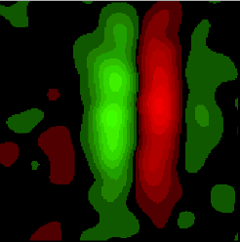
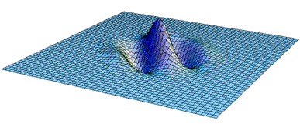
First stage of visual processing: V1
V1 is the first stage of visual processing in the brain.
Hubel & Wiesel (1962)’s simple cell model:
Green: Responds to white dot.
Red: Responds to black dot.
Schematic of simple cell
Actual simple cell
Alternative treatment: Model as “Gabor functions.”
Also used in image compression and denoising.
[Images from DeAngelis, Ohzawa & Freeman, 1995]
Notes:
http://www.ldeo.columbia.edu/4d4/wavelets/dm.html

Slide 25
Learning sensor representations
Sparse coding (Olshausen & Field,1996)
Input: Images x⁽¹⁾, x⁽²⁾, …, x^{(m)} (each in R^{n x n})
Learn: Dictionary of bases φ₁, φ₂, …, φ_{k} (also R^{n x n}), so that each input x can be approximately decomposed as:
x ∑ a_{j} φ_{j}
s.t. a_{j}’s are mostly zero (“sparse”)
Use to represent 14x14 image patch succinctly, as [a₇=0.8, a₃₆=0.3, a₄₁ = 0.5]. I.e., this indicates which “basic edges” make up the image.
^{k}
^{j=1}
[NIPS 2006, 2007]

Slide 26
Learning sensor representations
Sparse coding (Olshausen & Field,1996). Originally developed to explain early visual processing in the brain (edge detection).
Input: Images x⁽¹⁾, x⁽²⁾, …, x^{(m)} (each in R^{n x n})
Learn: Dictionary of bases φ₁, φ₂, …, φ_{k} (also R^{n x n}), so that each input x can be approximately decomposed as:
x ∑ a_{j} φ_{j}
s.t. a_{j}’s are mostly zero (“sparse”)
^{k}
^{j=1}
[NIPS 2006, 2007]

Slide 27
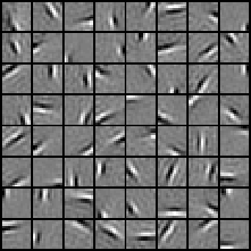





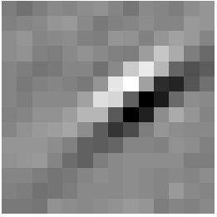
Sparse coding illustration
Natural Images
Learned bases (φ_{1 , …,} φ₆₄): “Edges”
Test example
≈ 0.8 * + 0.3 * + 0.5 *
x ≈ 0.8 * φ₃₆ + 0.3 * φ₄₂ + 0.5 * φ₆₃
[0, 0, …, 0, 0.8, 0, …, 0, 0.3, 0, …, 0, 0.5, …]
= [a₁, …, a₆₄] (feature representation)
Compact & easily
interpretable

Slide 28








More examples
Represent as: [a₁₅=0.6, a₂₈=0.8, a₃₇ = 0.4].
Represent as: [a₅=1.3, a₁₈=0.9, a₂₉ = 0.3].
0.6 * + 0.8 * + 0.4 *
φ₁₅ φ₂₈ φ₃₇
1.3 * + 0.9 * + 0.3 *
φ₅ φ₁₈ φ₂₉
Method “invents” edge detection.
Automatically learns to represent an image in terms of the edges that appear in it. Gives a more succinct, higher-level representation than the raw pixels.

Slide 29
Sparse coding applied to audio
Image shows 20 basis functions learned from unlabeled audio.
[Evan Smith & Mike Lewicki, 2006]

Slide 30
Sparse coding applied to audio
Image shows 20 basis functions learned from unlabeled audio.
[Evan Smith & Mike Lewicki, 2006]

Slide 31
What about text?
Sparse coding works great on “natural signals” like images and audio.
But text is different!
≈ 0.8 * + 0.3 * + 0.5 *
φ₃₆ φ₄₂ φ₆₃
Image ≈ 0.8 * “Edge 36” + 0.3 * “Edge 42” + 0.5 * “Edge 63”

Slide 32
Sparse coding on bag-of-word vectors (illustration)
a
aardvark
aardwolf
able
account
acid
across
…
baby
back
…
cradle
…
…
…
zylophone
1
0
0
0
1
0
0
0
1
0
0
1
0
0
0
1
x
Document

Slide 33
Sparse coding on bag-of-word vectors (illustration)
a
aardvark
aardwolf
able
account
acid
across
…
baby
back
…
cradle
…
…
…
zylophone
1
0
0
0
1
0
0
0
1
0
0
1
0
0
0
1
.1
.2
0
0
.1
.1
0
0
1.2
0
0
1
0
.1
0
.1
1.8
0
.1
0
0
.1
0
.2
0
0
.2
.1
0
.1
.1
0
.1
0
0
0.8
0
0
.1
.2
.1
.2
0
.3
0
0
0
1.2
0.8 * + 0.3 * + 0.5 *
Basis functions correspond to topics. But who needs another topic model? (Already have LSA, LDA, etc….)
φ₃₆ φ₄₂ φ₆₃
x
Document ≈ 0.8 * “Topic 36” + 0.3 * “Topic 42” + 0.5 * “Topic 63”

Slide 34
Sparse coding on text
Top five words in example “topics”:
Topic 1: Share, exchange, stock securities, commission.
Topic 2: Subscribe, online, service, server, database.
Topic 3: Actor, actress, film, comedian, star.
But… who needs another topic model? LSA (Landauer, et al., 1998), Distributional clustering (Brown et al 1992; Pereira et al., 1993) LDA (Blei et al., 2003), ….

Slide 35

Learning feature hierarchies
Higher layer
(Combinations of edges;
cf. V2)
“Sparse coding”
(edges; cf. V1)
Input image (pixels)
[Technical details: Sparsified version of Hinton’s DBN.]
[Lee, Ranganath & Ng, 2007]

Slide 36
Learning feature hierarchies
Higher layer
(Model V3?)
Higher layer
(Model V2?)
Model V1
Input image
[Technical details: Sparsified version of Hinton’s DBN.]
[Lee, Ranganath & Ng, 2007]

Slide 37


Sparse DBN: Training on face images
object models
object parts
(combination
of edges)
edges
Note: Sparsity important for these results.
pixels
[Lee, Grosse, Ranganath & Ng, 2009]

Slide 38
Learning abstract representations
object models
object parts
(combination
of edges)
Convolutional
DBN layers
edges
pixels
[Lee, Grosse, Ranganath & Ng, 2009]

Slide 39
Sparse DBN
Features learned from different object classes.
Faces
Cars
Elephants
Chairs
[Lee, Grosse, Ranganath & Ng, 2009]

Slide 40
Training on multiple objects
Features learned by training on 4 classes (cars, faces, motorbikes, airplanes).
Third layer bases learned from 4 object categories.
Object specific features
Features shared across object classes
Second layer bases learned from 4 object categories.
Edges
[Lee, Grosse, Ranganath & Ng, 2009]

Slide 41

Training on multiple objects
Trained on 4 classes (cars, faces, motorbikes, airplanes).
Second layer: Shared-features and object-specific features.
Third layer: More specific features.
Third layer bases learned from 4 object categories.
Plot of H(class|neuron active)
Second layer bases learned from 4 object categories.

Slide 42

Hierarchical probabilistic inference
Generating posterior samples from faces by “filling in” experiments
(cf. Lee and Mumford, 2003). Combine bottom-up and top-down inference.
Input images
Samples from
feedforward
Inference (control)
Samples from
Full posterior
inference
Notes:
Aglioti et al., 1994; Halligan et al., 1993; Weinstein, 1969; Ramachandran, 1998; Halligan et al., 1993; Sadato et al., 1996; Halligan et al., 1999

Slide 43
Machine learning applications

Slide 44












Traditional machine learning
Cars
Motorcycles
Testing:
What is this?

Slide 45






Unsupervised feature learning (Self-taught learning)
Unlabeled data
Testing:
What is this?
Car
Motorcycle
[Lee, Raina and Ng, 2007; Raina, Lee, Battle, Packer & Ng, 2008]

Slide 46


Unsupervised feature learning (Self taught learning)
Natural scenes
Testing:
What is this?
Segway
[NIPS 2006, ICML 2007]

Slide 47



Unsupervised feature learning (Self-taught learning)
Unlabeled data
Image
Learned bases φ_{i}
Learned representation [a₁, ... , a₆₄]
In NLP:
Distributional representations and vector space model ideas. (Brown et al., 1992; Pereira, Tishby & Lee, 1993; Salton et al., 1975; Pantel & Lin, 2002; Rapp, 2003; Turney et al., 2003).
Latent Semantic Analysis (Deerwester et al.,1990)
Structural Learning (Ando & Zhang, 2005)
….
Off-the-shelf classifier (SVM)

Slide 48

Activity recognition (Hollywood 2 benchmark)
Method | Accuracy
Hessian + ESURF [Williems et al 2008] | 38%
Harris3D + HOG/HOF [Laptev et al 2003, 2004] | 45%
Cuboids + HOG/HOF [Dollar et al 2005, Laptev 2004] | 46%
Hessian + HOG/HOF [Laptev 2004, Williems et al 2008] | 46%
Dense + HOG / HOF [Laptev 2004] | 47%
Cuboids + HOG3D [Klaser 2008, Dollar et al 2005] | 46%
Unsupervised feature learning (our method) | 52%
Unsupervised feature learning significantly improves on the previous state-of-the-art.

Slide 49



Self-taught learning: Example applications
Handwritten character classification
Speaker identification
Digits
Alphabets
Spectrogram | 38.5%
MFCCs | 43.8%
Sparse coding | 48.7%
Raw | 54.8%
PCA | 54.8%
Sparse coding | 58.5%
8.7% error reduction
8.2% error reduction
Music genre classification
Text classification
Newswire
Webpages
Spectrogram | 48.4%
MFCCs | 54.0%
Music-specific model | 49.3%
Sparse coding | 56.6%
# examples | 4 | 10 | 20
Raw words | 70.4% | 75.7% | 81.6%
LDA | 66.8% | 75.3% | 82.4%
Exp. Fam. Sparse coding | 75.0% | 81.4% | 85.1%
5.7% error reduction
15-23% error reduction
[Lee, Battle, Raina, & Ng, 2006; Raina, Battle, Lee, Packer & Ng, 2007, Grosse, Raina, Kwong & Ng, 2007]

Slide 50

CDBN for audio
Max pooling unit
Detection units
Spectrogram
[ICML 2009, NIPS 2009]

Slide 51

Sparse coding on audio
Spectrogram
≈ 0.9 * + 0.7 * + 0.2 *
x φ₃₆ φ₄₂ φ₆₃
[Lee, Pham and Ng, 2009]

Slide 52
Probabilistic max pooling
Convolutional DBN:
Convolutional Neural net:
max {x₁, x₂, x₃, x₄}
max {x₁, x₂, x₃, x₄}
X₁
X₂
X₃
X₄
Where x_{i} are {0,1}, and mutually exclusive. Thus, 5 possible cases:
X₁
X₂
X₃
X₄
Where x_{i} are real numbers.
Collapse 2^{n} configurations into n+1 configurations. Permits bottom up and top down inference.

Slide 53
Dictionary of bases φ_{i} learned for speech
Many bases seem to correspond to phonemes.
[Lee, Pham and Ng, 2009]
Notes:
Visual bases: Look at them and see if make sense/correspond to Gabors. Try to perform similar analysis on audio bases.

Slide 54








Many bases seem to be detecting phonemes
“oy”
“el”
“s”
Phoneme
First layer bases
[Lee, Pham and Ng, 2009]
Notes:
We select the bases that have the highest average activation for each phoneme.
Visual inspection shows bases capture patterns relevant to the phoneme.

Slide 55






Comparison of bases to gender (“ae” phoneme)
Phonemes
First layer bases
Second layer bases
Female
Male
[Lee, Pham and Ng, 2009]
Notes:
Female speech is characterized by clear horizontal banding patterns whereas male speech is characterized by intensity spread across lower frequencies.
Both first and second CRBM layers found these patterns even though they were trained in an unsupervised manner.

Slide 56
Sparse DBN for audio
Spectrogram
[Lee, Pham and Ng, 2009]
Notes:
Time-invariant features

Slide 57
Sparse DBN for audio
Spectrogram
[Lee, Pham and Ng, 2009]
Notes:
Time-invariant features

Slide 58
Sparse DBN for audio
Spectrogram
[Lee, Pham and Ng, 2009]

Slide 59

Convolutional DBN for audio
Max pooling
Second CDBN
layer
Detection units
Max pooling
One CDBN
layer
Detection units
[ICML 2009, NIPS 2009]

Slide 60
Sparse DBN for audio
[Lee, Pham and Ng, 2009]

Slide 61
Application to speech recognition tasks
Speaker identification
Phone classification
Gender classification
Music classification
Use same set of learned features for all three tasks.
Notes:
Basic idea: compute CDBN activations and use them as features for supervised learning algorithms. We used the same CDBN for all three tasks.

Slide 62

Phone Classification (TIMIT benchmark)
Test set accuracy:
Feature Learning
Clarkson and Moreno (1999): 77.6%
Gunawardana et al. (2005): 78.3%
Sung et al. (2007): 78.5%
Petrov et al. (2007): 78.6%
Sha and Saul (2006): 78.9%
Yu et al. (2009): 79.2%
Unsupervised feature learning significantly improves on the previous state-of-the-art.

Slide 63
Phoneme Classification (TIMIT benchmark)
Method | Accuracy
Clarkson and Moreno (1999) | 77.6%
Gunawardana et al. (2005) | 78.3%
Sung et al. (2007) | 78.5%
Petrov et al. (2007) | 78.6%
Sha and Saul (2006) | 78.9%
Yu et al. (2006) | 79.2%
Unsupervised feature learning (our method) | 80.3%
Clarkson and Moreno (1999): 77.6%
Gunawardana et al. (2005): 78.3%
Sung et al. (2007): 78.5%
Petrov et al. (2007): 78.6%
Sha and Saul (2006): 78.9%
Yu et al. (2009): 79.2%
Unsupervised feature learning significantly improves on the previous state-of-the-art.
[Lee, Pham and Ng, 2009]

Slide 64



Audio problems
Gender classification:
Music genre classification:
Music artist classification:
Outperforms MFCC baselines. Having a deeper network generally does better.

Slide 65

Speaker Identification
Test set accuracy:
[16] D. A. Reynolds. Speech Commun,1995.
The CDBN features outperform the MFCC features, especially when the number of training examples is small.

Slide 66
Scaling up:
GPU hardware

Slide 67

Scaling up: GPU hardware
Scale up algorithms to realistic problems using GPU (Graphics Processor Unit) hardware.
You already have this in your desktop, and it runs 10-100x faster than your CPU.
[Raina, Madhavan and Ng, 2008]

Slide 68
State-of-the-art Unsupervised feature learning

Slide 69
State-of-the-art task performance
Audio
TIMIT Phone classification | Accuracy
Prior art (Clarkson et al.,1999) | 79.6%
Stanford Feature learning | 80.3%
TIMIT Speaker identification | Accuracy
Prior art (Reynolds, 1995) | 99.7%
Stanford Feature learning | 100.0%
Images
CIFAR Object classification | Accuracy
Prior art (Yu and Zhang, 2010) | 74.5%
Stanford Feature learning | 75.5%
NORB Object classification | Accuracy
Prior art (Ranzato et al., 2009) | 94.4%
Stanford Feature learning | 96.2%
Video
UCF activity classification | Accuracy
Prior art (Kalser et al., 2008) | 86%
Stanford Feature learning | 87%
Hollywood2 classification | Accuracy
Prior art (Laptev, 2004) | 47%
Stanford Feature learning | 52%
Multimodal (audio/video)
Other unsupervised feature learning records:
Different phone recognition (Geoff Hinton)
PASCAL VOC object detection (Kai Yu)
AVLetters Lip reading | Accuracy
Prior art (Zhao et al., 2009) | 58.9%
Stanford Feature learning | 63.1%
Notes:
Other SOTA performance records held by Kai Yu, Geoff Hinton.

Slide 70


Kai Yu’s PASCAL VOC (Object recognition) result (2009)
Class
Feature
Learning
Best of
Other Teams
Difference
Sparse coding to learn features.
Unsupervised feature learning beat all the other approaches by a significant margin.
[Slide courtesy of Kai Yu]

Slide 71
Music Classification results
Music Genre Classification
Music Artist Classification
The CDBN features give better performance than the MFCC features.

Slide 72
What about text?

Slide 73
Sparse coding on bag-of-word vectors (illustration)
a
aardvark
aardwolf
able
account
acid
across
…
baby
back
…
cradle
…
…
…
zylophone
1
0
0
0
1
0
0
0
1
0
0
1
0
0
0
1
0
0
0
0
0
0
0
0
1
0
0
1
0
0
0
0
1
0
0
0
0
0
0
0
0
0
0
0
0
0
0
0
0
0
0
1
0
0
0
0
0
0
0
0
0
0
0
1
0.8 * + 0.3 * + 0.5 *
But we already have lots of topic models.
E.g., LSA (Landauer, et al., 1998), Distributional clustering (Brown et al 1992; Pereira et al., 1993), LDA (Blei, Ng & Jordan, 2003), ….
φ₃₆ φ₄₂ φ₆₃
x
Document ≈ 0.8 * “Topic 36” + 0.3 * “Topic 42” + 0.5 * “Topic 63”

Slide 74
Sparse coding on bag-of-word vectors (illustration)
a
aardvark
aardwolf
able
account
acid
across
…
baby
back
…
cradle
…
…
…
zylophone
1
0
0
0
1
0
0
0
1
0
0
1
0
0
0
1
.1
.2
0
0
.1
.1
0
0
1.2
0
0
1
0
.1
0
.1
1.8
0
.1
0
0
.1
0
.2
0
0
.2
.1
0
.1
.1
0
.1
0
0
0.8
0
0
.1
.2
.1
.2
0
.3
0
0
0
1.2
0.8 * + 0.3 * + 0.5 *
But we already have lots of topic models.
E.g., LSA (Landauer, et al., 1998), Distributional clustering (Brown et al 1992; Pereira et al., 1993), LDA (Blei, Ng & Jordan, 2003), ….
φ₃₆ φ₄₂ φ₆₃
x
Document ≈ 0.8 * “Topic 36” + 0.3 * “Topic 42” + 0.5 * “Topic 63”

Slide 75
Sparse coding on text
Top five words in example “topics”:
Topic 1: Share, exchange, stock securities, commission.
Topic 2: Subscribe, online, service, server, database.
Topic 3: Actor, actress, film, comedian, star.
There’re already lots of topic models: LSA (Landauer, et al., 1998), Distributional clustering (Brown et al 1992; Pereira et al., 1993) LDA (Blei, Ng & Jordan, 2003), ….

Slide 76

Text classification results
20 Newsgroups
Webpages (business) classification
Error
Error
Sparse coding
Sparse coding
#examples
#examples
Red: feature learning (sparse coding). Cyan: LDA. Green: PCA. Black: Raw words.
Another success: Ranganath, Jurafsky and McFarland (EMNLP 2009).
[Lee, Raina, Teichman & Ng, IJCAI 2009]
Notes:
LDA not tuned tremendously. Probably other LDA-like algorithms if tuned could beat sparse coding. But nice sanity-check that this sort of algorithm promising.

Slide 77
But text is different….

Slide 78
Some ways that text is different
It’s symbolic! → Very sparse representations
Recursive structure
Rest of this talk: Ideas (some preliminary) for adapting feature learning ideas to text.

Slide 79
Text is different #1: Sparse vectors
Image representation:
Text representation:
One-hot vectors
to represent sequence of words
Sparse bag-of-word vector
0
0
0
0
1
0
0
0
0
1
0
0
0
0
0
0
0
0
0
1
0
0
0
0
0
1
0
1
1
0
0
0
Dense 196-dimensional vector
or
255
98
93
87
89
91
48
…
The cat sat ….

Slide 80
Feature learning problem
Given a 14x14 image patch x, can represent it using 196 real numbers.
Problem: Can we find a learn a better representation for this?
255
98
93
87
89
91
48
…

Slide 81
Idea #1: Dense representations
Imagine taking each word, and embedding it in an n-dimensional space. (cf. distributional representations).
2-d embedding example below, but in practice use ~100-d embeddings.
5
4
3
2
1
On
8
5
0
0
0
0
1
0
0
0
0
1
0
0
0
0
0
0
2
4
Monday
x₂
Tuesday
2.1
3.3
Britain
9
2
France
9.5
1.5
Monday Britain
0 1 2 3 4 5 6 7 8 9 10
x₁
On Monday, Britain ….
Representation:
8
5
2
4
9
2
E.g., LSA (Landauer & Dumais, 1997); Distributional clustering (Brown et al., 1992; Pereira et al., 1993);

Slide 82
Algorithms for finding word vector representations
Examples of algorithms:
Many distributional representation and vector space model ideas (Brown et al., 1992; Pereira et al., 1993; Salton et al., 1975; Pantel & Lin, 2002; Rapp, 2003; Turney et al., 2003).
LSA (Landauer & Dumais, 1997).
Latent Dirichlet Allocation (LDA; Blei et al., 2003)
…
E.g., Represent a word via the statistics of what it co-occurs with.
Recent development: “Neural Language models.” (Bengio et al., 2003. Collobert & Weston, 2008).
Learn a separate parameter vector for each word, that summarizes its co-occurrence with other words.
Formally, learn an embedding f(w) of each word w so that you can estimate a language model as:

Slide 83

Visualization of learned embedding
[Image courtesy of Joseph Turian, Lev Ratinov and Yoshua Bengio.]

Slide 84

Comparing learned representations
Notes:
We train our model on 24,000 reviews from the IMBD archive and use cosine similarity to find the words deemed most similar to a given query word (bold)
Our model (top) captures semantic similarity whereas the representations trained via a neural language model (bottom) capture similar parts of speech or short-range context
TODO the words here are somewhat random. I need to hand select better examples. The new model should do a much better job on these
CAVEAT the LM representations were induced with newspaper articles, not reviews

Slide 85
Closest words in “semantic” space (IMDB data)
Select a word (left column), and show nearest words in 100-d embedding space.
Center word | Nearest neighbor words in embedding space
Comedy | Laughs Comedic Hilarious Funny
Romantic | Chemistry Love Smitten Engaged
Amazing | Brilliant Incredible Greatest Ever
Awful | Worst Worse Bad Boring
[Andrew Maas]
Notes:
comedy
laughs
comedies
comedic
hilarious
funny
romantic
romance
chemistry
love
smitten
engaged
amazing
brilliant
incredible
greatest
ever
everything
awful
worst
worse
bad
boring
lame
thrills
thrilling
thriller
suspense
chills
thrillers

Slide 86
Closest words in “semantic” space
Select a word (shown in bold), and show nearest words in 100-d embedding space.
amazing, incredible, absolutely, fantastic, the, delicious, simply, awesome, spectacular, fabulous, food, and, totally, terrific, was
wonderful, lovely, evening, a, meal, setting, fabulous, terrific, perfect, superb, outstanding, wow, ambiance, delicious, absolutely
bad, never, many, disappointment, disappointed, otherwise, before, found, could, maybe, having, here, though, had, over
terrible, ok, horrible, okay, rather, average, mediocre, poor, overpriced, decent, bland, nearly, maybe, less, seemed
[Andrew Maas]
Notes:
comedy
laughs
comedies
comedic
hilarious
funny
romantic
romance
chemistry
love
smitten
engaged
amazing
brilliant
incredible
greatest
ever
everything
awful
worst
worse
bad
boring
lame
thrills
thrilling
thriller
suspense
chills
thrillers

Slide 87
Sentiment classification
Features | # Features | Accuracy
Bag of Words | 20,000 | 87.45
Neural language model (Mnih & Hinton ’09) | 100 | 71.25
LDA p(word|topic) vectors (Blei et al ‘03) | 100 | 71.20
LSA word vectors (Landauer et al ‘07) | 100 | 77.85
Our method word vectors | 100 | 87.05
Our method + BoW | 20,100 | 89.35
Contextual valence shifters (Kennedy & Inkpen ‘06) | 43,607 | 86.20
Appraisal taxonomy (Whitelaw et al ‘05) | 49,911 | 90.20
Delta TF-IDF weighting (Martineau & Finin ‘09) | ? | 88.10
Pang and Lee; 2004. Sentiment polarity v. 2.0
Notes:
We evaluate our method using the movie review dataset of Pang and Lee 2004. It has 1k positive and 1k negative reviews, and we report numbers on 10-fold CV as specified in the dataset
Our model uses 24,000 Imdb reviews from Pang and Lee’s raw html files to induce word vectors
To use word vectors in classification, we take the mean word vector of all words present in a review. We see that the word vectors of topic models (LSA and LDA) perform poorly, as does the syntactically focused word vectors of the neural language model of Mnih and Hinton.
When we concatenate our word vectors with the BoW representation we obtain a classifier competitive with the best reported results in the literature
TODO need more information on the previously published models?
TODO our results should improve with further learning on the new unsupervised dataset

Slide 88
Sentiment classification (Movie reviews)
Sentiment polarity v. 2.0 dataset (Pang & Lee, 2004)
Features | # Features | Accuracy
Bag of Words | 20,000 | 87.45
Neural language model (Mnih & Hinton ’09) | 100 | 71.25
LDA p(word|topic) vectors (Blei et al ‘03) | 100 | 71.20
LSA word vectors (Landauer et al ‘07) | 100 | 77.85
Our method word vectors | 100 | 87.05
Learned features (Our method) | 20,100 | 89.35
Contextual valence shifters (Kennedy & Inkpen ‘06) | 43,607 | 86.20
Appraisal taxonomy (Whitelaw et al ‘05) | 49,911 | 90.20
Delta TF-IDF weighting (Martineau & Finin ‘09) | ? | 88.10
Features | Accuracy
LDA word vectors (Blei et al ‘03) | 71.20
LSA word vectors (Landauer et al ‘07) | 77.85
Contextual valence shifters (Kennedy & Inkpen ‘06) | 86.20
Delta TF-IDF weighting (Martineau & Finin ‘09) | 88.10
Learned embedding (Mass and Ng; our method) | 89.35
Appraisal taxonomy (Whitelaw et al ‘05) | 90.20
89.35
[Andrew Maas]

Slide 89
Sentiment classification (Movie reviews)
Sentiment polarity v. 2.0 dataset (Pang & Lee, 2004)
Features | # Features | Accuracy
Bag of Words | 20,000 | 87.45
Neural language model (Mnih & Hinton ’09) | 100 | 71.25
LDA p(word|topic) vectors (Blei et al ‘03) | 100 | 71.20
LSA word vectors (Landauer et al ‘07) | 100 | 77.85
Our method word vectors | 100 | 87.05
Learned features (Our method) | 20,100 | 89.35
Contextual valence shifters (Kennedy & Inkpen ‘06) | 43,607 | 86.20
Appraisal taxonomy (Whitelaw et al ‘05) | 49,911 | 90.20
Delta TF-IDF weighting (Martineau & Finin ‘09) | ? | 88.10
Features | Accuracy
NLM model (Mnih & Hinton ’09) | 71.25
LDA word vectors (Blei et al ‘03) | 71.20
LSA word vectors (Landauer et al ‘07) | 77.85
Contextual valence shifters (Kennedy & Inkpen ‘06) | 86.20
Delta TF-IDF weighting (Martineau & Finin ‘09) | 88.10
Learned embedding (Mass and Ng; our method) | 89.35
Appraisal taxonomy (Whitelaw et al ‘05) | 90.20
89.35
[Andrew Maas]
Notes:
XXXX

Slide 90
Classification results
20 newsgroups (10 examples per class):
Algorithm | Error
Raw features (BOW) | 24.3
PCA (exponential family) | 26.3
LDA (Blei, Ng, Jordan, 2003) | 24.7
Our method | 18.6
OpenTable sentiment classification (1000 examples, predict 1-5 star rating)
Algorithm | Abs. Error
Raw features (BOW) | 0.92
Our method | 0.68

Slide 91
Closest words in 100-d embedding space
Select a word (show in blue), and show nearest four words in 100-d embedding space.
chemistry
flat
uninteresting
lovers
romantic
dull
steal
lifeless
comedy
romance
computer
realistic
excellent
totally
effects
highly
special
twister
ending
enjoyable
[Andrew Maas]

Slide 92
Text representations
0
0
0
0
0
0
0
1
0
0
0
1
0
0
0
0
0
0
0
0
0
0
0
0
1
0
0
0
0
0
0
0
1
0
0
0
0
0
0
0
0
0
0
1
0
0
0
0
0
1
0
0
0
0
One-hot
representation
The cat sat on the mat.
“Semantic”
embedding
9
1
5
3
7
3
8
5
9
1
4
3
The cat sat on the mat.

Slide 93

Text is different #2: Variable length input, recursive structure
Audio/Images
Text
Recursive structure,
Input-specific hierarchy.
“Generic” hierarchies.

Slide 94
Text is different #2: Variable recursive structure
Images/audio
Text
Recursive structure.
“Generic” hierarchies.

Slide 95
“Generic” hierarchy on text doesn’t make sense
Node has to represent sentence fragment “cat sat on.” Doesn’t make sense.
9
1
5
3
7
1
8
5
9
1
4
3
The cat sat
The cat on the mat.

Slide 96
What we want (illustration)
S
This node’s job is to represent
“on the mat.”
VP
PP
NP
NP
9
1
5
3
7
1
8
5
9
1
4
3
The cat sat
The cat on the mat.
[Socher, Manning & Ng]

Slide 97
What we want (illustration)
5
4
S
This node’s job is to represent
“on the mat.”
7
3
VP
8
3
PP
5
2
NP
3
3
NP
9
1
5
3
7
1
8
5
9
1
4
3
The cat sat
The cat on the mat.
[Socher, Manning & Ng]

Slide 98
What we want (illustration)
5
4
3
2
1
The day after my birthday
x₂
Monday
Tuesday
The country of my birth
Britain
France
0 1 2 3 4 5 6 7 8 9 10
x₁
3
5
9
3
8
3
9
2
5
2
3
3
2
8
3
2
g
9
2
3
2
g
9
9
3
2
8
5
2
4
9
2
8
5
9
2
2
2
The day after my birthday, …
The country of my birth…

Slide 99

Recursive Neural Networks
In the past only used to rank or classify given an existing structure (from a symbolic system)

Slide 100
Learning recursive representations
5
4
S
This node’s job is to represent
“on the mat.”
7
3
VP
8
3
PP
5
2
NP
3
3
NP
9
1
5
3
7
1
8
5
9
1
4
3
The cat sat
The cat on the mat.
[Socher, Manning & Ng]

Slide 101
Learning recursive representations
This node’s job is to represent
“on the mat.”
8
3
3
3
8
5
9
1
4
3
The cat on the mat.
[Socher, Manning & Ng]

Slide 102
Learning recursive representations
This node’s job is to represent
“on the mat.”
8
3
3
3
8
5
9
1
4
3
The cat on the mat.
[Socher, Manning & Ng]

Slide 103
Learning recursive representations
Basic computational unit: Neural Network that inputs two candidate children’s representations, and outputs:
Whether we should merge the two nodes.
The semantic representation if the two nodes are merged.
This node’s job is to represent
“on the mat.”
8
3
8
3
“Yes”
3
3
Neural
Network
8
5
9
1
4
3
The cat on the mat.
8
5
3
3
[Socher, Manning & Ng]

Slide 104
Parsing a sentence
9
1
5
3
7
1
8
5
9
1
4
3
The cat sat
The cat on the mat.
[Socher, Manning & Ng]

Slide 105
Parsing a sentence
5
2
Yes
Neural
Network
9
1
5
3
7
1
8
5
9
1
4
3
The cat sat
The cat on the mat.
[Socher, Manning & Ng]

Slide 106
Parsing a sentence
5
2
0
1
0
1
0
0
3
3
Yes
No
No
No
Yes
Neural
Network
Neural
Network
Neural
Network
Neural
Network
Neural
Network
9
1
5
3
7
1
8
5
9
1
4
3
The cat sat
The cat on the mat.
[Socher, Manning & Ng]

Slide 107
Parsing a sentence
0
1
0
1
8
3
No
No
Yes
Neural
Network
Neural
Network
Neural
Network
5
2
3
3
9
1
5
3
7
1
8
5
9
1
4
3
The cat sat
The cat on the mat.
[Socher, Manning & Ng]

Slide 108
Parsing a sentence
0
1
8
3
No
Yes
Neural
Network
Neural
Network
5
2
3
3
9
1
5
3
8
5
9
1
4
3
The cat on the mat.
[Socher, Manning & Ng]

Slide 109
Parsing a sentence
5
4
7
3
8
3
5
2
3
3
9
1
5
3
7
1
8
5
9
1
4
3
The cat sat
The cat on the mat.
[Socher, Manning & Ng]

Slide 110
Details
Parsing: Not really greedy. Done with CKY chart parser.
Neural network is trained discriminatively, with CKY in the inner-loop, to optimize a large margin objective. (Similar to max margin parsing, Taskar et al., 2004).
Neural network has access to context surrounding its inputs.
Related work: Recursive Neural Networks (e.g. Goller et al., 1996).
[Socher, Manning & Ng]

Slide 111

Model: Recursive Neural Networks
We extend it to actually build the structure based on a 1-d scoring layer:
[Socher, Manning & Ng]

Slide 112

Model: Context-Sensitive RNN
Parsing and other labeled structure problems are often context-sensitive, incorporate this through context units
[Socher, Manning & Ng]

Slide 113


Model: RNN for Structure Prediction
Similar to max-margin parsing by (Taskar et al. 2004), we can formulate a global structure risk optimization
Where the score is the sum of local parsing decision scores from the RNN
Learning is done via subgradient ascent and backpropagation through structure (Goller et al. 1996)
[Socher, Manning & Ng]

Slide 114
Preliminary Results
Training a joint category classifier implicitly encourages the representations to incorporate more syntactic structure (which helps a bit)
[Socher, Manning & Ng]

Slide 115
Preliminary Results
Model without explicit POS or category labels
No linguistic features. Train only using the structure and words of WSJ training trees, and word embeddings from (Collobert & Weston, 2008).
WSJ, Development Test Section 22, max. sentences length 15
Category tagger has 87% accuracy
Method | F1
Greedy Neural Network (NN) | 76.55
Greedy, context-sensitive NN | 83.36
Greedy, context-sensitive, NN + joint category classifier | 87.05
CKY, context-sensitive, NN + joint category classifier | 90.56
Stanford Parser, (Klein and Manning, '03) | 93.98
[Socher, Manning & Ng]

Slide 116
Improved Word Representations
Leverage unlabeled data by pre-training using (Collobert & Weston, 2008) word embeddings
Word embeddings improve and become more syntactically plausible
Below are frequent words and their closest neighbors in embedding space
Notice how words are more similar to other words with the same POS tag
Collobert&Weston embedding | C&W + RNN training
the -- a, its, an, this, his, their, UNK and -- ,, or, but, as, --, ., that, for, in in -- at, on, from, for, over, after, and, as that -- which, but, ,, and, --, as, for, or, about, if | the -- an, The, no, some, A, these, another and -- or, but, And, But, &, least, sell in -- In, from, into, since, for, For, like, with, that -- what, who, if, this, some, which, If
said -- added, says, --, while, but, reported, on | said -- says, fell, added, did, rose, sold, reported
he -- she, it, they, which, also, now, who, we | he -- they, I, we, you, It, she, it, He, We, They
share -- high, higher, business, market, current, stock, lower, increase, price, financial | share -- increase, bank, income, industry, issue, state, sale, growth, unit, president
when -- after, while, before, if, but, where, as | when -- where, how, which, during, including
[Socher, Manning & Ng]

Slide 117
Finding Similar Sentences
Each phrase has an embedding.
Pick a sentence and list nearest neighbor sentences.
Often either semantically or syntactically similar. (Digits all mapped to 2.)
Similarities | Center Sentence | Nearest Neighbor Sentences in Embedding Space
Bad News | Both took further hits yesterday | We 're in for a lot of turbulence ... BSN currently has 2.2 million common shares outstanding This is panic buying We have a couple or three tough weeks coming
Something said | I had calls all night long from the States, he said | Our intent is to promote the best alternative, he says We have sufficient cash flow to handle that, he said Currently, average pay for machinists is 22.22 an hour, Boeing said Profit from trading for its own account dropped, the securities firm said
Gains and good news | Fujisawa gained 22 to 2,222 | Mochida advanced 22 to 2,222 Commerzbank gained 2 to 222.2 Paris loved her at first sight Profits improved across Hess's businesses
Unknown words which are cities | Columbia , S.C | Greenville , Miss UNK , Md UNK , Miss UNK , Calif
[Socher, Manning & Ng]

Slide 118
Finding Similar Sentences
Similarities | Center Sentence | Nearest Neighbor Sentences in Embedding Space
Bad News | Both took further hits yesterday | We 're in for a lot of turbulence ... BSN currently has 2.2 million common shares outstanding This is panic buying We have a couple or three tough weeks coming
Something said | I had calls all night long from the States, he said | Our intent is to promote the best alternative, he says We have sufficient cash flow to handle that, he said Currently, average pay for machinists is 22.22 an hour, Boeing said Profit from trading for its own account dropped, the securities firm said
Gains and good news | Fujisawa gained 22 to 2,222 | Mochida advanced 22 to 2,222 Commerzbank gained 2 to 222.2 Paris loved her at first sight Profits improved across Hess's businesses
Unknown words which are cities | Columbia , S.C | Greenville , Miss UNK , Md UNK , Miss UNK , Calif

Slide 119
Finding Similar Sentences
Similarities | Center Sentence | Nearest Neighbor Sentences in Embedding Space
Declining to comment = not disclosing | Hess declined to comment | PaineWebber declined to comment Phoenix declined to comment Campeau declined to comment Coastal wouldn't disclose the terms
Large changes in sales or revenue | Sales grew almost 2 % to 222.2 million from 222.2 million | Sales surged 22 % to 222.22 billion yen from 222.22 billion Revenue fell 2 % to 2.22 billion from 2.22 billion Sales rose more than 2 % to 22.2 million from 22.2 million Volume was 222.2 million shares , more than triple recent levels
Negation of different types | There's nothing unusual about business groups pushing for more government spending | We don't think at this point anything needs to be said It therefore makes no sense for each market to adopt different circuit breakers You can't say the same with black and white I don't think anyone left the place UNK UNK
People in bad situations | We were lucky | It was chaotic We were wrong People had died They still are
[Socher, Manning & Ng]

Slide 120
Finding Similar Sentences
Each phrase has an embedding.
Pick a sentence and list nearest neighbor sentences.
Often either semantically or syntactically similar (digits are all mapped to 2)
Similarities | Center Sentence | Nearest Neigbhor Sentences in Embedding Space
Large changes in sales or revenue | Sales grew almost 2 % to 222.2 million from 222.2 million | Sales surged 22 % to 222.22 billion yen from 222.22 billion Revenue fell 2 % to 2.22 billion from 2.22 billion Sales rose more than 2 % to 22.2 million from 22.2 million Volume was 222.2 million shares , more than triple recent levels
Subjective sentences | I had calls all night long from the States , he said | Our intent is to promote the best alternative, he says We have sufficient cash flow to handle that, he said Currently, average pay for machinists is 22.22 an hour, Boeing said Profit from trading for its own account dropped, the securities firm said
[Socher, Manning & Ng]

Slide 121
More Similar Sentences
Similarities | Center Sentence | Nearest Neigbhor Sentences in Embedding Space
Bad News | Both took further hits yesterday | We're in for a lot of turbulence ... BSN currently has 2.2 million common shares outstanding This is panic buying We have a couple or three tough weeks coming
Spokesmen who don’t speak | A DPC spokesman declined to elaborate on the group 's new plan | Those two offers were private and the spokesman refused to identify the bidding companies Among the firms were Merrill Lynch & Co. and Dean Witter Reynolds Inc The real key is to have the economy working and interest rates down The market upheaval apparently hasn't triggered any cash crunch – yet
Negation of different types | There's nothing unusual about business groups pushing for more government spending | We don't think at this point anything needs to be said It therefore makes no sense for each market to adopt different circuit breakers You can't say the same with black and white I don't think anyone left the place UNK UNK
[Socher, Manning & Ng]
Notes:
So... I think finding negation can be very important for lots of nlp
applications such as sentiment detection, rating (this product was no
good, this product was not good, i don't recommend this product) and
others.
The similarities are not always semantic, they can also just be
syntactic, like ending with ", X said".

Slide 122

Images vs. Text inputs
“Cat in a hammock”
Pixel Vector:
[10, 14, 14, 16, …]
Real-valued, dense
Bag-of-words:
[1, 0,0,0,0,0,0,0,…]
[0,0,0,…, 1, 0,0,0…]
Binary, extremely sparse

Slide 123

Sentiment Classification: OpenTable dataset
OpenTable.com

Slide 124

Visualization of learned representation

Slide 125

Invariance metric
Notes:
Has nice scaling properties. E.g., neuron can’t get a higher score just by firing twice as often.

Slide 126
Visualization of learned representation

Slide 127

Invariance metric
Notes:
Has nice scaling properties. E.g., neuron can’t get a higher score just by firing twice as often.

Slide 128
Addressing ways that text is different from images/audio
Text is symbolic → Very sparse representations
Recursive structure
Address with:
Dense vector representations of words
Recursive feature representations

Slide 129
Weaknesses
& Criticisms

Slide 130
Weaknesses & Criticisms
Learning everything. Better to encode prior knowledge about structure of images.
A: Compare with machine learning vs. linguists debate in NLP.
Results not yet competitive with best engineered systems.
A: True for some domains. Much less true now than 1 year ago.
Notes:
Q1: Encode translation, rotational invariance.
Q2: Kai Yu’s result.

Slide 131
Weaknesses & Criticisms
You’re learning everything. Better to encode prior knowledge about structure of language (or images, or audio).
A: Wasn’t there a similar machine learning vs. linguists debate in NLP ~20 years ago….
We don’t understand the learned features. Language is symbolic! We’d like have symbolic features like NP, VP, etc. and see why their combination makes sense.
A: True. This might be a bad approach if your goal is to study language. But note many NLP features are already not human-understandable (e.g, concatenations/combinations of different features).
Works well for “natural” inputs like vision and audio. But NLP results not competitive with best hand-engineered systems.
A: Agreed. Absolutely true for most NLP problems.
I used to give a similar caveat when giving computer vision talks 2 years ago. I don’t anymore (now feature learning regularly outperforms hand-engineered vision systems). Maybe in 2 years time….
However, adding learned features to hand-engineered ones often already improve on state-of-the-art.
Notes:
Q1: Encode translation, rotational invariance.
Q2: Kai Yu’s result.

Slide 132
Conclusions

Slide 133
Conclusions
Notes:
NS goal: Understanding the brain
CS/engineering goal:

Slide 134












Unsupervised feature learning summary
Unsupervised feature learning.
Lets learn rather than hand-engineer our features.
Sparse coding and deep variants very successful on vision and audio tasks. Learns reasonable models on bag-of-words too.
But text is different!
  Learning dense “semantic” embeddings.
  Learning recursive structures and embeddings
  of phrases and sentences.
Online tutorials for applying algorithms available.
E.g., http://cs294a-deeplearning.stanford.edu.
Thanks to:
Car
Motorcycle
Natural scenes
Quoc Le Honglak Lee Andrew Saxe Andrew Maas Chris Manning Jiquan Ngiam Richard Socher

Slide 135


Unsupervised feature learning summary
Unsupervised feature learning.
Convolutional DBN for images and audio:
Good vision/audio classification results.
Direct measurement of invariances.
Additional way to evaluate and understand
deep learners.
Depth leads to modest increases in invariance.
Sparsity has significant effect on invariance.
Object parts “Filling in”

Slide 136
END END END
Notes:
NS goal: Understanding the brain
CS/engineering goal:

Slide 137
Measuring Invariances

Slide 138






Unsupervised feature learning & Invariance
We want deep networks that give features that are:
  Invariant (does not change under irrelevant input transformations).
  Selective (respond only to a few inputs).
Evaluation of learned features:
Invariance metrics. Shed light on (i) Effect of different types of training; (ii) Why deep networks?
Inspiration from Quiroga et al., 2005.
Gratings: Measures only rotation,
translation, frequency invariances.
Object classification: Very
complex transformations.
Notes:
Measure other types of invariance.
Shed light on how different networks do.
Also, why do we want deep networks?

Slide 139
Invariance metric
Shoot natural video of objects undergoing transformations such as:
  Translation.
  2D (in-plane) rotation.
  3D (out-of-plane) rotation.
Local firing rate (Invariance)
Score =
Global firing rate (Selectivity)
Local firing rate:
If neuron detects a feature in frame t of a video, what is the probability that it still detects that feature in a nearby frame t+k?
Global firing rate:
- Overall firing rate of neuron.
[Note: Description simplified slightly for this presentation.]
Notes:
Has nice scaling properties. E.g., neuron can’t get a higher score just by firing twice as often.

Slide 140


Increasing invariance with depth
Mean
Translation
2-D Rotation
3-D Rotation
Autoencoder enjoys modest increase in invariances with depth (16.6 to 18.5)
Weight decay parameter selected with cross-validation.
No sparsity.
Invariance Score
1
2
3
1
2
3
1
2
3
1
2
3
Layer
Layer
Layer
Layer
Layer 1
Layer 2
Layer 3
Notes:
Note scale on plot.

Slide 141

Sparsity regularization and weight decay
Layer 1, Natural video test
One layer sparse autoencoder.
1. Sparsity has a significant effect on invariance.
2. The most invariance units correspond roughly to Gabors.
Invariance score
Log₁₀ Target mean activation (Sparsity)
Log₁₀ Weight decay

Slide 142

Convolutional DBN invariance
Results not comparable to previous ones because of receptive field size (11x11 and 31x31 in first two layers).
Notes:
Invariances: As we try out new algorithms, I often struggle with how to figure out whether making progress.

Slide 143



Acknowledgments
Honglak Lee Quoc Le Andrew Saxe
Ian Goodfellow Rajat Raina
Thanks also to: Yan Largman, Peter Pham, Rajesh Ranganath.

Slide 144

































Recent history of machine learning
20 years ago: Supervised learning
10 years ago: Semi-supervised learning.
3 years ago: Transfer learning.
Next: Self-taught learning – unsupervised discovery of structure?
Cars
Motorcycles
Cars
Motorcycles
Bus
Tractor
Aircraft
Helicopter
Cars
Motorcycles
Car
Motorcycle
Natural scenes

Slide 146
Model of V1

Slide 147
First stage of visual processing: V1
V1 is the first stage of visual processing in the brain.
Hubel & Wiesel (1962)’s simple cell model:
Green: Responds to white dot.
Red: Responds to black dot.
Schematic of simple cell
Actual simple cell
Alternative treatment: Model as “gabor functions.”
Also used in image compression and denoising.
[DeAngelis, Ohzawa & Freeman, 1995]
Notes:
http://www.ldeo.columbia.edu/4d4/wavelets/dm.html

Slide 148

Model of V1
An unsupervised learning model of V1.
Interpret as finding a “sparse code” of the input image. (Olshausen & Field,1996)
V1
Notes:
202 360 3982 nicky goldber, producer

Slide 149




Example of learned bases: stereo pairs
Left
¼ 4.2 £ + 3.1 £ + 2.2 £
Right
x (stereo pair) φ₁₄₂ φ₂₉₈ φ₂₇₇
Bases learned from stereo pairs also capture correlations (i.e., different disparities) between stereo pairs.
[cf. Hoyer & Hyvarinen, 2002]

Slide 150
Efficient algorithms

Slide 151
Scaling up: Efficient algorithms
Prior work on V1 models used ~14x14 images, and needed 1-3 hours to learn a model with 64 V1 cells (i.e., with 64 bases φ_{i}).
Apply convex optimization principles to develop more efficient algorithms.
Absolute value term
¼ 0.8 £ + 0.3 £ + 0.5 £
x ¼ a₇ £ φ₇ + a₃₆ £ φ₃₆ + a₄₁ £ φ₄₁
Algorithm idea:
Guess signs (positive/negative) of the a_{i}’s.
Solve resulting quadratic optimization problem in closed form.

Slide 152
Scaling up: Efficient algorithms
Prior work on V1 models used ~14x14 images, and needed 1-3 hours to learn a model with 64 bases φ_{i} (i.e., to model 64 V1 cells).
Apply convex optimization principles to develop more efficient algorithms.
L₁ sparsity term
¼ 0.8 £ + 0.3 £ + 0.5 £
x ¼ a₈₇ £ φ₈₇ + a₃₇₆ £ φ₃₇₆ + a₄₁₁ £ φ₄₁₁

Slide 153
Scaling up: Efficient algorithms
Prior work on V1 models used ~14x14 images, and needed 1-3 hours to learn a model with 64 bases φ_{i} (i.e., to model 64 V1 cells).
Apply convex optimization principles to develop more efficient algorithms.
L₁ sparsity term
Algorithm idea:
Suppose I tell you signs (positive/negative) of the a_{i}’s.
Then |a₁| + |a₂| + |a₃| + … becomes, say, a₁ – a₂ + a₃ + …
Problem is now quadratic function of the a_{i}’s. Can be minimized efficiently in closed form.

Slide 154
Feature sign search (solve for a_{i}’s)
Simplified example:
Suppose I tell you:
Problem simplifies to:
This is a quadratic function of the a_{i}’s. Can be solved efficiently in closed form.
Algorithm:
  Repeatedly guess sign (+, - or 0) of each of the a_{i}’s.
  Solve for a_{i}’s in closed form. Refine guess for signs.

Slide 155
Learning coefficients
With fixed bases, we get an L₁-regularized least squares problem:
This is a convex QP, but generic QP solvers are too slow for large problems
    Conjugate gradient descent applied to a smooth approximation is not accurate.
    Other methods: Grafting (Perkins & Thelier, 2003); LARS (Efron et al., 2004); Basis pursuit (Chen et al., 1998).
Observation: If the signs of x are known, this is just a least-squares problem.
Feature-sign search idea: Maintain a set of active coefficients, and perform greedy search for the active coefficients’ signs.

Slide 156






Feature-sign search algorithm: details
Initialize active set = {} and . Here, θ_{i} 2 {-1,0,1} denotes sign(x_{i}).
From zero components of x, select: , and
  Activate x_{i} (add x_{i} into the active set) if it locally improves the objective:
Perform a least-squares step with line-search (a feature-sign step):
  = sub-matrix of A containing columns corresponding to current active set.
  = sub-vector of x correspond to active set. = sign( ).
  Solve the resulting least squares problem:
  Update using a discrete line search between and .
  Remove any zero coefficients from the active set.
Check optimality conditions. If some x_{i} in the active set is not optimal, go to Step 3;
  if x is optimal in the active set, but not globally optimal, go to Step 2.

Slide 157

Solving for the bases φ_{j}
Optimization problem:
Repeatedly:
Solve for coefficients a^{(i)}
Solve for bases φ_{j}
Generic QP solvers are too slow:
  For learning 1000 bases for 20x20 images, there are 400,000 optimization variables.
Instead, we analytically derive the Lagrange dual:
  This formulation has a single dual variable for each basis.
  For learning 1000 bases for 20x20 images, the dual has only 1000 optimization variables.

Slide 158
Overall running time
Using L1 sparsity
(Running times in seconds)
Using approximate sparsity
Notes:
CS goal: Build stuff, not model brain per se, but build artificial human brain.

Slide 159

Efficient Algorithms
Running times in seconds
Over 50x speedup compared to baseline algorithm.
[Lee et al., NIPS 2006; Lee et al., AAAI 2006; Grosse et al., 2007]
Notes:
CS goal: Build stuff, not model brain per se, but build artificial human brain.

Slide 160
Example of learned bases

Slide 161
Overall running time for learning sparse codes
(using small benchmark data)
Using L1 sparsity
running time (s)
Using epsilon-L1 sparsity
Notes:
CS goal: Build stuff, not model brain per se, but build artificial human brain.

Slide 162

Scaling up: Efficient algorithms
Same algorithm applicable to finding succinct representations for wide range of input modalities.
Prior work on V1 models used ~14x14 images, and needed 1-3 hours to learn a model with 64 bases φ_{i} (i.e., to model 64 V1 cells).
Apply convex optimization principles to develop more efficient algorithms.
We have:
Key technical ideas: Lagrangian dual and QP (quadratic program) formulation.

Slide 163
Solving for the coefficients a_{i}
Exact solution
Approximate solution
Running times in seconds.
Notes:
CS goal: Build stuff, not model brain per se, but build artificial human brain.

Slide 164
Overall running time for learning sparse codes
(using small benchmark data)
Using L1 sparsity
running time (s)
Using epsilon-L1 sparsity
Notes:
CS goal: Build stuff, not model brain per se, but build artificial human brain.

Slide 165
Scaling up: Efficient algorithms
Running times:
Over 100x speedup compared to COTS software.
Omitted from this talk: Further 10-20x speedup via parallelization.
Algorithm | Images | Speech (audio) | Stereo images | Video
COTS software | 456s | 1198s | 738s | 1636s
Our algorithm | 3.4s | 1.3s | 3.8s | 1.7s

Slide 166
Evaluation

Slide 167

Ito & Komatsu (2004)

Slide 168
V2 responses
Characterization of V2 as responding to pairs of lines (“corners”).
[Source: Ito & Komatsu, 2004]

Slide 169




Learning algorithm’s second layer responses
“Cell 1”
“Cell 2”
“Cell 4”
“Cell 5”
Four typical angle profiles from our algorithm.
* Compare these with the figures from Ito & Komatsu (2004).

Slide 170
Learning algorithm’s second layer responses
Four typical angle profiles from our algorithm:
“Cell 1”
“Cell 2”
“Cell 3”
“Cell 4”
Figures from Ito & Komatsu (2004):

Slide 171


Our learned model
Comparison of our 2-layer model to actual V2 neurons.

Slide 172

Quantitative summary statistics
Angle width axis
Angle orientation axis
Secondary line axis
Primary line axis
Angle profile, and four axes of characterization.
[Source: Ito & Komatsu, 2004]

Slide 173





Quantitative comparison
Learning alg.
Learning alg.
Learning alg.
Learning alg.
Learning alg.
Distribution over stimulus response statistics from our algorithm compared to [Ito and Komatsu, 2004].

Slide 174




Other comparisons
  Some V2 neurons respond maximally to angles (cf. Ito & Komatsu); also, some respond maximally to complex shapes such as intersections, tri-stars, circles, and arcs of varying length.
[Hegde & van Essen, 2000]
Learning algorithm results:
Top 3 optimal stimuli
Model neuron 1
Model neuron 2
Model neuron 3
…
Acute angles
Obtuse angles
Three-bars
* Figures redrawn from Hegde and van Essen (2000).

Slide 175
Future work:
Other applications
Notes:
Talk about research agenda of searching through space of algortihms. Need eval function. (1) Applications. (2) Comparisons to biology.
No one knows what function brain is computing. But can probe on certain inputs. E.g., of images, edges span only a tiny subspace. Compare along those few dimensions; might give hint of whether we’re on the right track. Gradient signal.

Slide 177

Computer vision features
Caltech 101 classification: 65.4% accuracy
(Convolutional DBN trained on natural images.)
Algorithm | Accuracy
Baseline | 37.3
GIST | 54.7
Ranzato et al. | 71.0%

Slide 178
Learning from natural images
Second layer bases
Features respond to longer contours, corners, arcs, and surface boundaries
First layer bases

Slide 179
Learning from natural images
Second layer bases
Features respond to longer contours, corners, arcs, and surface boundaries
First layer bases
Pixels

Slide 180
Convolutional DBN for Images
‘’max-pooling’’ node (binary)
Max-pooling layer P
Detection layer H
At most one hidden node active.
Hidden nodes (binary)
W^{k}
“Filter” weights (shared)
At most one hidden nodes are active.
Input data V
Visible nodes (binary or real)

Slide 181
Convolutional DBN for Images
‘’max-pooling’’ node (binary)
Max-pooling layer P
Detection layer H
Hidden nodes (binary)
W^{k}
“Filter” weights (shared)
At most one hidden nodes are active.
Input data V
Visible nodes (binary or real)

Slide 182
Learning sensor representations
Learned dictionary of bases φ₁, φ₂, …, φ_{k} :
Example:
0.8 * + 0.3 * + 0.5 *
x 0.8 * φ₇ + 0.3 * φ₃₆ + 0.5 * φ₄₁
(input image)
Learned bases
Represents image in terms of the edges in it.

Slide 183






Learning input representations
Find a better way to represent audio, 3d range scans.

Slide 184
Training on natural images
Second layer bases.
“V2” model neurons responds to longer contours, corners, arcs, and surface boundaries (cf., Ito & Komatsu, 2004, Zhou et al., 2000).
First layer bases

Slide 185


One layer: Convolutional DBM
Notes:
Aglioti et al., 1994; Halligan et al., 1993; Weinstein, 1969; Ramachandran, 1998; Halligan et al., 1993; Sadato et al., 1996; Halligan et al., 1999

Slide 186
Hi Andrew,
Here are my comments about the results in the paper. Let me know if you have questions.
Thank you.
Honglak
----------
Speaker identification (for the case using all frames):
I compared to the MFCC+GMM based algorithm, which achieved 99.7%
accuracy for 168 way classification using 8 training utterances per
speaker. However, although not surprising, this algorithm performed
rather poorly when using a very small number of training examples. In
contrast, our algorithm achieved a dramatic performance gap in this
regime (e.g., 40% vs 90% for 1 training utterance/speaker). At the
same time, by combing the two methods, we got even further improvement
consistently for all numbers of training utterances/speaker).
Phone classification:
I compared to Clarkson+Moreno that used MFCC+SVM for the phone
classification task. By replicating their results, we got 2% better
results (79.6% vs 77.6%).*
By augmenting the CDBN features, we achieved 80.3% accuracy.
Considering the progress in the last decade (where the best method has
achieved 79.2%), this improvement of 0.7% is fairly significant.
* This suggests some variability in terms of results depending on
implementation details (e.g., MFCC feature computation, SVM package,
etc). So, our results are within a variability range in the
state-of-the-art level.
Gender classification:
I could not find a good baseline that is comparable to ours. (In fact,
I did find some papers that achieve comparable performance to ours,
but using a much larger number of training examples). In fact, the
performance gap between CDBN and MFCC/Spectrogram features are quite
big across all numbers of training examples. In addition, using second
layer CDBN features is clearly beneficial compared to using the first
layer CDBN features only. This gives some justification about why deep
learning can be helpful in speech recognition.**
** This is consistent with our visual analysis, where we measured
mutual information between gender and first/second layer CDBN
activation. The second layer CDBN turned out to have significantly
larger MI than the first-layer.
Music classification:
We compared to reasonable baseline (I focused in speech tasks in the
paper; no reviewers commented about music results), but it is not
clear whether we compared against to the state-of-the-art (different
experimental setting are used for music classification tasks).
However, our CDBN features outperformed MFCC fairly clearly. Ths
suggests that our learning algorithms can be applied to a fairly wide
range of audio data (speech, music, maybe something new).
Notes:
Speaker identification (for the case using all frames):
I compared to the MFCC+GMM based algorithm, which achieved 99.7%
accuracy for 168 way classification using 8 training utterances per
speaker. However, although not surprising, this algorithm performed
rather poorly when using a very small number of training examples. In
contrast, our algorithm achieved a dramatic performance gap in this
regime (e.g., 40% vs 90% for 1 training utterance/speaker). At the
same time, by combing the two methods, we got even further improvement
consistently for all numbers of training utterances/speaker).
Phone classification:
I compared to Clarkson+Moreno that used MFCC+SVM for the phone
classification task. By replicating their results, we got 2% better
results (79.6% vs 77.6%).*
By augmenting the CDBN features, we achieved 80.3% accuracy.
Considering the progress in the last decade (where the best method has
achieved 79.2%), this improvement of 0.7% is fairly significant.
* This suggests some variability in terms of results depending on
implementation details (e.g., MFCC feature computation, SVM package,
etc). So, our results are within a variability range in the
state-of-the-art level.
Gender classification:
I could not find a good baseline that is comparable to ours. (In fact,
I did find some papers that achieve comparable performance to ours,
but using a much larger number of training examples). In fact, the
performance gap between CDBN and MFCC/Spectrogram features are quite
big across all numbers of training examples. In addition, using second
layer CDBN features is clearly beneficial compared to using the first
layer CDBN features only. This gives some justification about why deep
learning can be helpful in speech recognition.**
** This is consistent with our visual analysis, where we measured
mutual information between gender and first/second layer CDBN
activation. The second layer CDBN turned out to have significantly
larger MI than the first-layer.
Music classification:
We compared to reasonable baseline (I focused in speech tasks in the
paper; no reviewers commented about music results), but it is not
clear whether we compared against to the state-of-the-art (different
experimental setting are used for music classification tasks).
However, our CDBN features outperformed MFCC fairly clearly. Ths
suggests that our learning algorithms can be applied to a fairly wide
range of audio data (speech, music, maybe something new).

Slide 187

Convolutional DBNs for music data
Used the same training procedure as in speech data.
Learned first-layer bases for music data

Slide 188

Scaling up: Number of examples
Average Precision
1,000
10,000
1,000,000
100,000,000
Training Examples

Slide 189


Large Deep Belief Networks
Previous models: Up to ~1000 visible units, ~1000 hidden units.
  Our model: About 10⁵ - 10⁶ parameters
14x14
image
32x32
image
Full size image
[Raina, Madhaven & Ng, ICML 2009]
Notes:
Convolutional networks can handle many visible units by using weight sharing.
www.iro.umontreal.ca/~lisa/seminaires/24-01-2006.ppt (Yoshua Bengio and Pascal Lamblin)

Slide 190
Convolutional learning discussion
Know about a few types of invariance: Translation, rotation, size.
Convolutional learning advantages:
  Scale up to larger model: 200x200 images instead of 32x32.
  Explicitly capture translational invariance. (Bad reason?)
Disadvantage:
  Want to learn lots of invariances beyond the ones above. Better to not explicitly code up translational invariance, so can test for it afterwards (?)

Slide 191
Object recognition
Caltech 101 classification: 65.4% accuracy
Learned features (1 layer)
Learned features (2 layers)
[Lee, Chaitanya & Ng, 2007; Lee, Grosse, Ranganath & Ng, 2009]

Slide 192


Audio classification
Also: 3d range scans, handwritten digit classification, text classification, ….
Learn features from unlabeled spoken speech, using 2 layer sparse model. Use same feature representation for different tasks.
Newswire
Webpages
Handwritten characters
3d range scans
[Lee, Chaitanya & Ng, 2007; Lee, Grosse, Ranganath & Ng, 2009]

Slide 193





Object detection using multiple sensors
Camera
Image
Low-level
vision features
Recognition
Stereo,
laser, etc.
Limited
depth information
Low-level
depth features
Laser
scanner

Slide 194

Object recognition: Coffee mugs
Using only a camera
Using cameras
and lasers
83% error
reduction

Slide 195
GPU schematic
30 MPs
MP
MP
…
MP
Shared Memory
(16K)
Shared Memory
(16K)
Shared Memory
(16K)
1000GB/s
SP
SP
SP
SP
SP
SP
SP
SP
SP
SP
SP
SP
SP
SP
SP
SP
SP
SP
SP
SP
…
SP
SP
SP
SP
Registers
Registers
100 GB/s
(coalesced)
Registers
Global Memory (~1GB)
Slow transfer from RAM
(Note: Some additional features not displayed.)

Slide 196



Why graphics processors?
US$ 250
NVIDIA GPU
Peak GFlops
Intel CPU
2003 2004 2005 2006 2007 2008
(Source: NVIDIA CUDA Programming Guide)
Notes:
http://www.cbsnews.com/stories/2000/06/29/tech/main210684.shtml: 12.3 Tflops, $110 million, used to simulate nuclear weapon testing. Like 13 graphics cards costing $250 each.
40 people with US$250 graphics card → #18 on top supercomputers list 2 years back.
http://www.top500.org/list/2006/11/100

Slide 197
CPU vs. GPU
If want to keep riding Moore’s law up, maybe GPU is better bet.
Simple tools/programming libraries exist to program GPUs.

Slide 198

Scaling up with GPUs
Approx. number of parameters (millions):

Slide 199
Results: RBM
Dual-core CPU
2 weeks
1 week
35 hours
1 day
Learning time
(log scale)
5 hours
8 hours
2 hours
GPU
1 hour
½ hour
1 18 36 45
Millions of parameters

Slide 200

Results
Densely connected RBMs, 10⁶ examples:

Slide 201



How is computer perception done?
Object detection
Image
Vision features
Recognition
Audio classification
Audio
Audio features
Speaker ID
Image
Low-level features
Grasp point
Helicopter control
Helicopter
State features
Action
Web search,
Spam classifier, etc.
NLP
Document
Language features

Slide 202







A plethora of sensors
Visible light image
Visible light image
Camera array
Audio
Thermal Infrared
3d range scan
(laser scanner)
3d range scans
(flash lidar)
Thermal Infrared
Can we automatically learn good sensor representations?
Notes:
XXX AI dedicated substantial amount of effort to high-level feature representations.
XXX Should now dedicate equal amount to low-level feature representations, because they’re what’s really needed to get our systems to work.

