Slide 1

The Online Revolution:
Education for Everyone
Daphne Koller & Andrew Ng
Stanford University & Coursera
Notes:
I’m a Stanford professor, and Co-founder of Coursera. Most people today will never have access to a Stanford class. But we’re changing that.

Slide 2
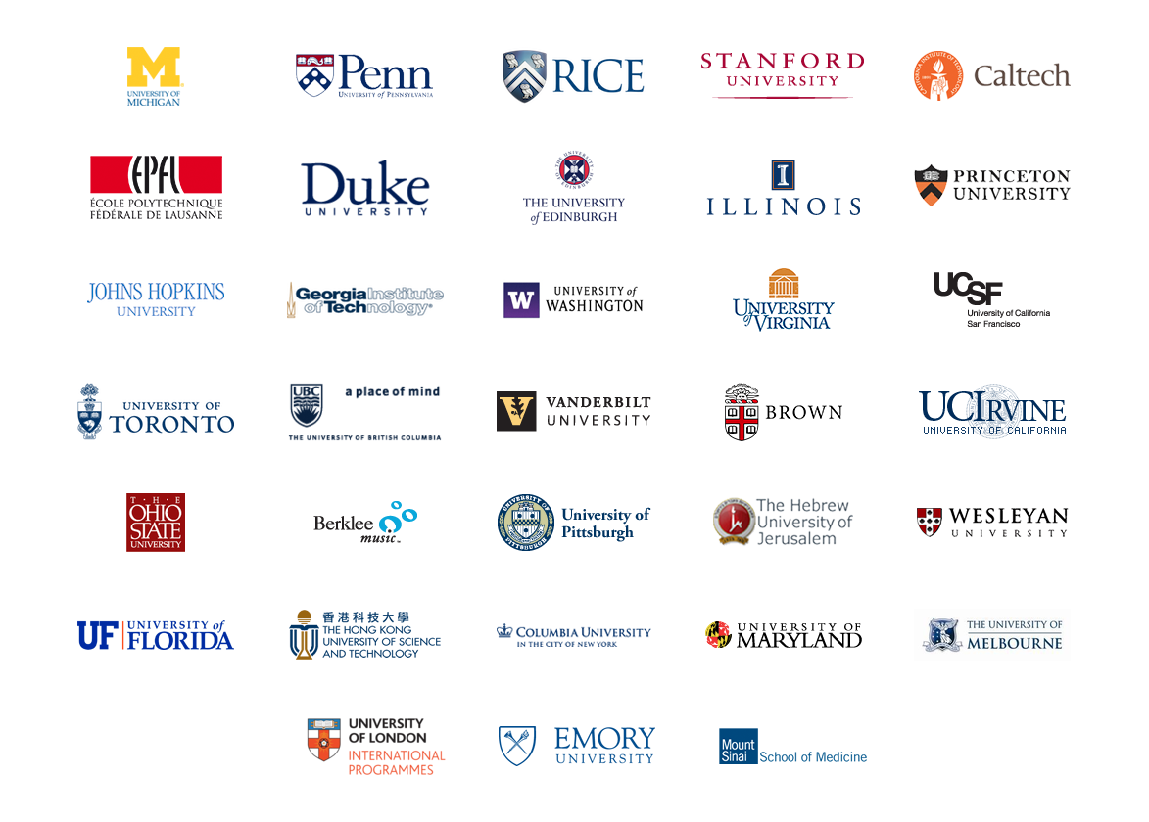
Courses from Top Universities
Notes:
Working with such schools as Princeton, Stanford, Caltech, HKUST [Hong Kong University of Science and Technology] and Columbia, we’re taking courses from these top universities, and putting them online, free for anyone to take. We’re using technology to offer high quality education, at scale.

Slide 3
400
100,000
Notes:
Let me share with you my story. I normally teach a 400 student Stanford class. Last year, I put my class online, and it reached an audience of 100,000 students. To put that number in context, in order to reach a comparable size audience, I would otherwise have had to teach my normal Stanford class for… 250 years.
Who were the students?

Slide 4
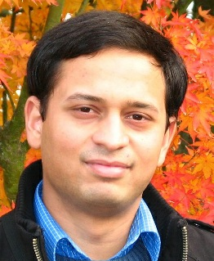
Coming from a middle class family from a small town in India. Never had the luck and guidance to reach Stanford for education. Guess what? God has sent the opportunity right across my door step! Heartfelt thanks to the great team and teachers who made this happen!
(Akash Goswami)
Notes:
It was students like Akash, who write to say that coming from a middle class family in India, he would otherwise never have had access to a Stanford class.

Slide 5
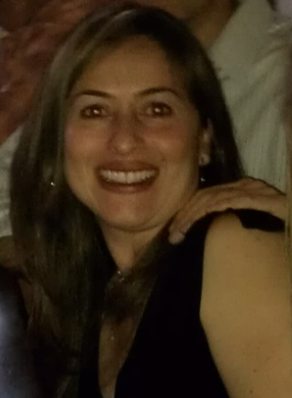
I'm a single mom 39 years old with two college boys... I've been trying to get back to college for my masters and want to learn more about computers. Looking forward to this class!
(Jenny Ramirez)
Notes:
Or Jenny… 39 year old single mother of two, who’s been wanting to go back to college, and for whom an online class allowed here to take the first step.
Since launching the first three classes a year ago, we’ve grown significantly, and now have almost 200 courses, across a range of disciplines. Let me show you some of our classes.

Slide 6

Education at Scale

Slide 7
190 countries
Discussion forum
33 Universities
Video lectures
1.25 million
198 courses
Community
5 million enrollments
1.6 million students
Assessments
Notes:
To report to you our progress: We now have 33 university partners, which allows us to be a hub of innovation, where we and our partners together invent best practices in pedagogy, and quickly share ideas with each other.
We also reached our first million users faster than facebook. Today, with almost 200 courses, and 1.6 million students, we are also by far the largest MOOC, or Massive Open Online Courses, platform.
So… why do all these students want to take our classes?

Slide 8
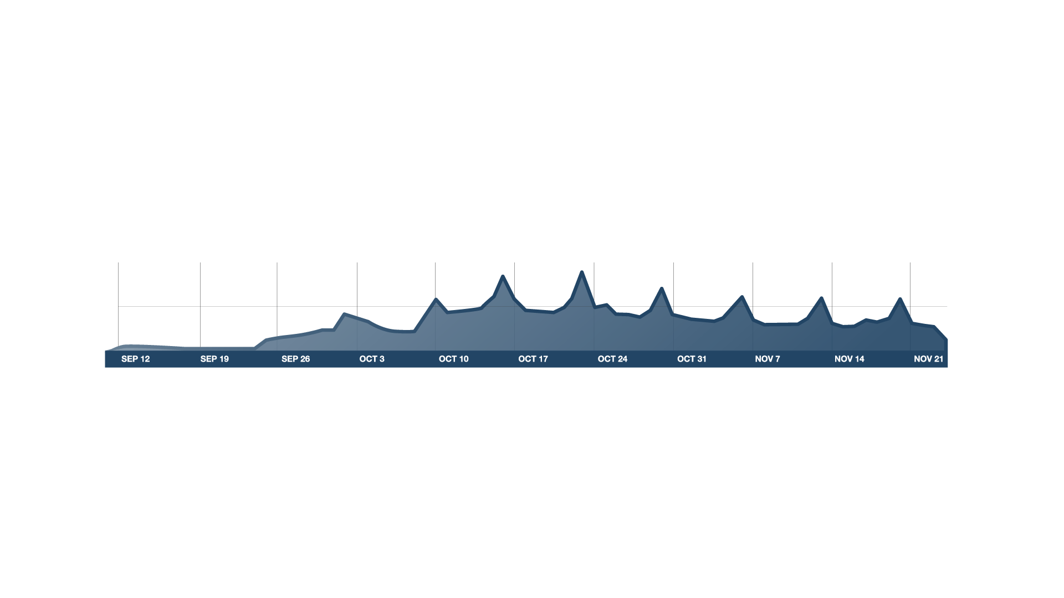

Course Begins
100K
# users on site
50K
v
Timeline
Real Course
Notes:
Well, I think that first and foremost, it’s that these are real courses.
It begins on a certain day. And runs for a fixed period of time—10 weeks in the case of my class—with weekly lectures and homeworks. The figure above is a plot of our web traffic over time. This peaks in the figure---those “heartbeats”---correspond to homework deadlines. Predictably… the 24 hours before a homework deadline, web traffic spikes… thus proving that procrastination is a global phenomenon.
Finally, at the end of the class, if the students completed the homeworks and meet our high grading bar, they also receive from us a certificate or similar, that they can put in their resume, and use to find a better job.
Let me show you what our courses look like.

Slide 9
Video-Based Instruction
Notes:
Notice the accelerated playback—the student is watching the video at 1.5x speed.
We also have english captioning, which is useful for non-native speakers of english.
And also crowd-sourced foreign language captioning. Only some of the courses have Chinese captions, since the captions are written by student volunteers.

Slide 10
Basic Genetics
Refresher (OPTIONAL)
Genes and alleles (7 min)
Modern Genomics
Modern sequencing methods (9 min)
Commercial Genomics
(OPTIONAL)
Mendelian
inheritance
(10 min)
History: The Human Genome Project (7 min)
Genetic testing businesses
(8 min)
What is DNA?
(8 min)
Genomic economics
(9 min)
Protecting privacy (10 min)
Personalized medicine (7 min)
Case study: direct-to-consumer genetics (9 min)
Case study: family planning
(6 min)
Personalized Learning
Notes:
Rather that posting online hour long lectures, we also encourage our instructors to take their content, and break it up into 10 minute chunks. This enables the student to watch the content in bite sized pieces.
The instructor can also post optional prerequisite material, for students that need the extra help, and also post optional advanced material. This format allows the student to navigate the content in their own ordering and at their own pace, thus moving us away from the one-size-fits-all model of education.

Slide 11
Retrieval Practice Improves Learning
"Retrieval Practice Produces More Learning than Elaborative Studying with Concept Mapping."
J. Karpicke, J. Blunt. Science (2011).
Student performance
Study
Repeated Study
Retrieval
Practice
Practice is Critical
Notes:
We know that students learn best not by passively listening, but by practicing with the material.
In this study, which appeared in Science last year, retrieval practice---that is, being tested on the material—was what resulted in by far the best student performance, more so than just study or even repeated study.
Because of this, we pervasively built into our courses many opportunities for students to practice with the material. Let me show you one example, the “in-video” quiz, where right in the middle of the lecture video, the student is asked a question by the instructor.

Slide 12
Interactive Video
Notes:
Here’s what it looks like to a student watching a lecture video.
The video pauses, and the student is asked a question. The student gets to submit an answer… it’s not quite right… so they try again, and get it right. They can also see an optional explanation before the class moves on.
I want to contrast this with my large lecture classes. When I asked a question in my on-campus Stanford class, usually half the students are still madly scribbling away, trying to write down the last thing I said. I find that in my class… about 10% of the students are zoned out on facebook. And invariably, there’s that one smarty pants, sitting on the first row, that just blurts out the answer. Then I feel really good that someone answered my question, and the class moves on.
So… only one student got to attempt an answer. In contrast, in our online courses, the video pauses, the question pops up, and every students gets to attempt an answer. Every student get instant feedback on whether or not they’re understanding the material. I think it’s ironic that a website can therefore be actually more interactive than a large lecture class.

Slide 13
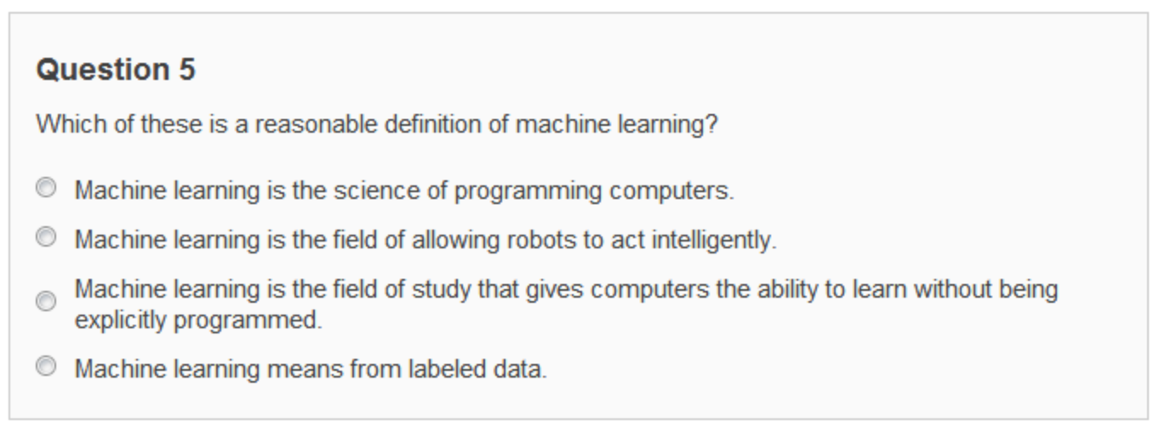
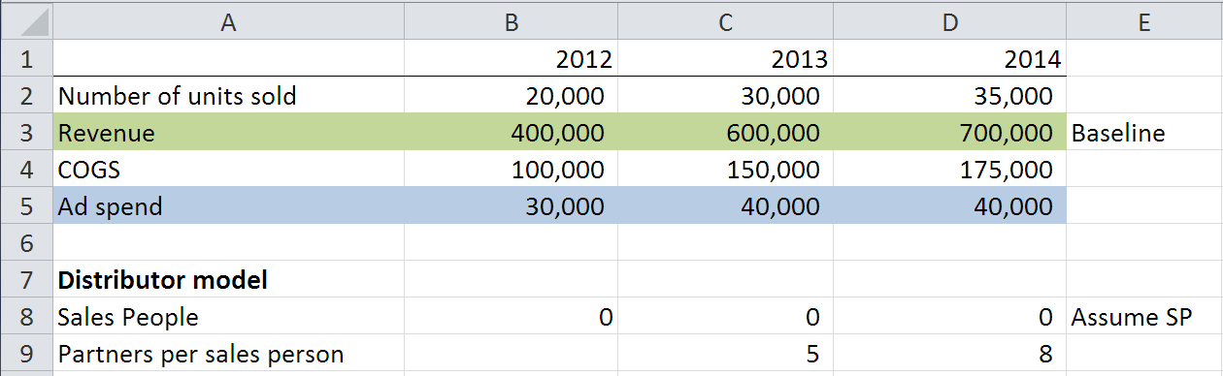
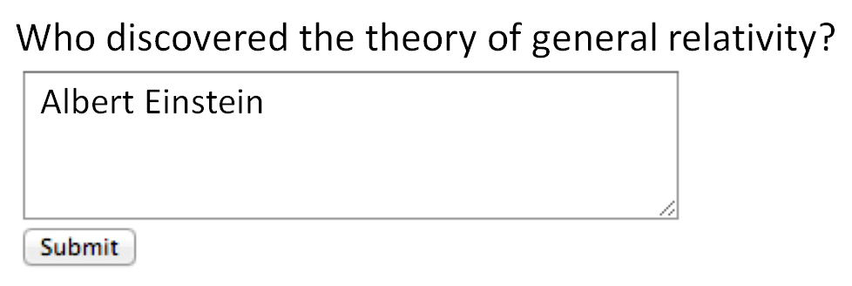
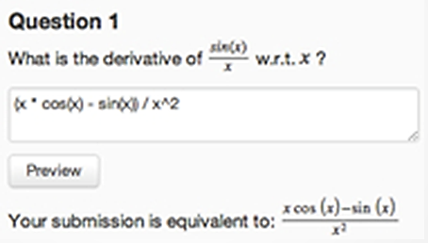
Multiple choice
Short answer (regular expression)
Math expressions
Autograded Homeworks and Exercises

Slide 14
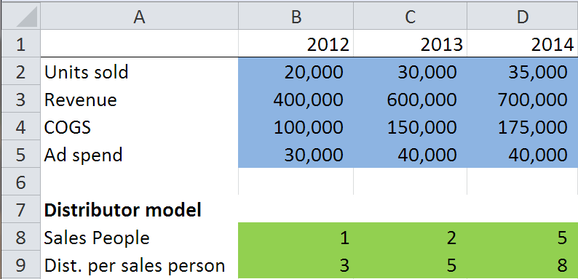
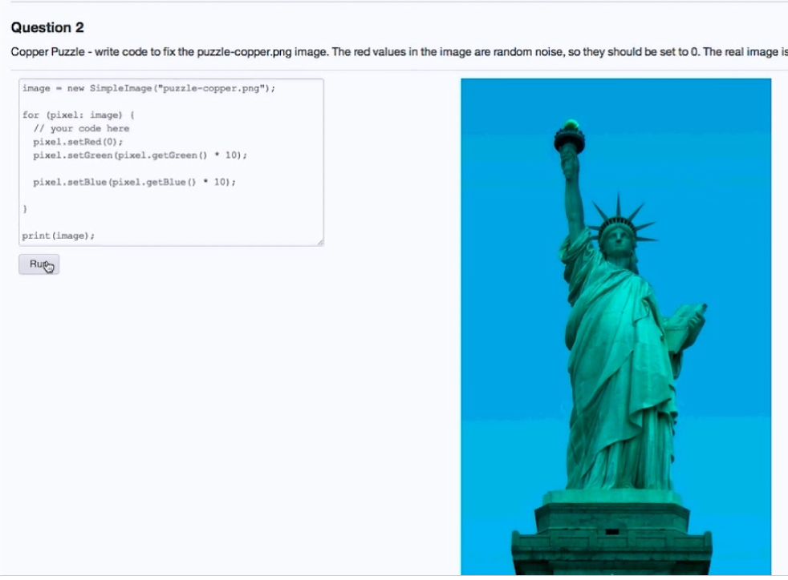
Structured data
Computer programs
Autograded Homeworks and Exercises
Notes:
We also have Open APIs, that allows instructors to grade arbitrary structured data. An example of structured data is a spreadsheet. So, for example, in a finance class you might have an exercise where you ask the students to build a financial model. Because the spreadsheet is a piece of structured data, we can grade it automatically for correct functionality. And similarly, we can ask the student to build models in biology, engineering, and so on as well.
Finally, we also have auto-grading of computer programs, where we test a program or algorithm provided by the student for correctness. Let me show you an example of that.

Slide 15
“The Impact of Self-and Peer-Grading on Student Learning”.
P. Sadler, E. Good. Educational Assessment (2006).
Student Grade
Peer Grade
Self Grade
Teacher Grade
Open-Ended Work
Notes:
Peer grading has been well studied in the education literature, in small classes of say 50 students, where it has been shown that it gives accurate grades. It turns out that self-grades---where students grade their own work---is also very accurate, if you set up the incentives right.
What we did was combine the ideas of peer-grading—which had previously been done in small classes of 50 students—with the idea from computer science of crowdsourcing, and now we’ve run the largest peer-graded exercises in the history of education, with peer-grading in classes of 50,000.
As a student in a class with peer grading, your experience would be that you’d first do the homewok--say, write a 300 word essay on some topic, or whatever. Then, you’d be shown an instructor supplied grading rubric [grading guideline], which teaches you how to grade other students’ work. You’d be asked to demonstrate proficiency in grading—say, by showing that you can assign accurate grades to a small number of homeworks that the instructor had also graded. And finally, you’d be asked to grade say 5 other students’ work, and in exchange, you get feedback from 5 other students about your own work.

Slide 16
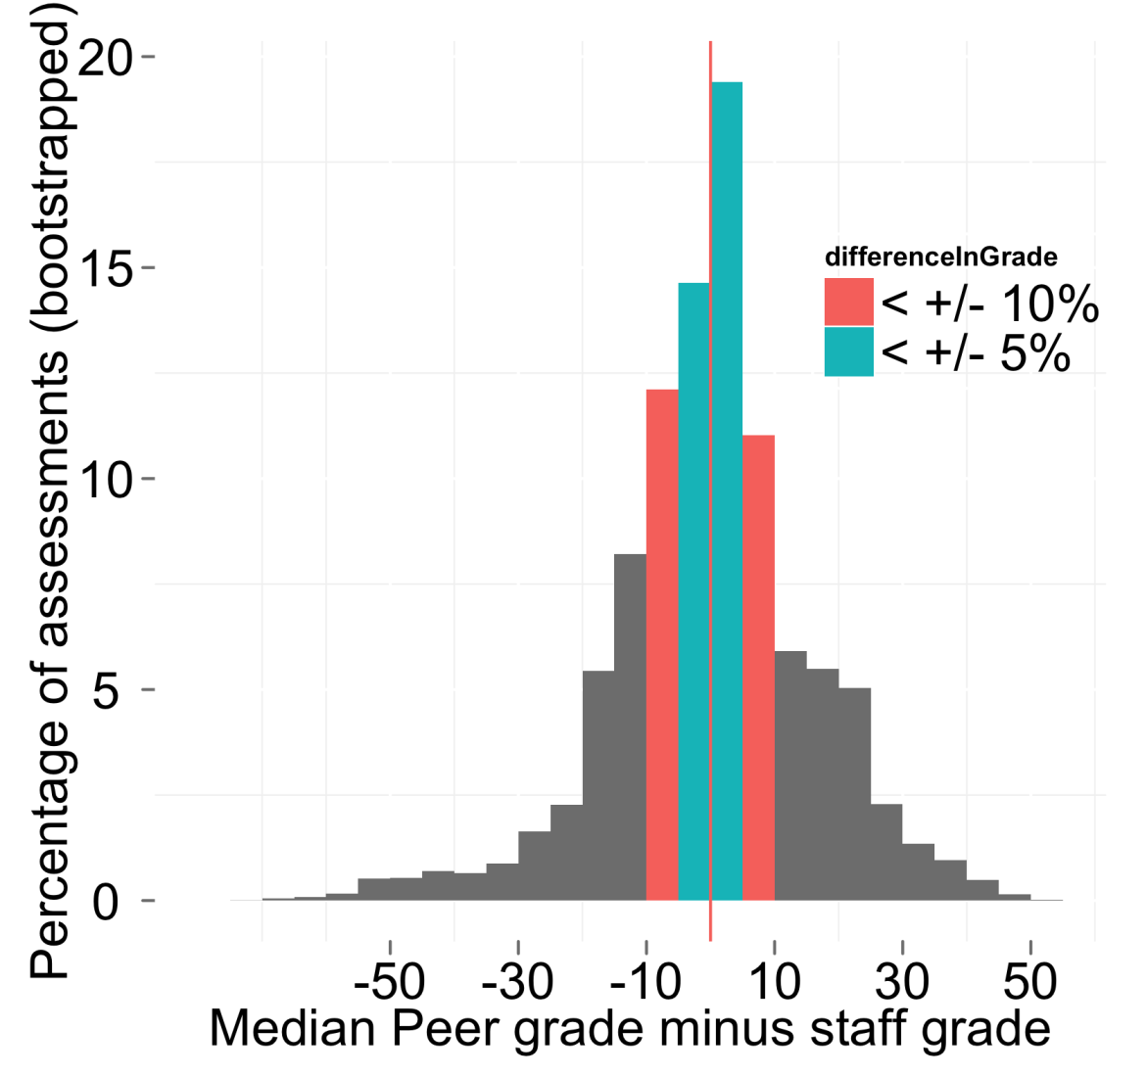
60% within
10% of score
Peer Grading Accuracy
Notes:
In the 7-8 classes that have used peer grading so far, we’ve been able to show that this process is giving highly accurate grades; and this is giving good feedback to students about their work.
Peer grading has been key to enabling us to offer more open-ended exercises. Including design classes where, say, students are asked to draw a design on a piece of paper, take a picture with their cellphone and have that be uploaded to the website for feedback, and other classes with open-ended homeworks.
This, together with our different auto-grading options, has been key to enabling us to offer a broad range of courses…

Slide 17
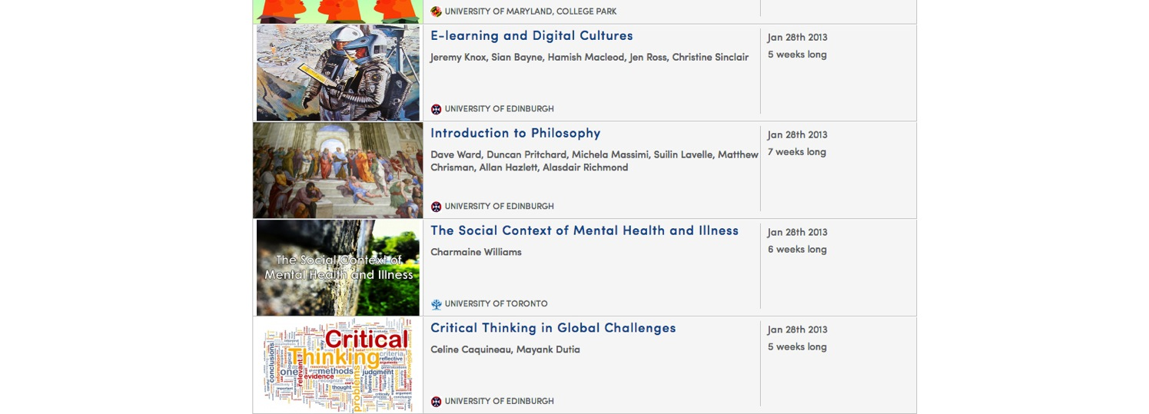
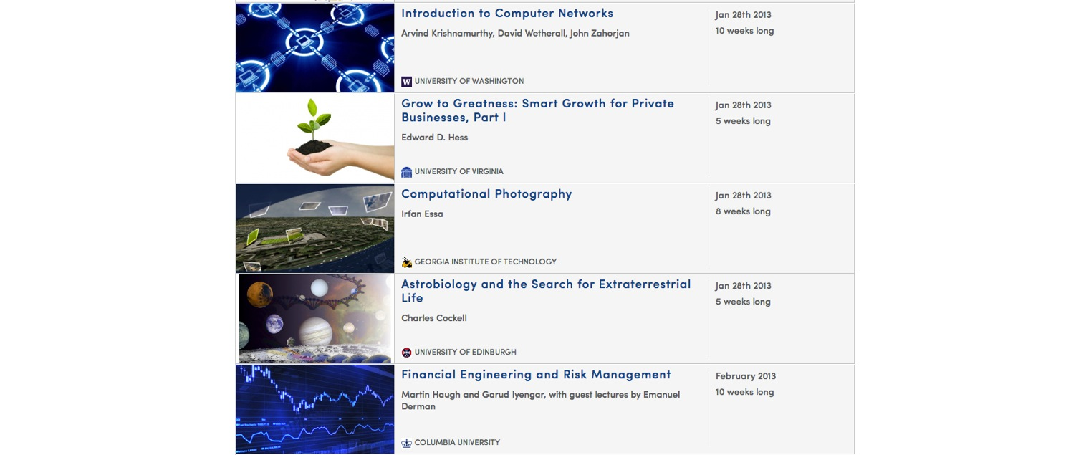
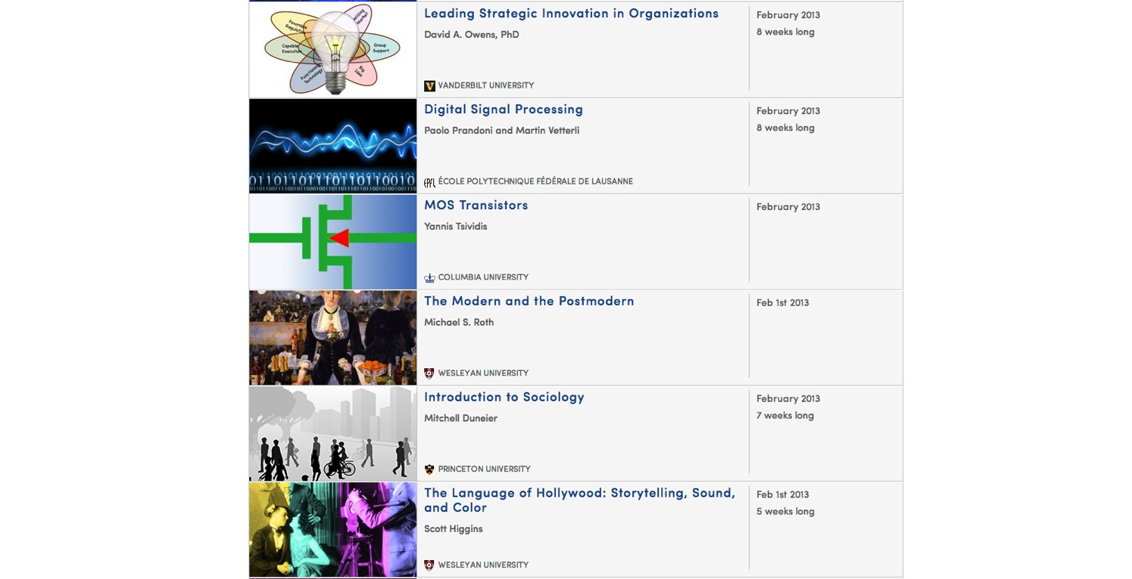
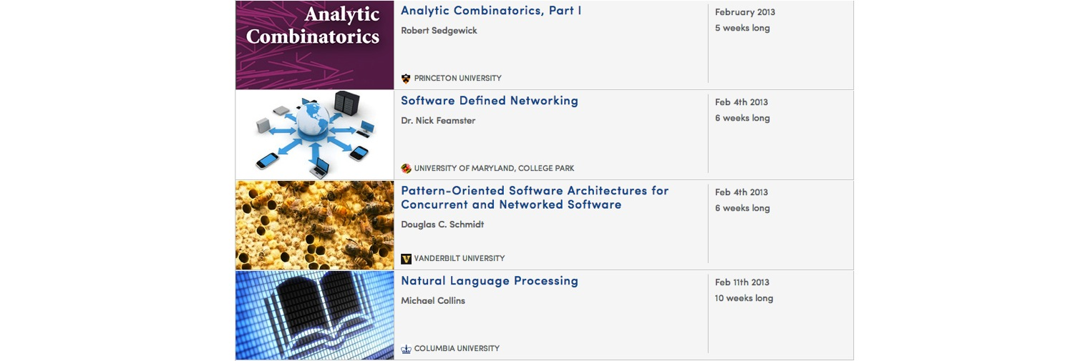
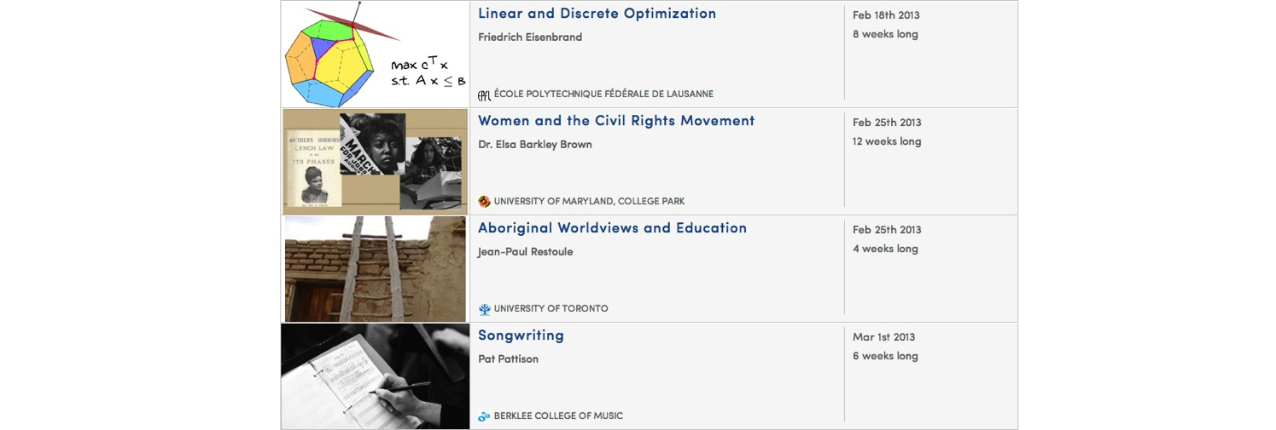
The Humanities, Sciences, Engineering, Business, ….
Notes:
… spanning the humanities, the social sciences, the basic sciences, engineering, computer science, business, law, finance, and other areas.

Slide 18
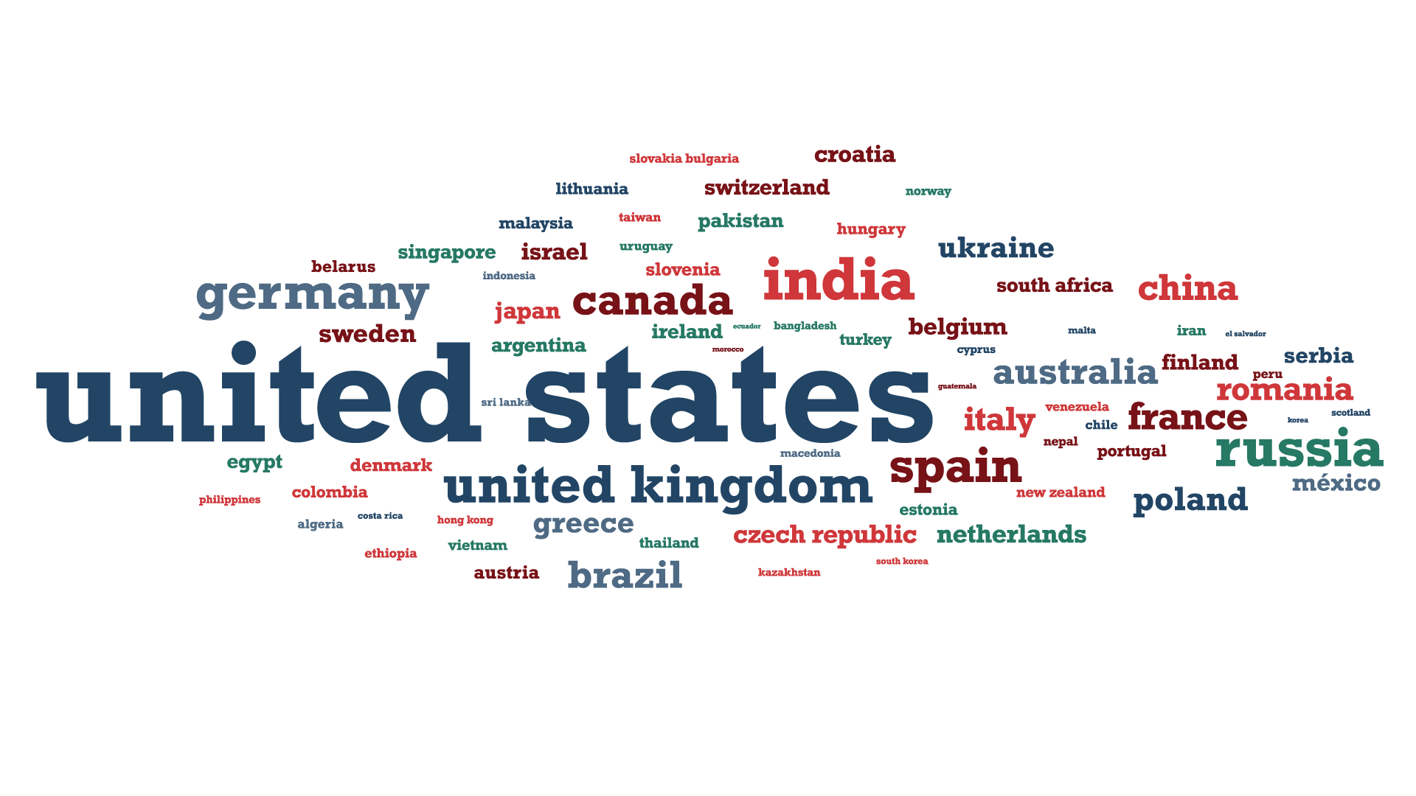
Global Community

Slide 19
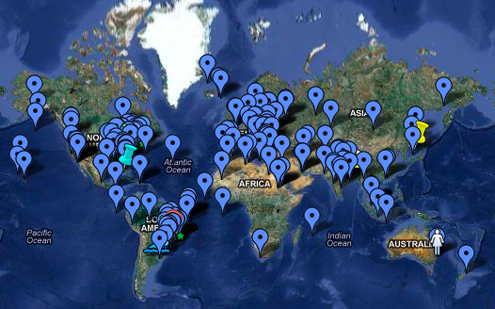
Sociology 101 Student Map
Global community of learners
Notes:
Here’s a map showing the students in the Princeton Sociology 101 class. It turns out that with 100,000 students in a class, it’s much easier to form a community than if you have “only” 100 students. Having 100,000 students also means that no matter what time of day you’re awake thinking about some problem, there’ll be someone in some timezone who’s awake thinking about the same thing as you are, who can talk about it with you.

Slide 20
San Francisco HCI-Class Study Group
Student Study Groups

Slide 21
Individual
Tutoring
Mastery Learning
Lecture
Achievement Score
"The 2 Sigma Problem: The Search for Methods of Group Instruction as Effective as One-to-One Tutoring." B. Bloom, Educational Researcher (1984).
The 2 Sigma Problem

Slide 22
The mind is not a vessel that
needs filling, but wood that
needs igniting.
—Plutarch
from Ian Kidd's translation of Essays
Notes:
To wrap up….
I’ve often been asked: If anyone can now take online Princeton courses for free, why would anyone still pay for a Princeton degree? I think the value of a Princeton education isn’t just the content—instead it’s the interactions with the professors and with other equally bright students. To quote Plutarch: The mind is not a vessel that needs filling, but wood that needs igniting.
I think the value of a Princeton education isn’t just the content. Content is increasingly free on the web anyway. Instead, the real value of attending a top university is the interactions with the professors and with other equally bright students.

Slide 23
"Improved Learning in a Large-Enrollment Physics Class."
L. Deslauriers, E. Schelew, and C. Wieman. Science (2011).
Lecture
Active
Learning
Attendance
Engagement
Learning
Igniting Minds
Notes:
So, most of our partners are using the online courses to give their on-campus students a better education as well. Using what’s come to be called the “flipped classroom”, they’re moving the lecture, or the content conveyal onto a website, and asking the students to watch the lectures from home the week before class. They then come into the classroom already having watched the lecture, and the classroom time can now be used for meaningful discussion, and for the deeper professor-student and student-student interactions, which I think is the real value of attending a top university.
Pedagogical studies such as this one also show that these more active modes of interaction result in much better student outcomes. On every dimension—attendance, engagement, learning—student improves not just by 1-2%, but by something like 30%.
So, we’re using this to improve the quality of education of the on-campus students as well.

Slide 24
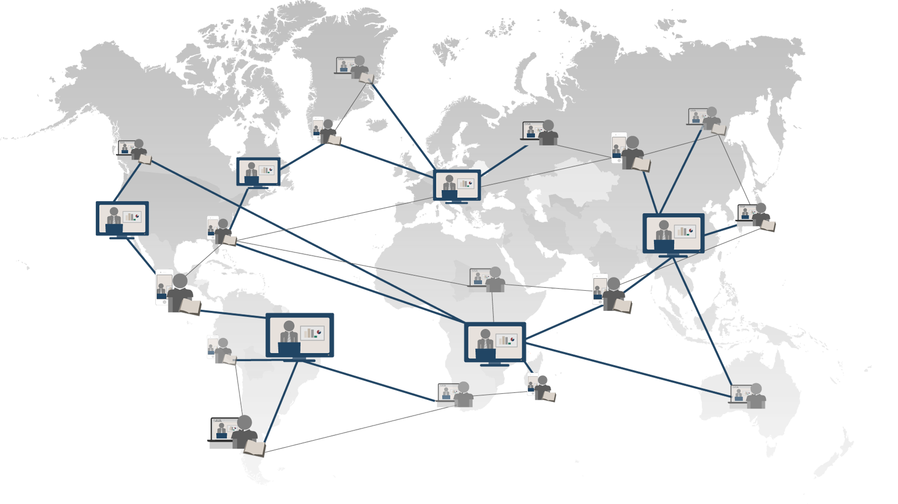
Universal Access to Education
Notes:
Over the last year or so, I’ve visited a lot of countries, and talked to a lot of people about education.
I find that even today…
A lot of people say that a high quality education… is only for the elite.
A lot of people say that a high quality education… is only for the priviledged.
I say that a high quality education… is a fundamental human right.
With technology, we’re working to bring this to everyone.

