Slide 1

The Online Revolution:
Education for Everyone
Daphne Koller & Andrew Ng
Stanford University & Coursera
Notes:
I’m a Stanford professor, and Co-founder of Coursera. Most people today will never have access to a Stanford class. But we’re changing that.

Slide 2

Courses from Top Universities

Slide 3

30 of the top 60 universities worldwide (Academic Ranking of World Universities)
The #1 or #2 ranked university in 14 countries.
Courses from Top Universities

Slide 4
400
100,000
Notes:
What is suddenly possible is to use technology to offer education at scale. This started with 3 courses that Stanford opened to the world in the fall. For example, the machine learning class was taught by my colleague Andrew Ng. Andrew’s ML class is one of the larger at Stanford, with 400 students. Andrew’s public machine learning class had an enrollment of over 100K students. So for Andrew to reach the same audience by teaching his Stanford class, he would have to teach it for … 250 years.

Slide 5
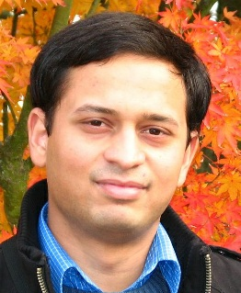
Coming from a middle class family from a small town in India. Never had the luck and guidance to reach Stanford for education. Guess what? God has sent the opportunity right across my door step! Heartfelt thanks to the great team and teachers who made this happen! (Akash Goswami)

Slide 6
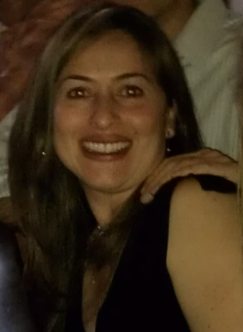
I'm a single mom 39 years old with two college boys... I've been trying to get back to college for my masters and want to learn more about computers. Looking forward to this class!
(Jenny Ramirez)

Slide 7

Education at Scale

Slide 8
190 countries
Discussion forum
62 Universities
Video lectures
1.25 million
333 courses
Community
10 million enrollments
3.2 million students
Assessments

Slide 9
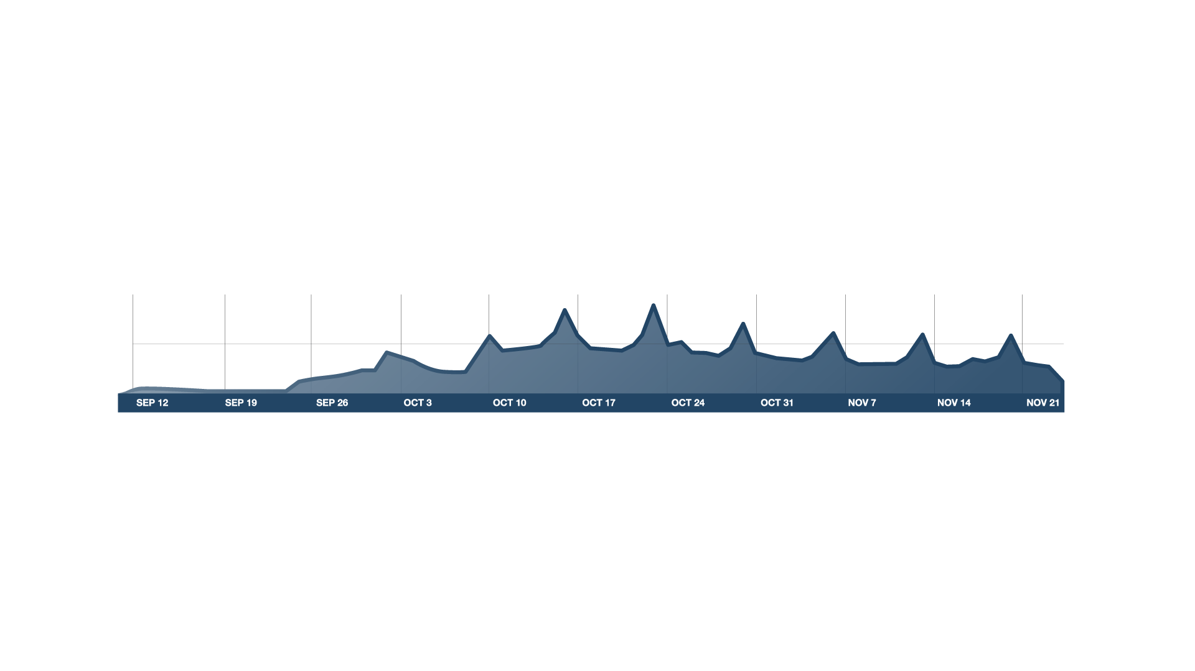

Course Begins
100K
# users on site
50K
v
Timeline
Real Course

Slide 10
video-based instruction

Slide 11
Video-Based Instruction
Notes:
ADD GRAPH?

Slide 12



Sustainability
Health Policy & the Affordable Care Act
Introduction to Sociology
Gamification
Many Different Formats

Slide 13
Basic Genetics
Refresher (OPTIONAL)
Modern Genomics
Genes and alleles (10 min)
Modern sequencing methods (11 min)
Commercial Genomics
(OPTIONAL)
Mendelian
inheritance
(13 min)
History: The Human Genome Project (12 min)
Genetic testing in the commercial world (11 min)
What is DNA?
(12 min)
Genomic economics (8 min)
Protecting privacy (9 minutes)
Personalized medicine (13 min)
Case study: direct-to-consumer genetics (12 min)
Case study: family planning (13 min)
Personalized Learning
Notes:
Let’s talk about some of the key elements that went into these courses. First, when we designs content for the online environment, we can remove the constraints of classroom scheduling, and abandon the monolithic 1hr lecture. The content can be divided into short, coherent modules of 8-12 minutes each, which can be traversed in different ways by different students. Some students might benefit from some additional preparation. Others might want go into depth in certain topics. So we can finally move away from the one-size-fits-all model of education into a much more personalized experience.

Slide 14
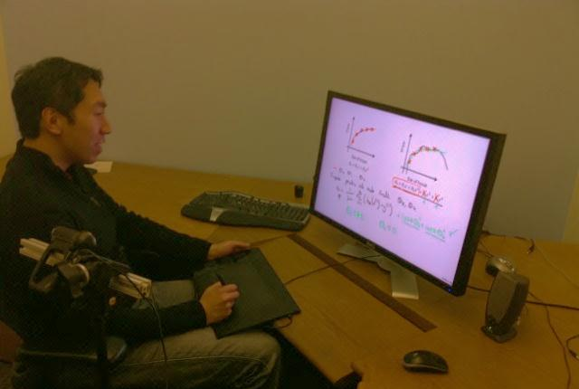
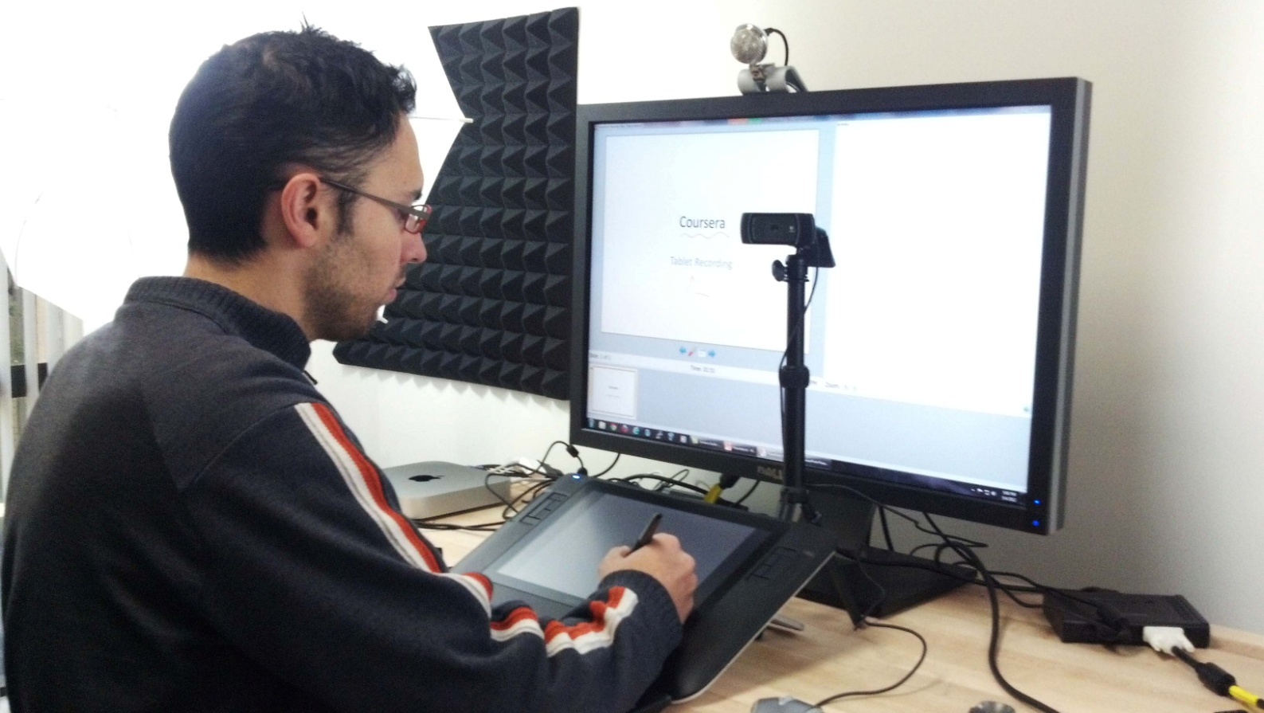
Writing on tablet appears on monitor
Webcam to record instructor
Lecture Recording

Slide 15
ASSESSMENTS

Slide 16
Retrieval Practice Improves Learning
"Retrieval Practice Produces More Learning than Elaborative Studying with Concept Mapping."
J. Karpicke, J. Blunt. Science (2011).
Study
Repeated Study
Retrieval
Practice
Practice is Critical

Slide 17
Interactive Video

Slide 18
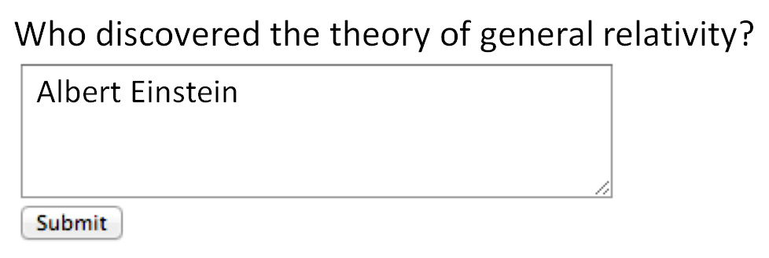
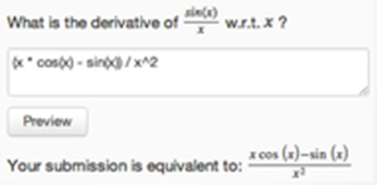
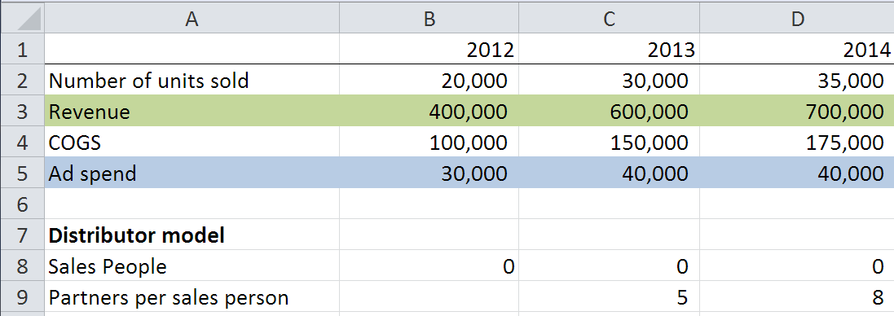
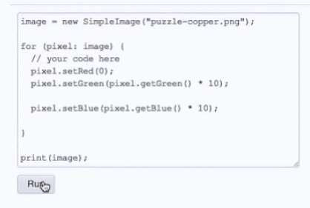
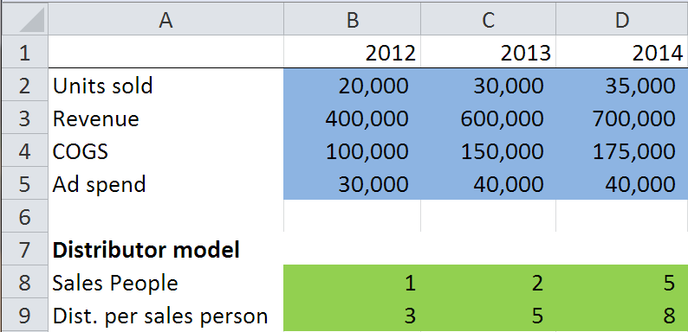
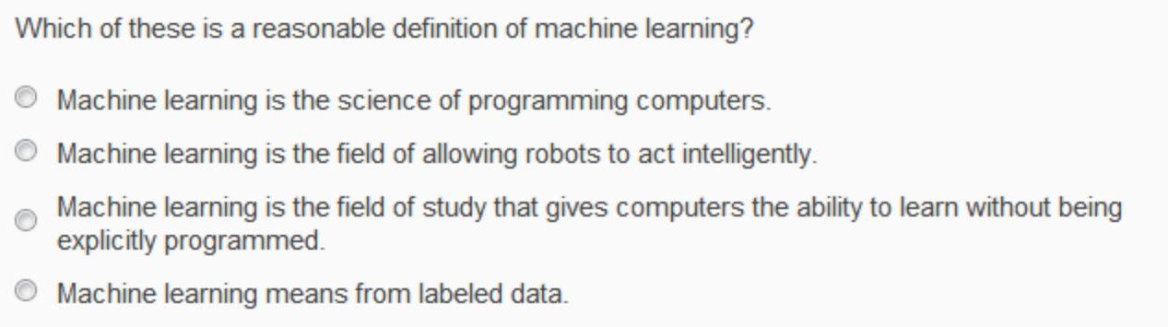
Autograded Homeworks and Exercises

Slide 19
Multiple choice
Short answer (regular expression)
Math expressions
Autograded Homeworks and Exercises

Slide 20
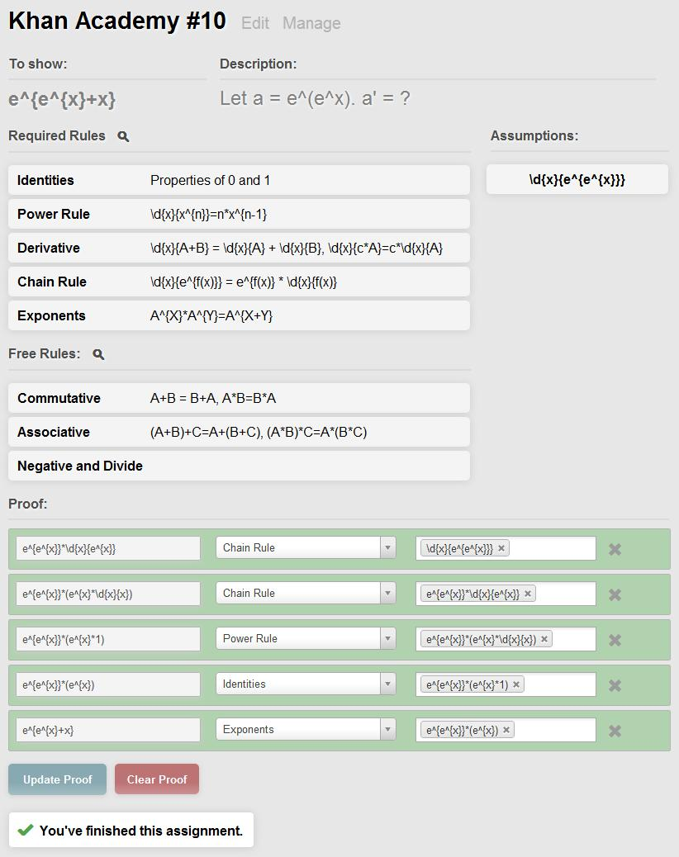
Colleen Lee, Ethan Fast, Alex Aiken
Autograded Homeworks and Exercises
Notes:
Expression equivalence (e.g., a^2 – b^2 = (a+b)(a-b)..)
Theorem proving

Slide 21
Structured data
Computer programs
Autograded Homeworks and Exercises

Slide 22
In-Depth Exercises

Slide 23
Which of the following statements are true? Check all that apply.
Archduke Franz Ferdinand of Austria started WWII.
The allied troops landed in Normandy on D-Day.
WWII started in 1939
Trench warfare was invented during WWII.
Personalization and Mastery

Slide 24
Which of the following statements are true? Check all that apply.
WWII started in 1939
The allied troops landed in Normandy on D-Day.
Archduke Franz Ferdinand of Austria started WWII.
Trench warfare was invented during WWII.
Which of the following statements are true? Check all that apply.
Correct options:
WWII started in 1939
WWII lasted about 6 years
Many troops from the UK fought in WWII.
The allied troops landed in Normandy on D-Day.
Incorrect options:
WWII ended in 1944
Many troops from Switzerland fought in WWII.
Archduke Franz Ferdinand of Austria started WWII.
Trench warfare was invented during WWII.
Which of the following statements are true? Check all that apply.
Many troops from the UK fought in WWII.
WWII ended in 1944
The allied troops landed in Normandy on D-Day.
Trench warfare was invented during WWII.
Which of the following statements are true? Check all that apply.
Many troops from Switzerland fought in WWII.
WWII started in 1939
WWII lasted about 6 years
Archduke Franz Ferdinand of Austria started WWII.
Randomization and Mastery

Slide 25
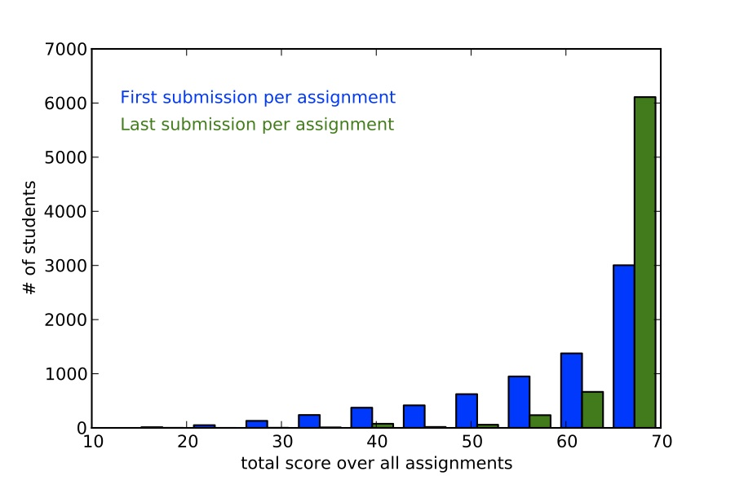
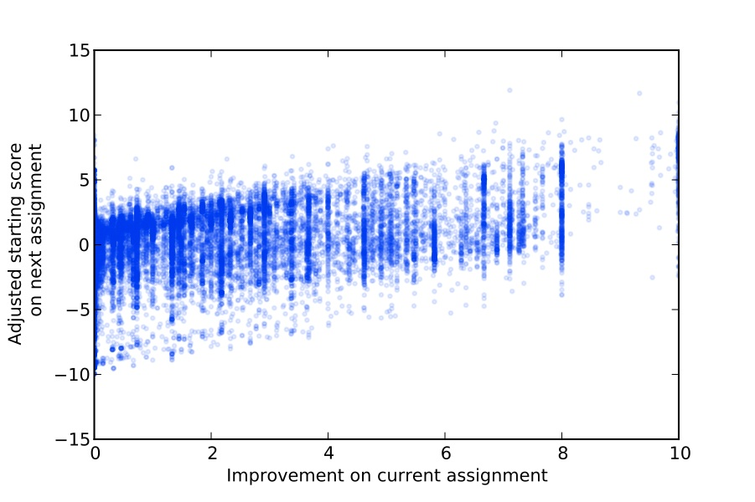
Mastery-based score improvements correlate with future performance
  3 points improvement ⇨ 1 point in next starting score
Martin Odersky
EPFL
Benefits of Mastery (Scala, EPFL)

Slide 26
“The Impact of Self-and Peer-Grading on Student Learning”.
P. Sadler, E. Good. Educational Assessment (2006).
Student Grade
Peer Grade
Self Grade
Teacher Grade
Open-Ended Work

Slide 27
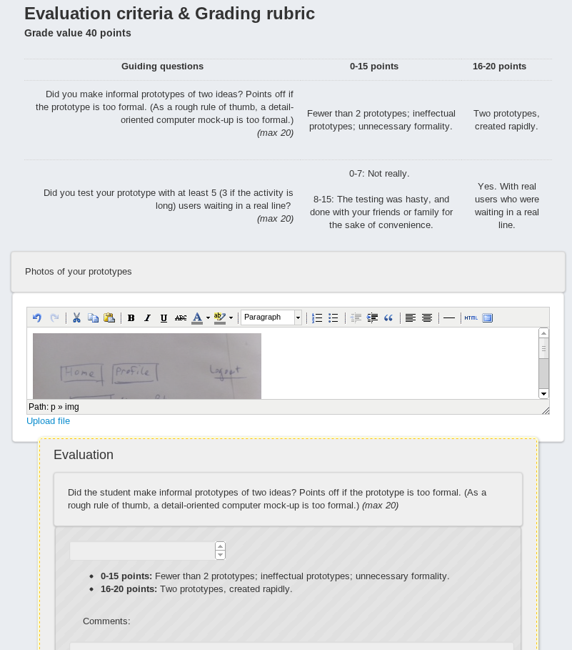
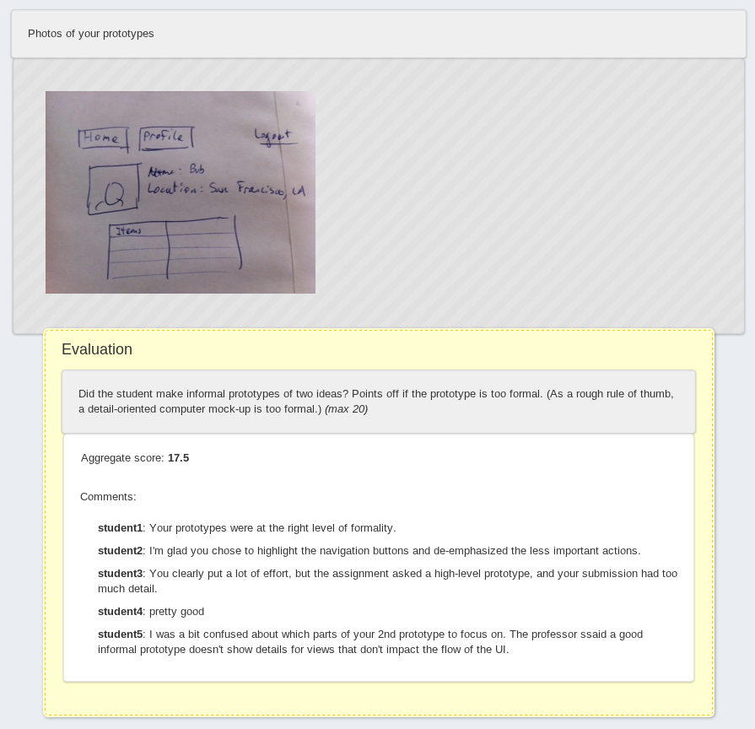
Peer Grading

Slide 28

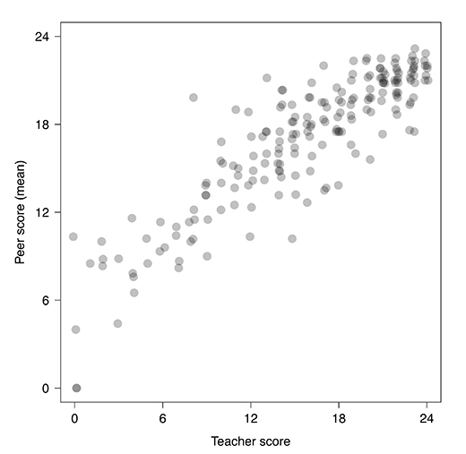
Mitch Duneier
Princeton
Analysis by:
Matthew Salganik & Mitch Duneier
Princeton University Sociology Dept.
Peer Grading Accuracy (Soc101, Princeton)

Slide 29
Mitch Duneier
Princeton
Variance from median
Reviewer’s own score
Peer Grading Reproducibility (Soc101, Princeton)
Notes:
Pie charts need to be redone

Slide 30
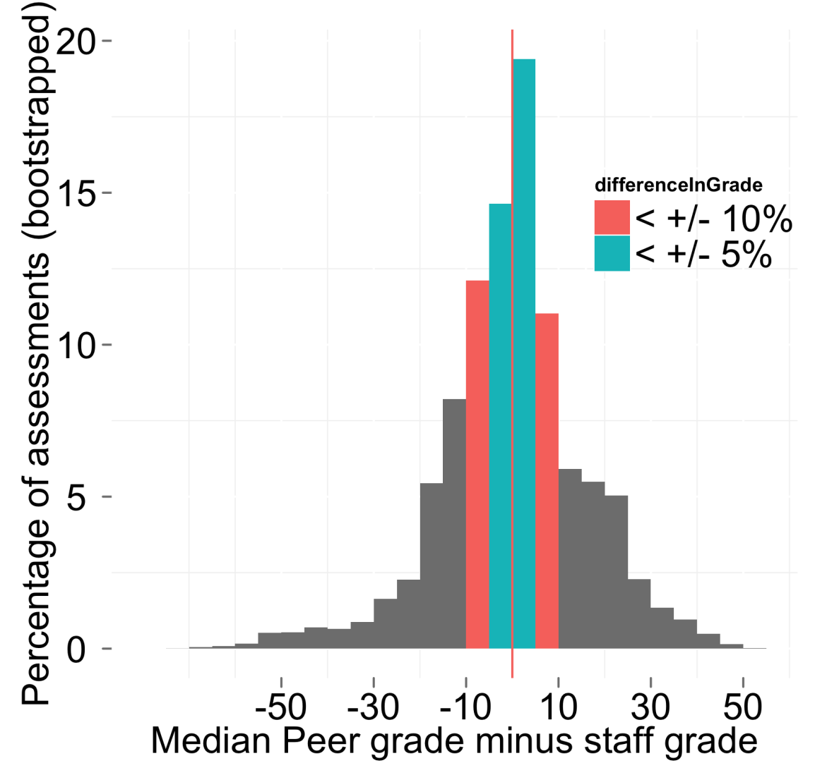
60% within
10% of score
Peer Grading Accuracy (HCI)
Notes:
In the 7-8 classes that have used peer grading so far, we’ve been able to show that this process is giving highly accurate grades; and this is giving good feedback to students about their work.
Peer grading has been key to enabling us to offer more open-ended exercises. Including design classes where, say, students are asked to draw a design on a piece of paper, take a picture with their cellphone and have that be uploaded to the website for feedback, and other classes with open-ended homeworks.
This, together with our different auto-grading options, has been key to enabling us to offer a broad range of courses…

Slide 31
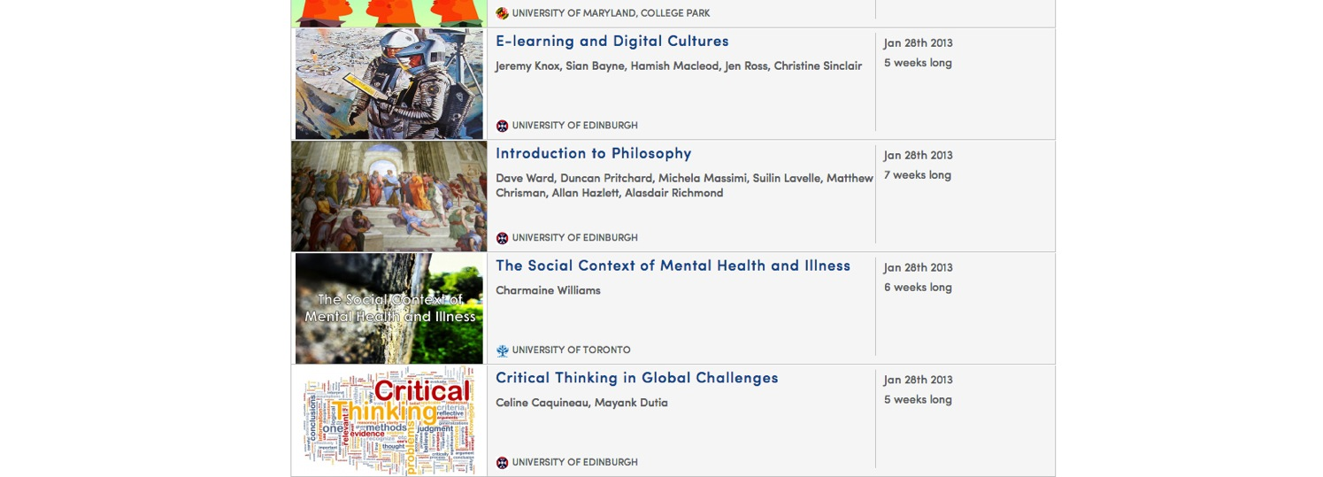
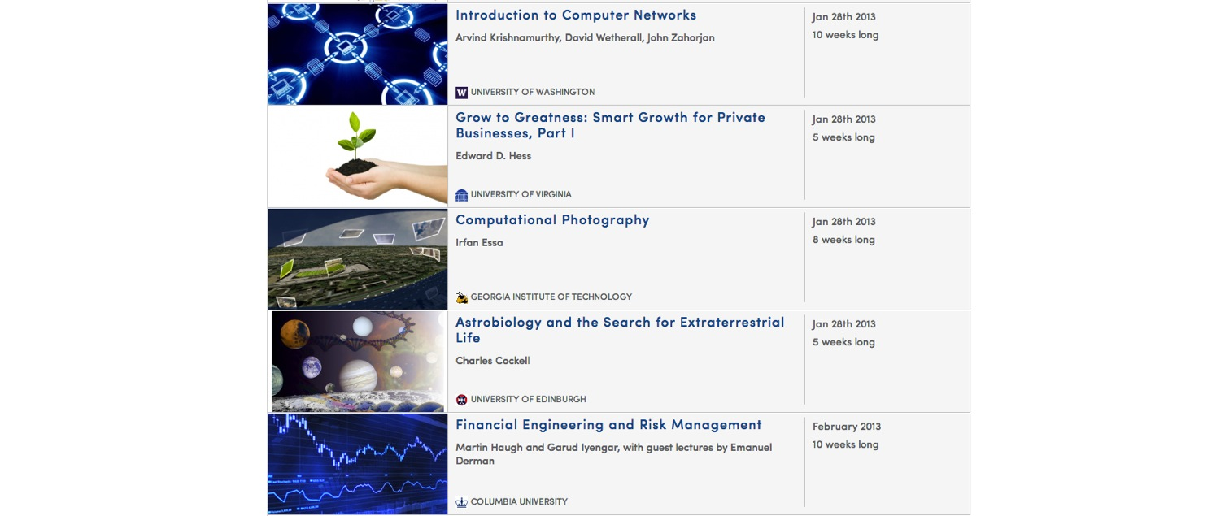
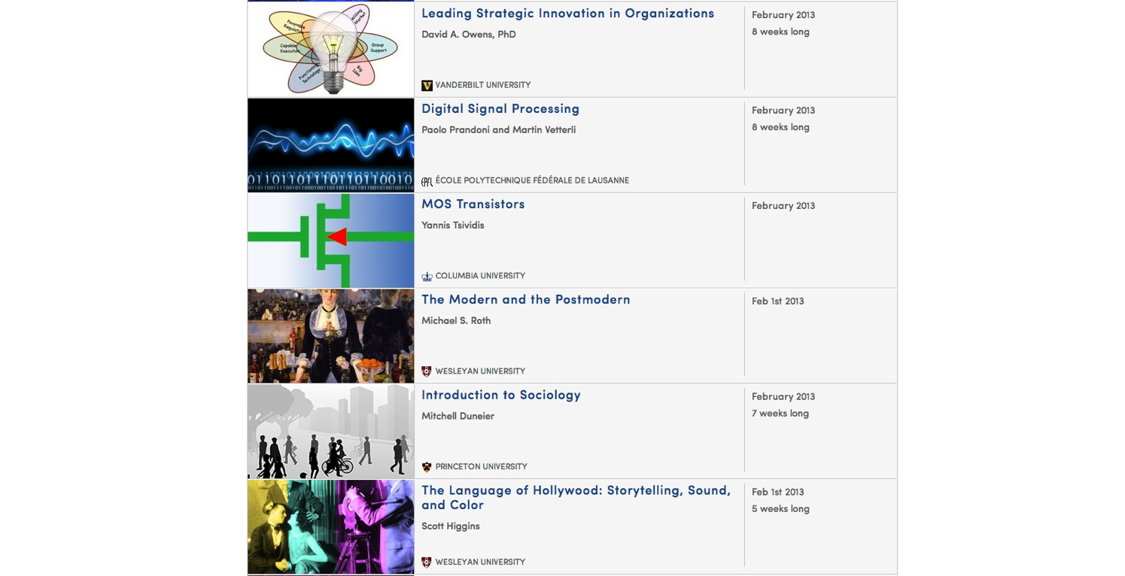
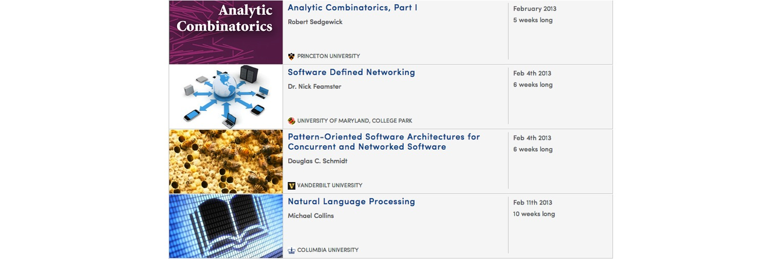
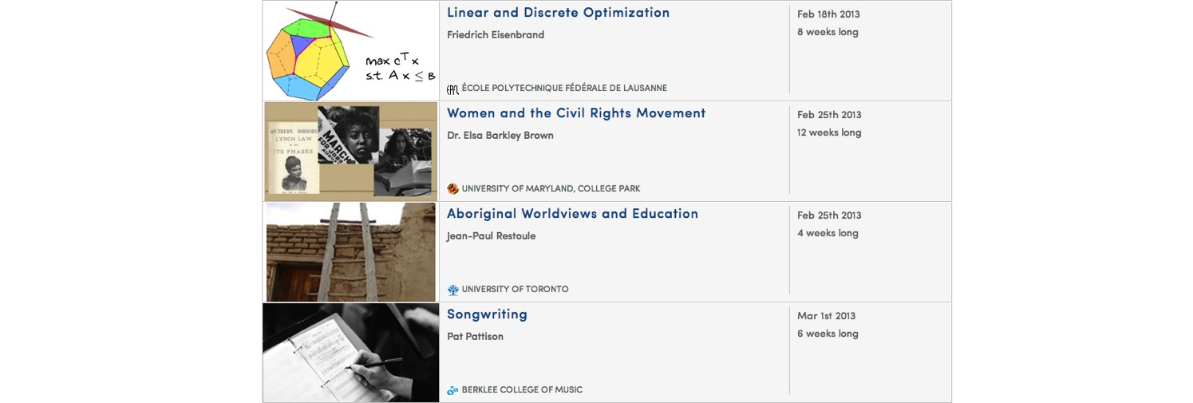
The Humanities, Sciences, Engineering, Business, ….

Slide 32
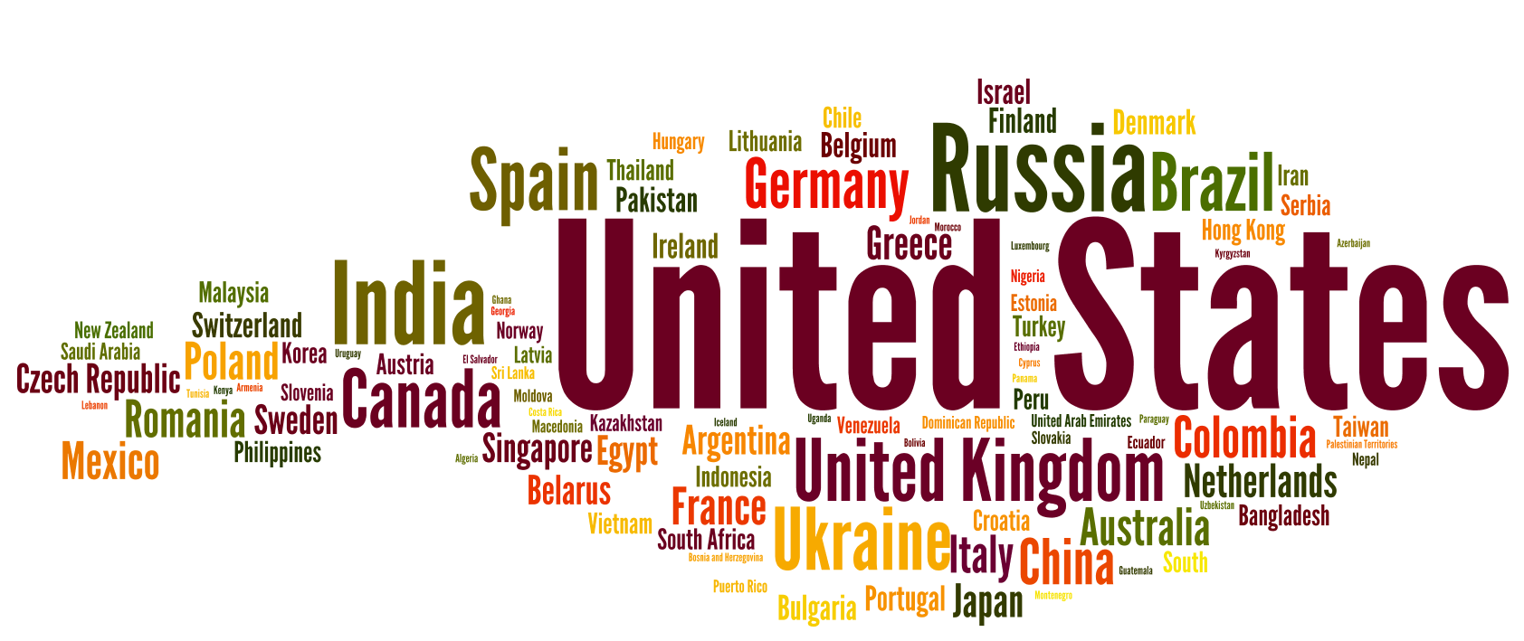
Community
** font size proportional to sqrt(number of participants)

Slide 33
Non-Traditional Population
Notes:
Pie charts need to be redone

Slide 34
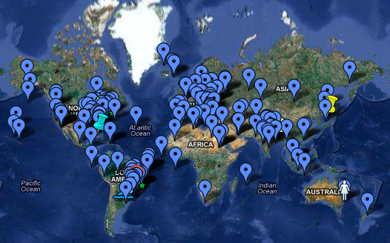
Sociology 101 Student Map
Global community of learners

Slide 35
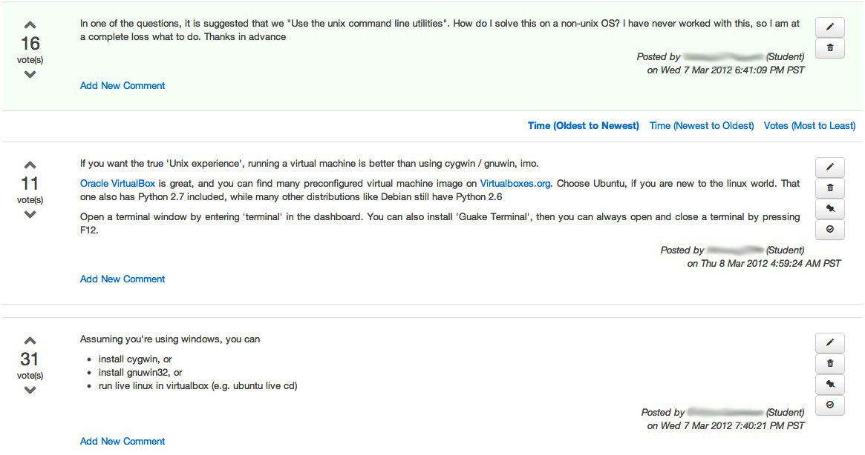
Students
Discussions

Slide 36
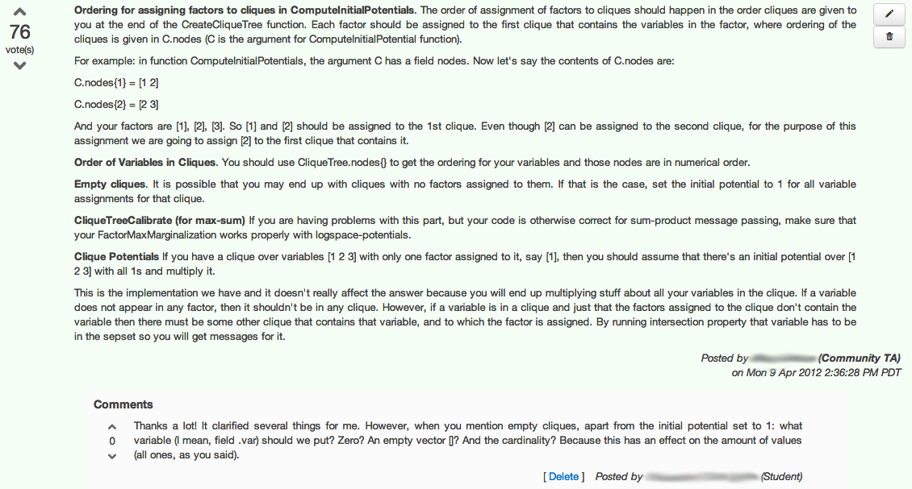
Community TA
Community TAs

Slide 37
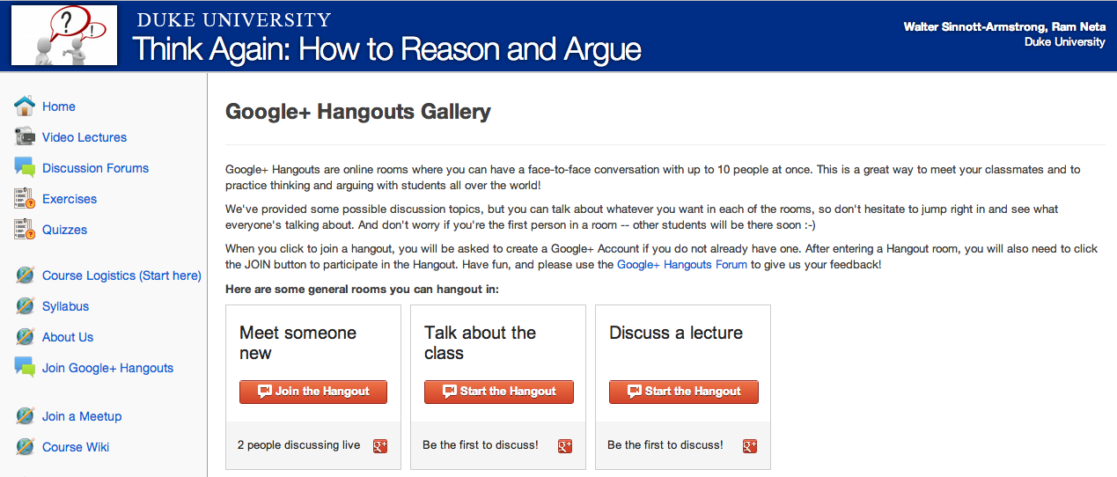
Live video chat

Slide 38
San Francisco HCI-Class Study Group
Student Study Groups

Slide 39
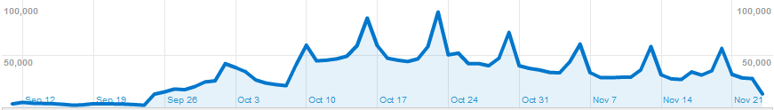
STATISTICS
& Analytics
First lectures
posted

Slide 40

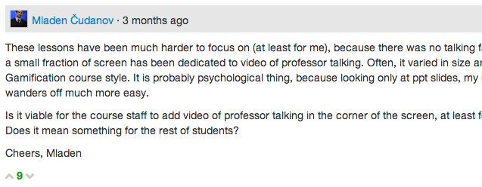

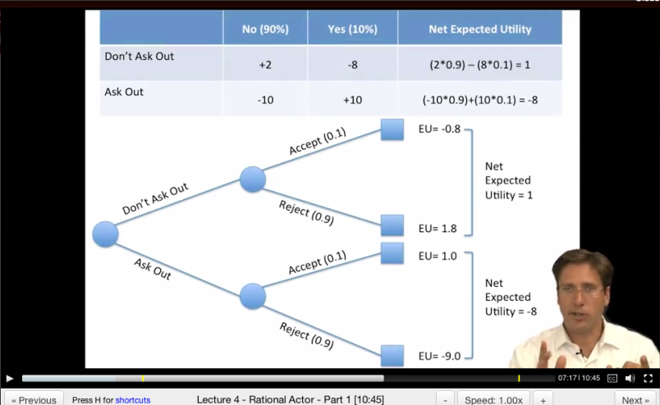
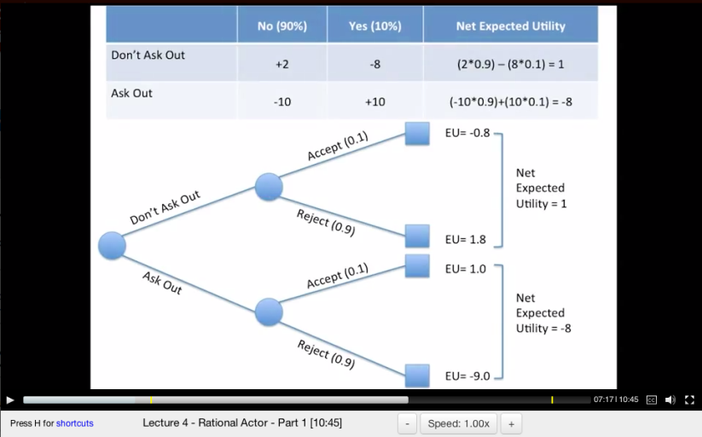
“These lessons have been much harder to focus on (at least for me), because there was no talking face.”
Dan MacFarland
https://class.coursera.org/organalysis-2012-001/forum/thread?thread_id=117&post_id=914
Student Group A
Student Group B
Data: Learn how students learn

Slide 41
Identify the forum discussion thread which is most likely to cause a student to correct misconception.
Experimental setup:
“incorrect” submission
“incorrect” submission
Final “correct” submission
Submission timeline
Forum visits
[Jon Huang]
New Window into Human Learning

Slide 42
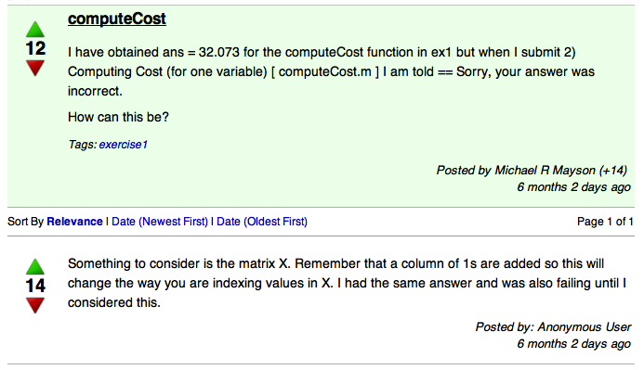
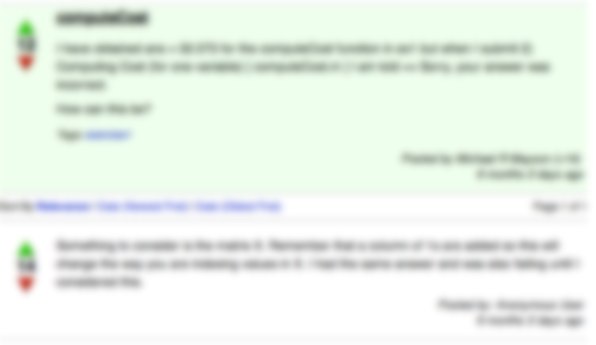
Most helpful forum discussion thread:
- Chance of correcting misconception if viewed: 64%
- Chance of correcting misconception if not viewed: 34%
- Improvement by viewing: 30%
[Jon Huang]
What helped the most?

Slide 43
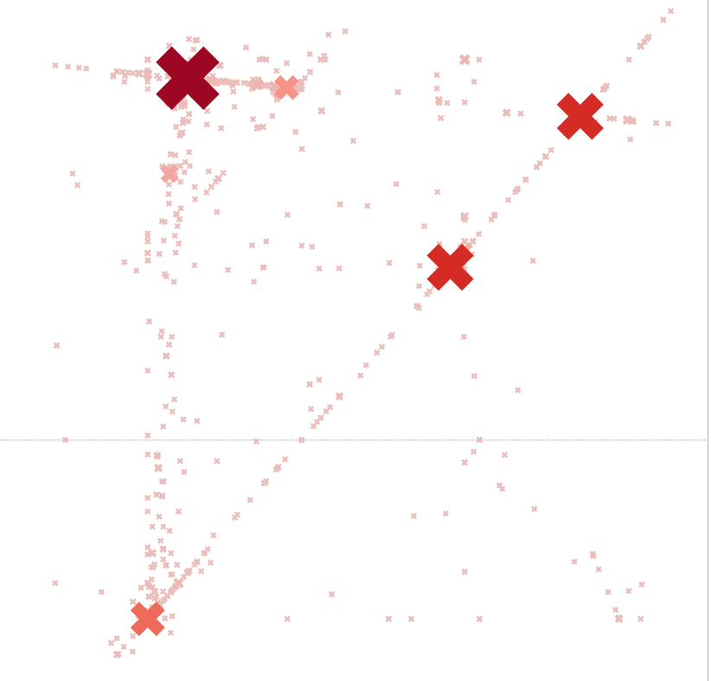
Wrong answers submitted for machine learning class
programming assignment
New Window into Human Learning
Notes:
ON HOLD

Slide 44
Individual
Tutoring
Mastery Learning
Lecture
Achievement Score
"The 2 Sigma Problem: The Search for Methods of Group Instruction as Effective as One-to-One Tutoring." B. Bloom, Educational Researcher (1984).
The 2 Sigma Problem

Slide 45
IMPACT

Slide 46

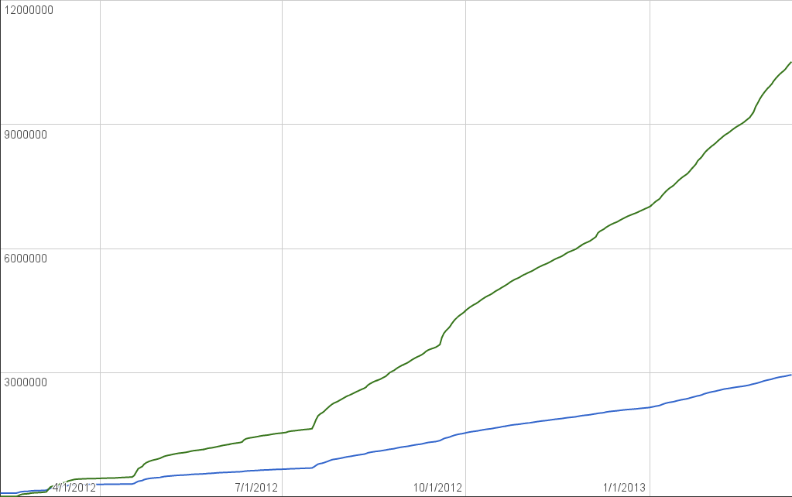





3.1 million students
20 Feb
Intl Partnerships
Enrollments
Users
9 Jan
Signature Track
19 Sept
Partnership Announcements
17 July
Partnership Announcements
18 April
Launch
Over 3m Students

Slide 47
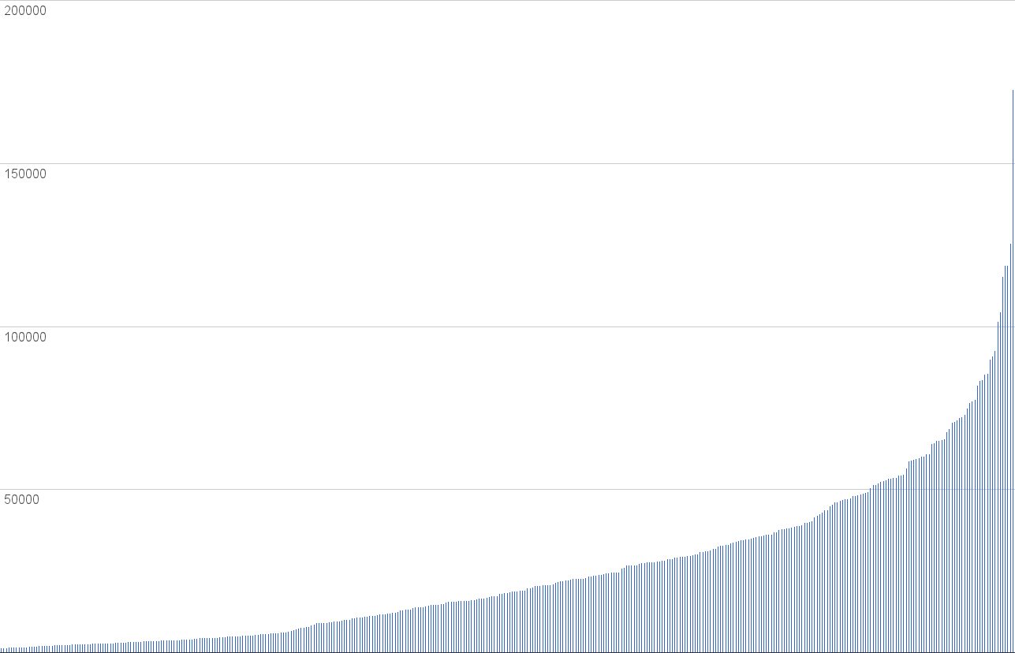
Think Again: How to Reason and Argue
180K
Introduction to
Finance
Learn to Program, Operations Management Algorithms
Design, Human Physiology, Sustainability
Gamification, Behavioral Econ,
How Things Work,
World Music,
Social Psychology
Discrete Optimization,
Planet Earth,
Equine Nutrition
Org. Chem, Law, Analyse Numérique pour Ingénieurs
Enrollment Distribution
Notes:
186179 Enrollments for Think Again --- the biggest class ever conducted in human history (world records?)

Slide 48
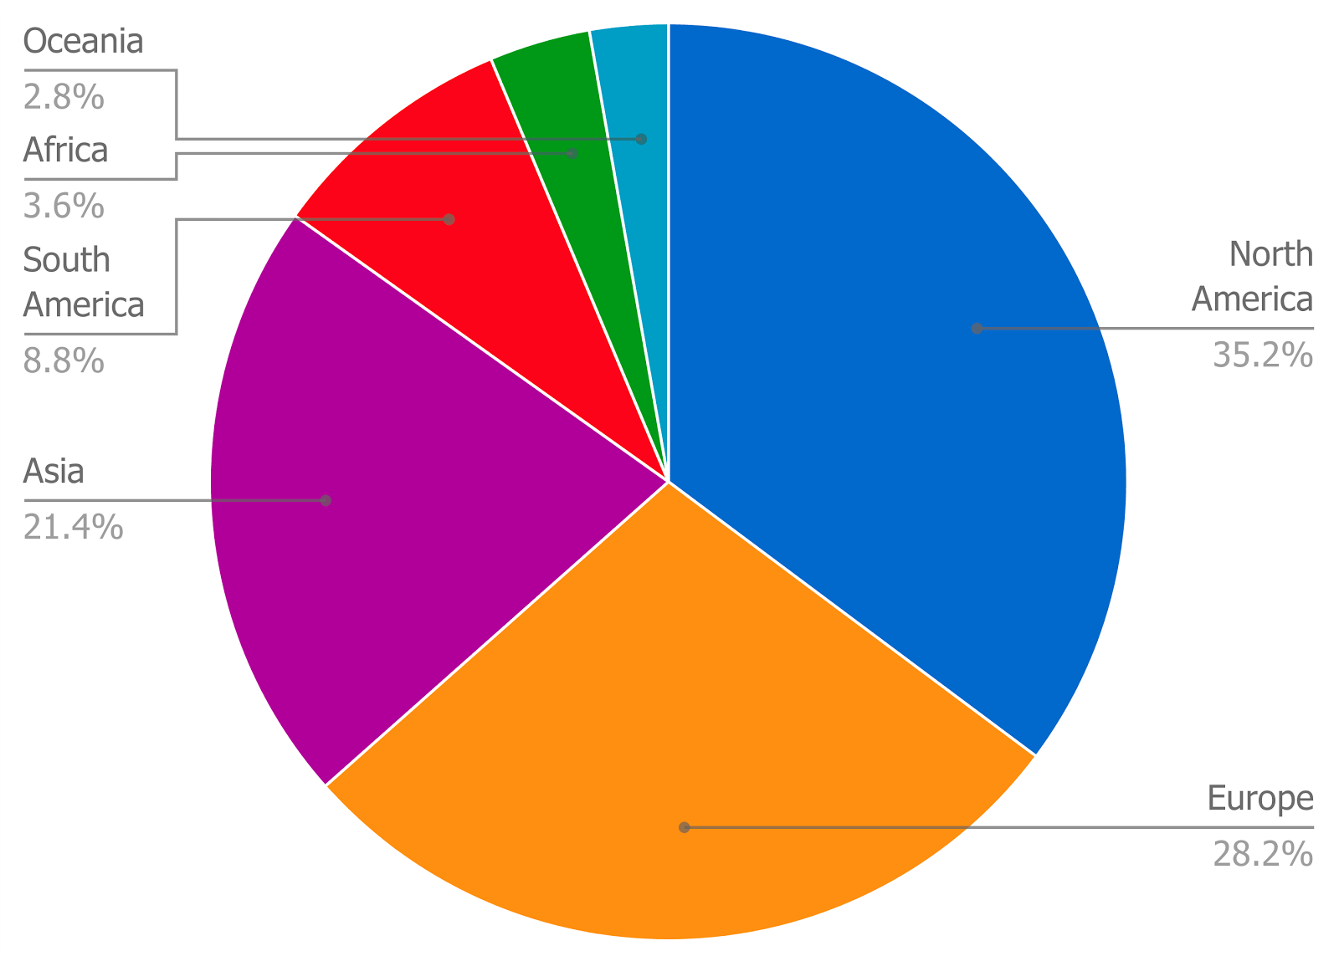
40% of users in the developing world
Comparison: 80% of Khan Academy users are in the US.
Global Reach

Slide 49
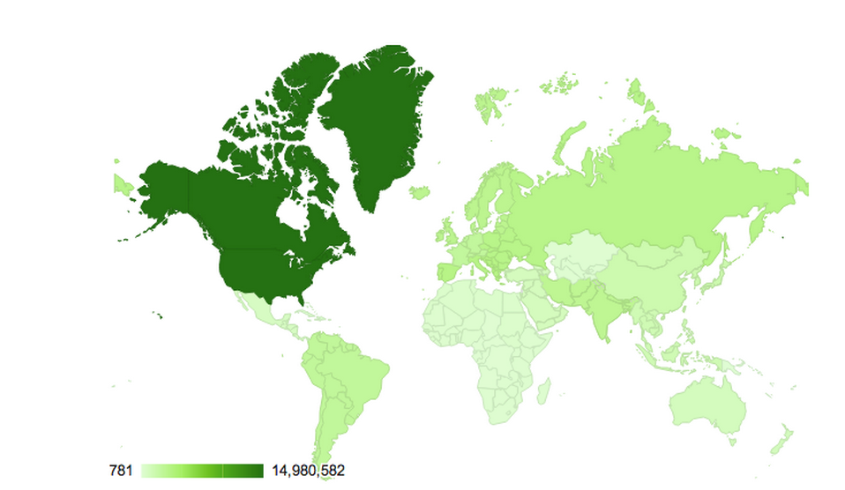
Reach in Developing World
(Jan-Mar 2013):
33% of total visits
3.8M unique visits
India: 665,800 uniques
Africa: 250,000 uniques
  biggest countries: Egypt, South Africa, Ethiopia, Algeria
Southeast Asia: 407,483 uniques
  biggest countries: Philippines, Thailand, Vietnam
South & Central America: 407,483 uniques
  biggest countries: Brazil, Chile, Argentina, Colombia, Ecuador, Peru, Venezuela, Bolivia
Global Reach

Slide 50
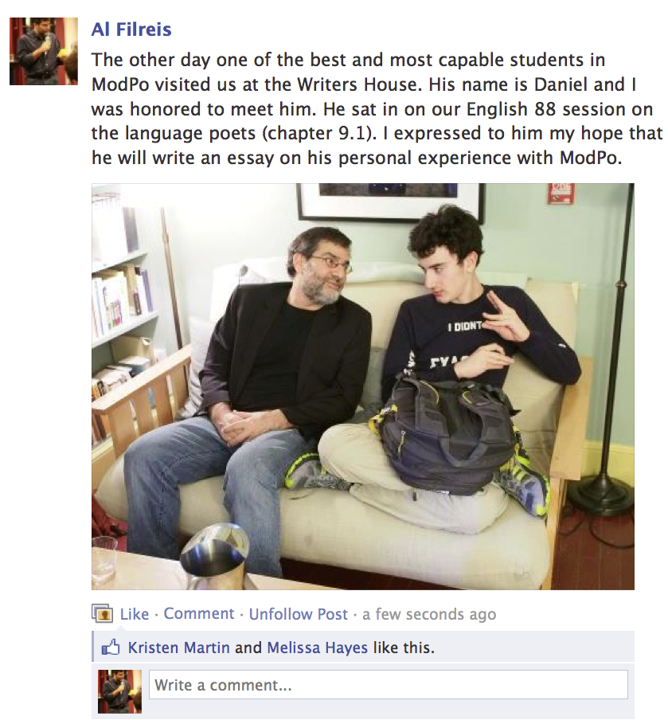
I grew a lot from answering the longer quizzes and wrestling with the complex essay grading rubrics… you are not only allowing autistic people to learn, but actually diminishing the severity of the illness itself. (Daniel Bergmann)

Slide 51
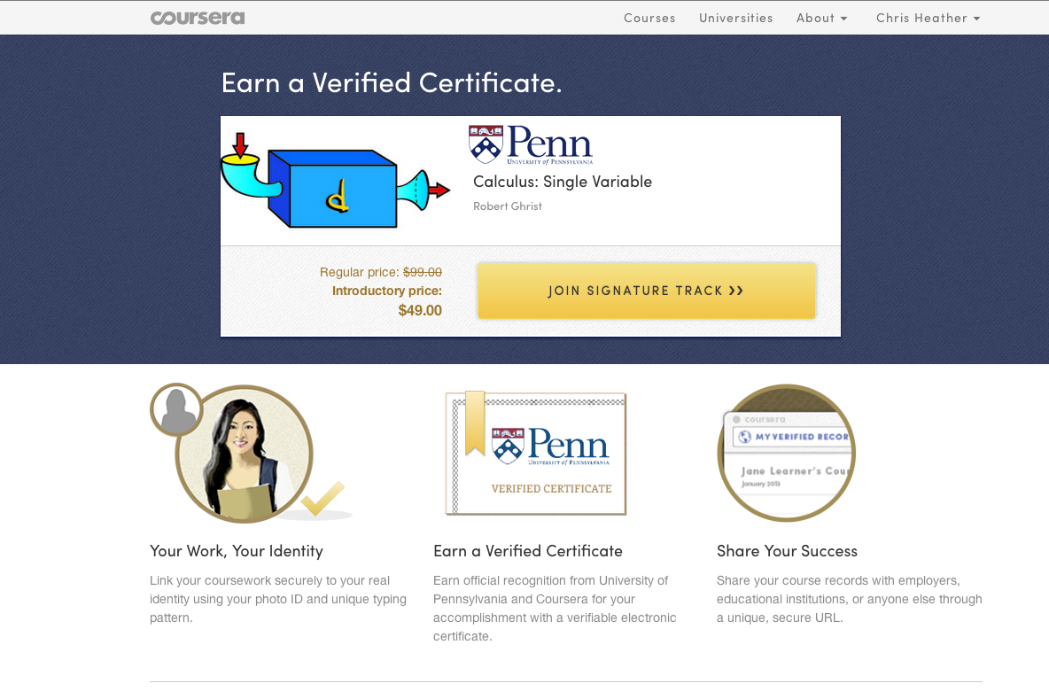
Signature Track
Notes:
: Identity verification through photo IDs, webcams and unique typing patterns
Ranges shown are inter-quartile ranges across completed classes.

Slide 52
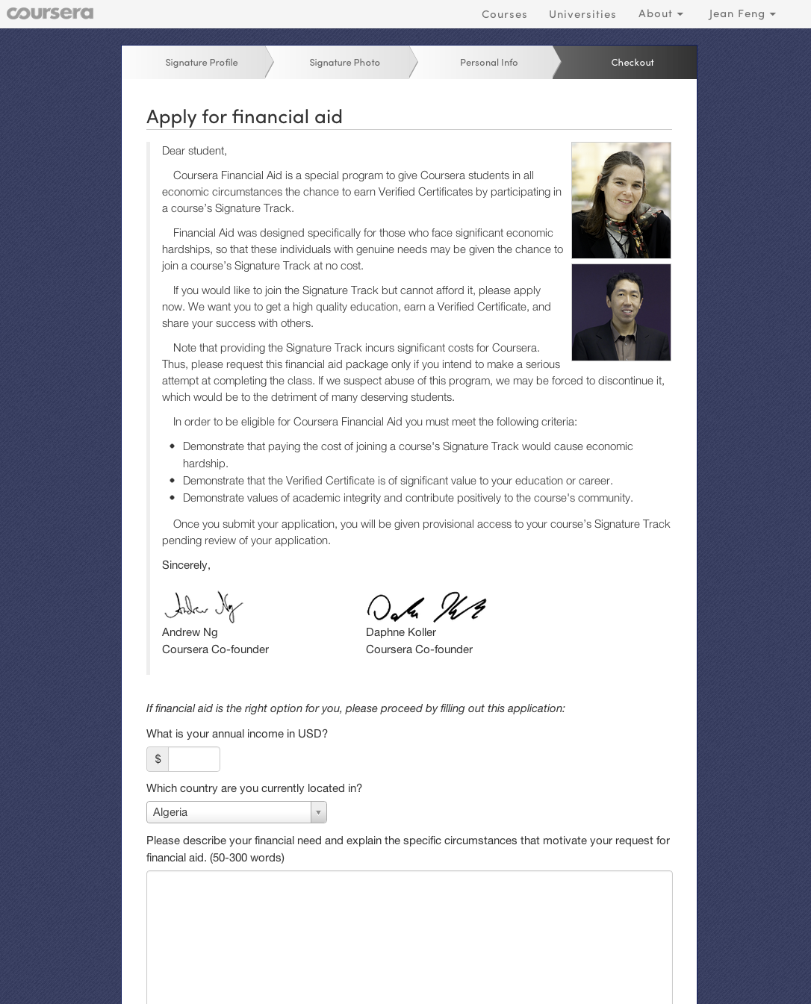
Over 1,000 applications accepted
A physician from Egypt planning to teach Nutrition for Health Promotion and Disease Prevention in her village despite a disorganized Ministry of Health
A Bangladeshi professional studying Global Sustainable Energy to improve the 53% access to electricity in Bangladesh
A student from Chile taking Neurons, Synapses and Brains to prepare to apply for a PhD in Huntington’s disease research
A young Pakistani working at a public policy think-tank applying Model Thinking concepts to understand the rise of political factions in Pakistan
Financial Aid

Slide 53
Instructor
INTERFACEs

Slide 54
Writing on tablet appears on monitor
Webcam to record instructor
Lecture Recording

Slide 55
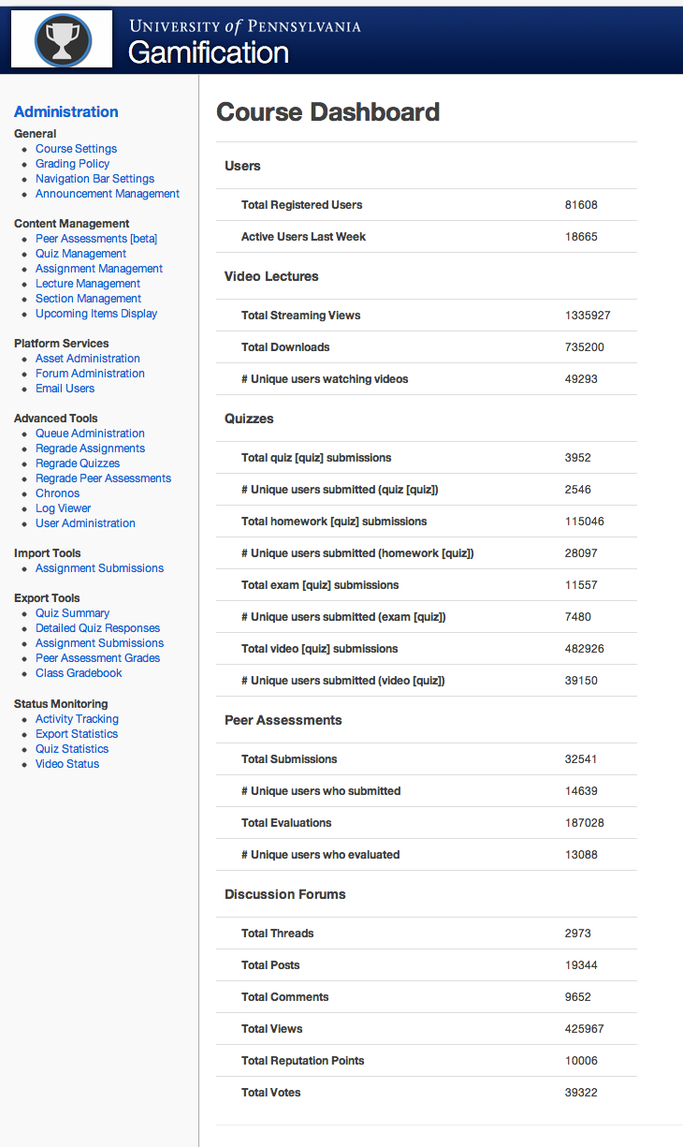
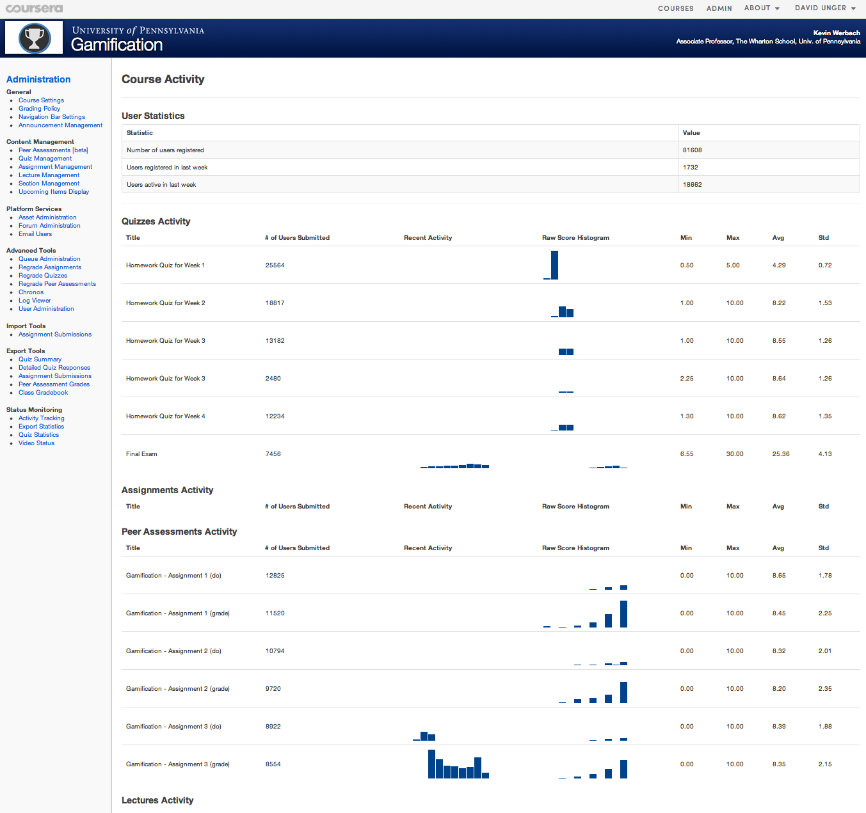
Instructor Interfaces: Course Dashboards

Slide 56
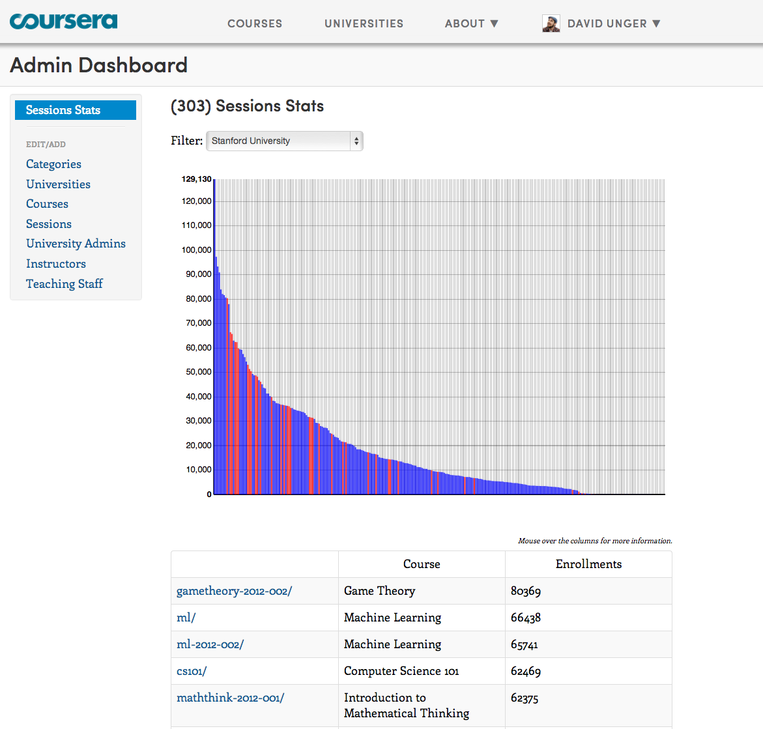
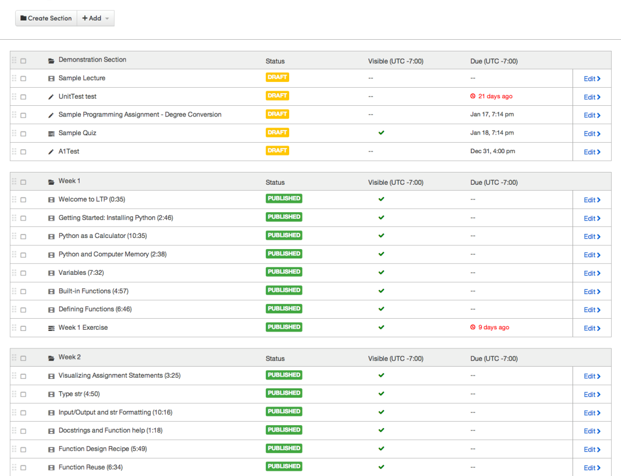

Instructor Interfaces: Course Dashboards

Slide 57

Instructor Interfaces: Course Dashboards

Slide 58
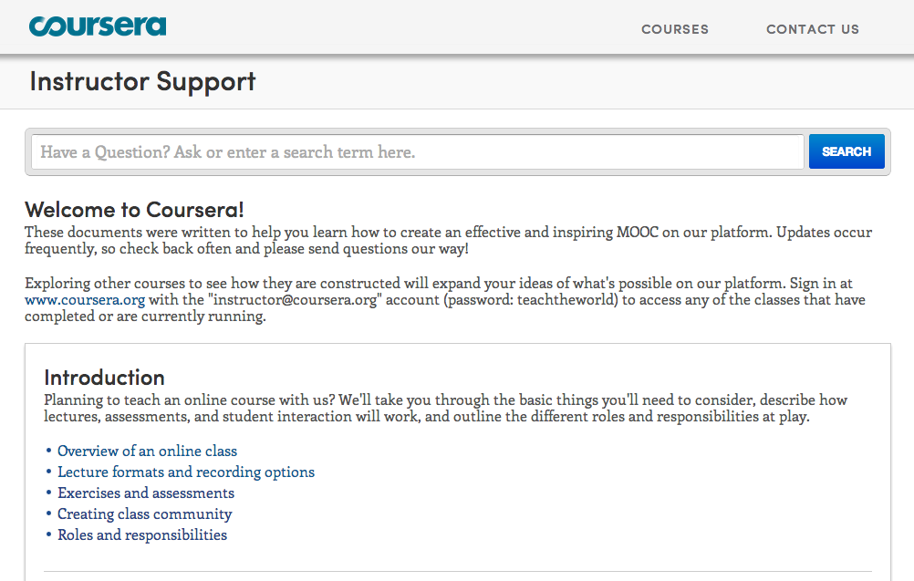
Instructor support

Slide 59
The mind is not a vessel that
needs filling, but wood that
needs igniting.
—Plutarch
from Ian Kidd's translation of Essays
Notes:
To wrap up….
I’ve often been asked: If anyone can now take online Princeton courses for free, why would anyone still pay for a Princeton degree? I think the value of a Princeton education isn’t just the content—instead it’s the interactions with the professors and with other equally bright students. To quote Plutarch: The mind is not a vessel that needs filling, but wood that needs igniting.
I think the value of a Princeton education isn’t just the content. Content is increasingly free on the web anyway. Instead, the real value of attending a top university is the interactions with the professors and with other equally bright students.

Slide 60
"Improved Learning in a Large-Enrollment Physics Class."
L. Deslauriers, E. Schelew, and C. Wieman. Science (2011).
Lecture
Active
Learning
Attendance
Engagement
Learning
Igniting Minds

Slide 61
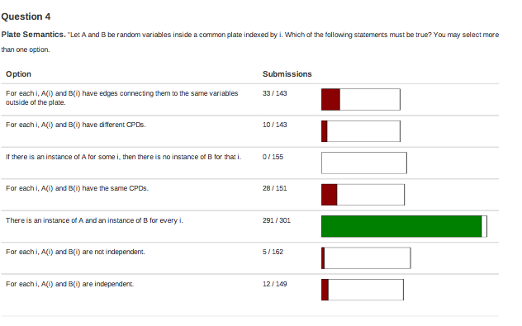
Just-in-time teaching
Small group problem solving
Flipped classroom

Slide 62
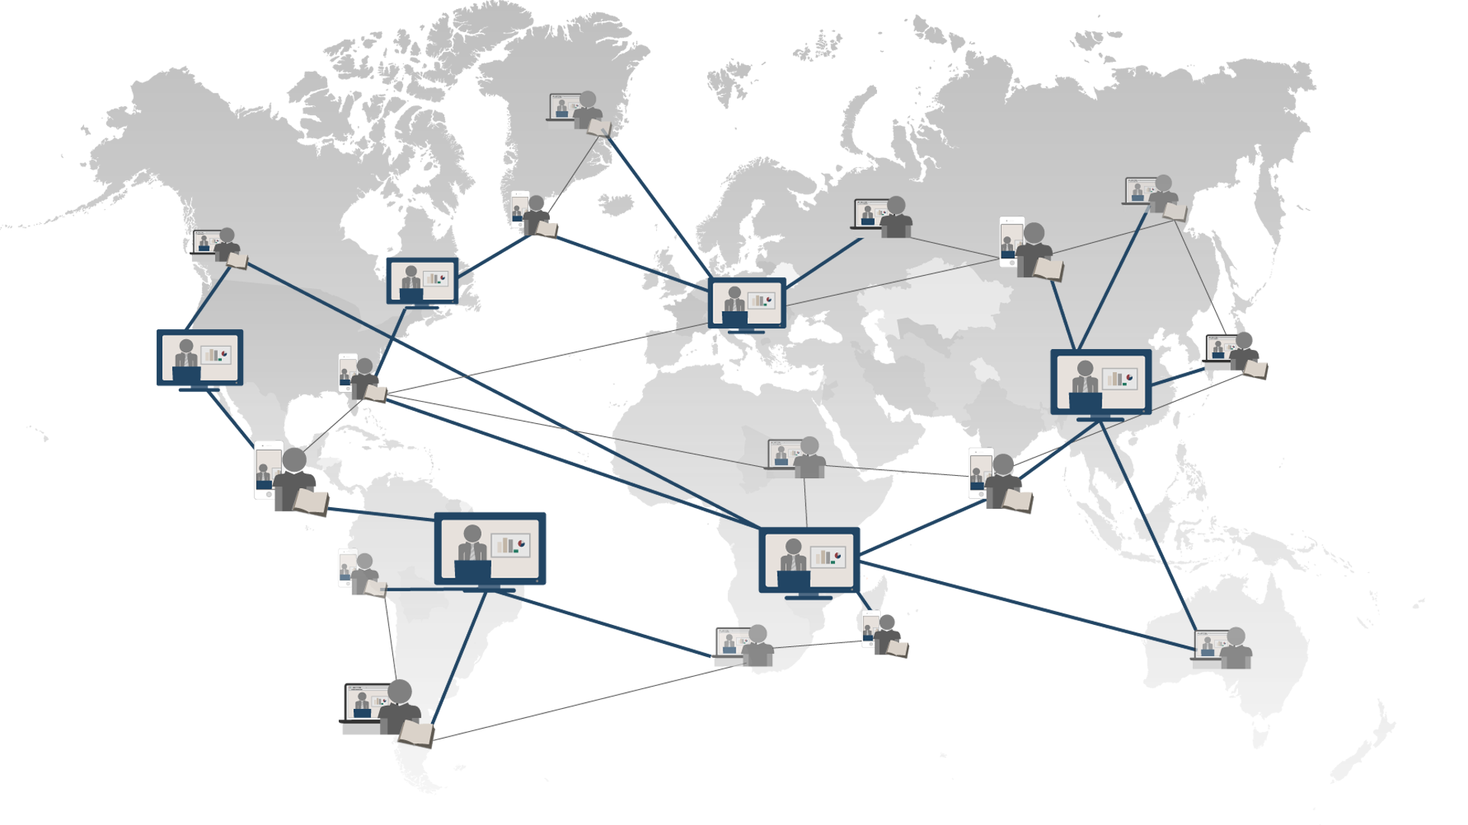
Universal Access to Education
Notes:
What would we get if we could offer a free high-quality education to everyone? First, it establishes education as a basic human right, so that anyone with the motivation and the ability would have the opportunity to get the skills that they need to make a better life for themselves, their families and their communities. Second, it enables lifelong learning. It’s a shame that for most of us, learning stops when we finish our formal education. With these amazing courses, we would always have the opportunity to explore new directions, whether to expand our minds or to make a change in our livesk. Finally, it opens the door to a wave of innovation. Because talent can be found everywhere. Maybe the next Albert Einstein or the next Steve Jobs is living in some remote village in Africa. With access to education, he or she can come up with the next big idea, and help make the world a better place for all of us.

Slide 63
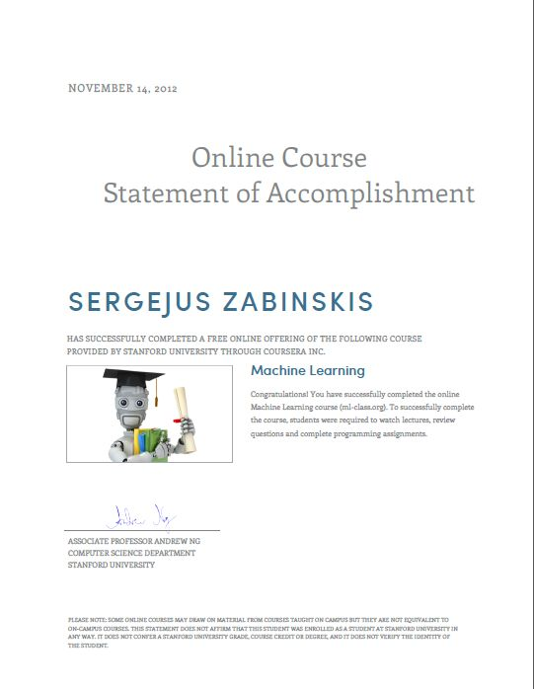


Does not confer Stanford credit.
Student identify not verified.
Statements of Accomplishment

Slide 64

Signature Track Courses

Slide 65
Financial Aid

