Slide 1
To whom it concerns:
Permission is hereby granted to use the images in this powerpoint file in any publication or presentation.
Andrew Ng

Slide 2
Deep Learning: Learns increasingly complex features
object models
object parts
(combination
of edges)
edges
pixels

Slide 3
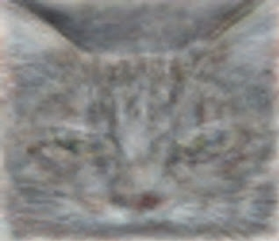
Cat neuron

