Slide 1

The Online Revolution:
Education for Everyone
Daphne Koller & Andrew Ng
Stanford University & Coursera
Notes:
I’m a Stanford professor, and Co-founder of Coursera. Most people today will never have access to a Stanford class. But we’re changing that.

Slide 2

Courses from Top Universities

Slide 3

30 of the top 60 universities worldwide (Academic Ranking of World Universities)
The #1 or #2 ranked university in 14 countries.
Courses from Top Universities

Slide 4
400
100,000
Notes:
What is suddenly possible is to use technology to offer education at scale. This started with 3 courses that Stanford opened to the world in the fall. For example, the machine learning class was taught by my colleague Andrew Ng. Andrew’s ML class is one of the larger at Stanford, with 400 students. Andrew’s public machine learning class had an enrollment of over 100K students. So for Andrew to reach the same audience by teaching his Stanford class, he would have to teach it for … 250 years.

Slide 5
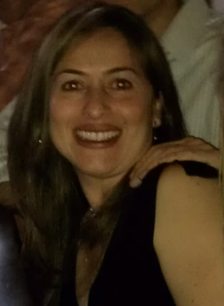
I'm a single mom 39 years old with two college boys... I've been trying to get back to college for my masters and want to learn more about computers. Looking forward to this class!
(Jenny Ramirez)

Slide 6
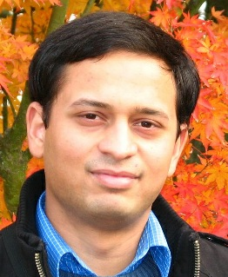
Coming from a middle class family from a small town in India. Never had the luck and guidance to reach Stanford for education. Guess what? God has sent the opportunity right across my door step! Heartfelt thanks to the great team and teachers who made this happen! (Akash Goswami)

Slide 7

Education at Scale

Slide 8
190 countries
Discussion forum
83 Universities
Video lectures
1.25 million
393 courses
Community
13 million enrollments
4.0 million students
Assessments

Slide 9
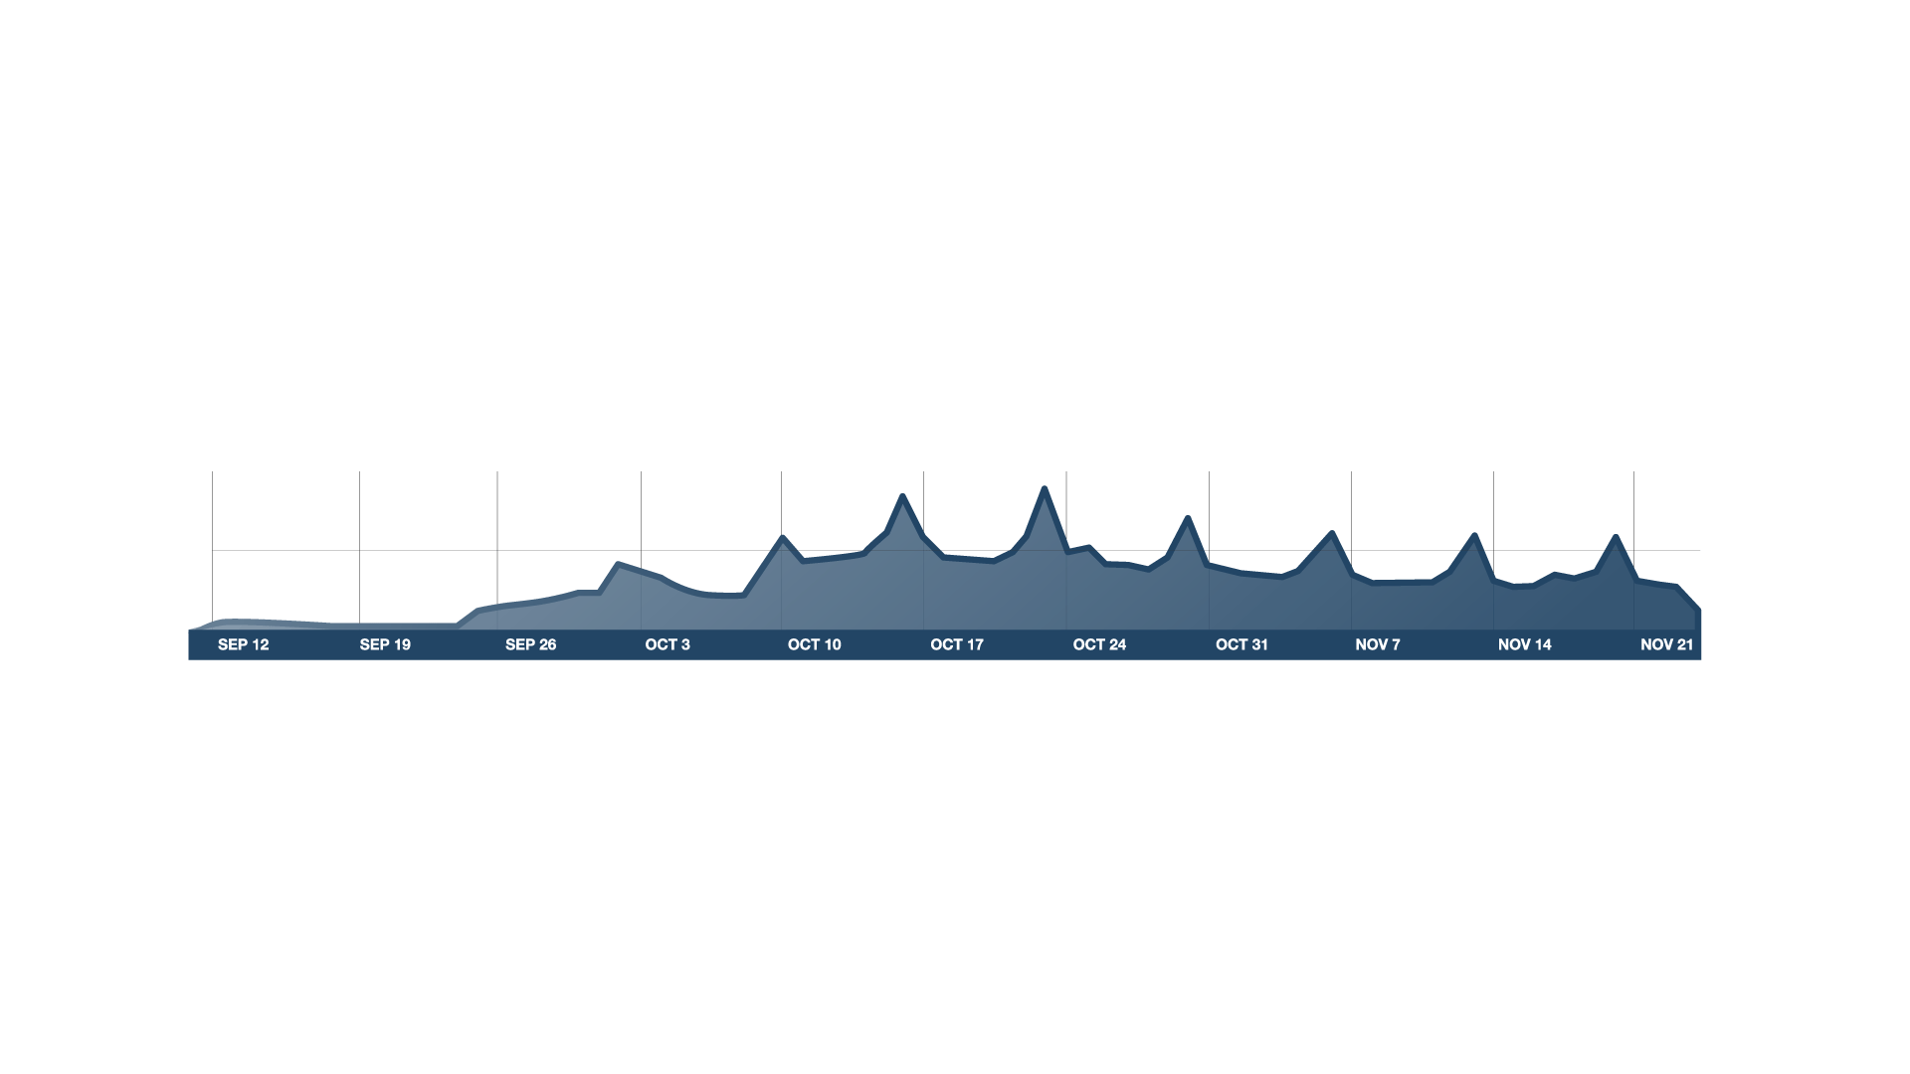

Course Begins
100K
# users on site
50K
v
Timeline
Real Course

Slide 10
The Student experience

Slide 11
Video-Based Instruction
Notes:
ADD GRAPH?

Slide 12
Basic Genetics
Refresher (OPTIONAL)
Modern Genomics
Genes and alleles (10 min)
Modern sequencing methods (11 min)
Commercial Genomics
(OPTIONAL)
Mendelian
inheritance
(13 min)
History: The Human Genome Project (12 min)
Genetic testing in the commercial world (11 min)
What is DNA?
(12 min)
Genomic economics (8 min)
Protecting privacy (9 minutes)
Personalized medicine (13 min)
Case study: direct-to-consumer genetics (12 min)
Case study: family planning (13 min)
Personalized Learning
Notes:
Let’s talk about some of the key elements that went into these courses. First, when we designs content for the online environment, we can remove the constraints of classroom scheduling, and abandon the monolithic 1hr lecture. The content can be divided into short, coherent modules of 8-12 minutes each, which can be traversed in different ways by different students. Some students might benefit from some additional preparation. Others might want go into depth in certain topics. So we can finally move away from the one-size-fits-all model of education into a much more personalized experience.

Slide 13
Retrieval Practice Improves Learning
"Retrieval Practice Produces More Learning than Elaborative Studying with Concept Mapping."
J. Karpicke, J. Blunt. Science (2011).
Study
Repeated Study
Retrieval
Practice
Practice is Critical

Slide 14
Interactive Video

Slide 15
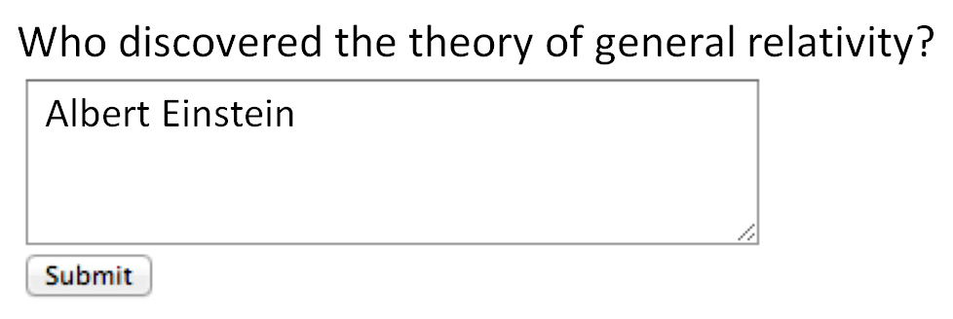
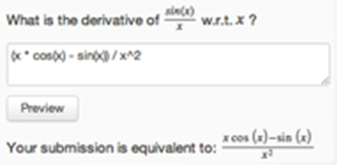
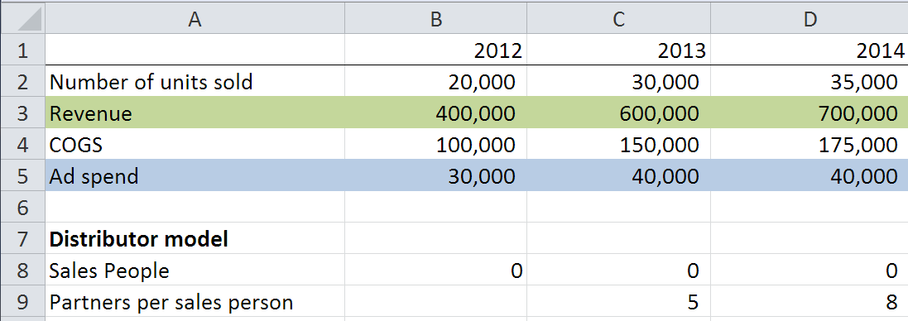
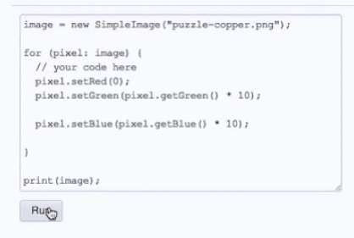
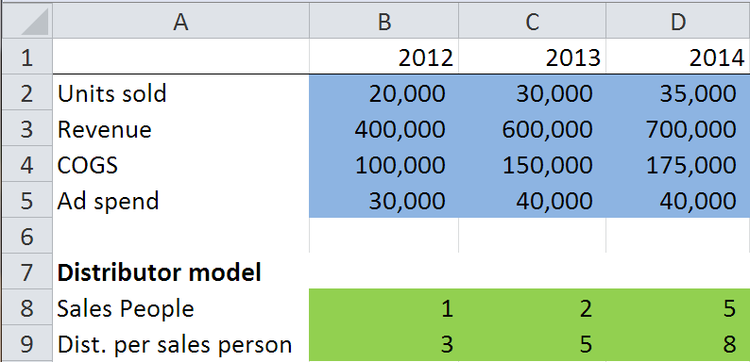
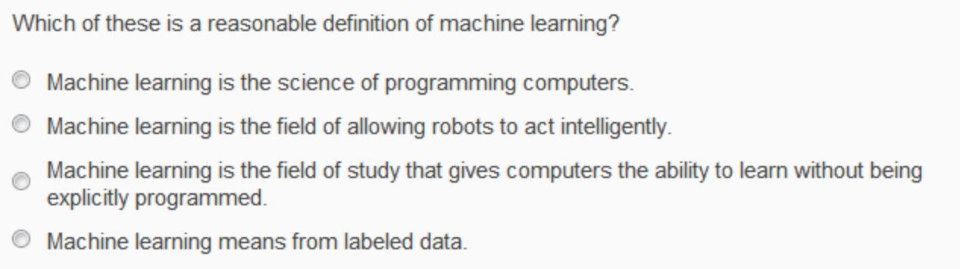
Autograded Homeworks and Exercises

Slide 16
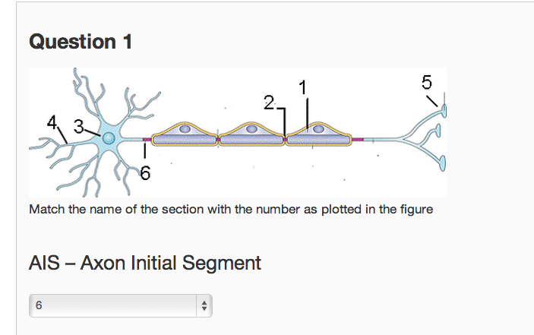
Multiple choice
Short answer (regular expression)
Math expressions
Autograded Homeworks and Exercises

Slide 17
Structured data
Computer programs
Autograded Homeworks and Exercises

Slide 18
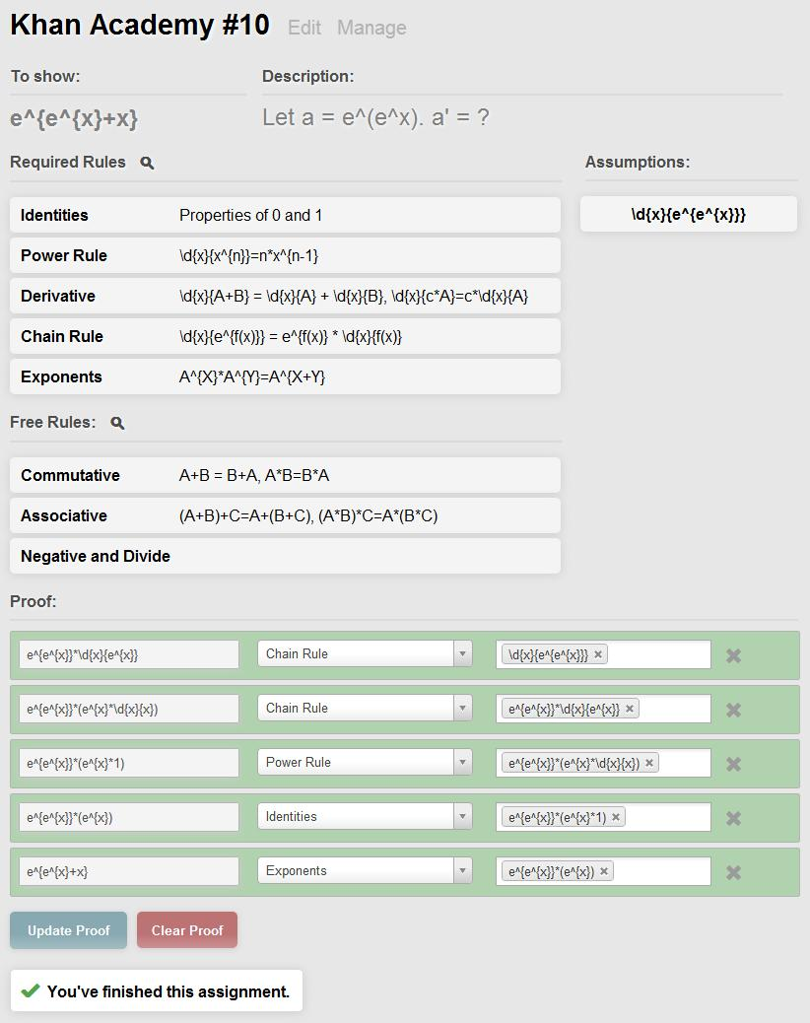
Colleen Lee, Ethan Fast, Alex Aiken
Autograded Homeworks and Exercises
Notes:
Expression equivalence (e.g., a^2 – b^2 = (a+b)(a-b)..)
Theorem proving

Slide 19
In-Depth Exercises

Slide 20
Which of the following statements are true? Check all that apply.
Archduke Franz Ferdinand of Austria started WWII.
The allied troops landed in Normandy on D-Day.
WWII started in 1939
Trench warfare was invented during WWII.
Personalization and Mastery

Slide 21
Which of the following statements are true? Check all that apply.
WWII started in 1939
The allied troops landed in Normandy on D-Day.
Archduke Franz Ferdinand of Austria started WWII.
Trench warfare was invented during WWII.
Which of the following statements are true? Check all that apply.
Correct options:
WWII started in 1939
WWII lasted about 6 years
Many troops from the UK fought in WWII.
The allied troops landed in Normandy on D-Day.
Incorrect options:
WWII ended in 1944
Many troops from Switzerland fought in WWII.
Archduke Franz Ferdinand of Austria started WWII.
Trench warfare was invented during WWII.
Which of the following statements are true? Check all that apply.
Many troops from the UK fought in WWII.
WWII ended in 1944
The allied troops landed in Normandy on D-Day.
Trench warfare was invented during WWII.
Which of the following statements are true? Check all that apply.
Many troops from Switzerland fought in WWII.
WWII started in 1939
WWII lasted about 6 years
Archduke Franz Ferdinand of Austria started WWII.
Randomization and Mastery

Slide 22
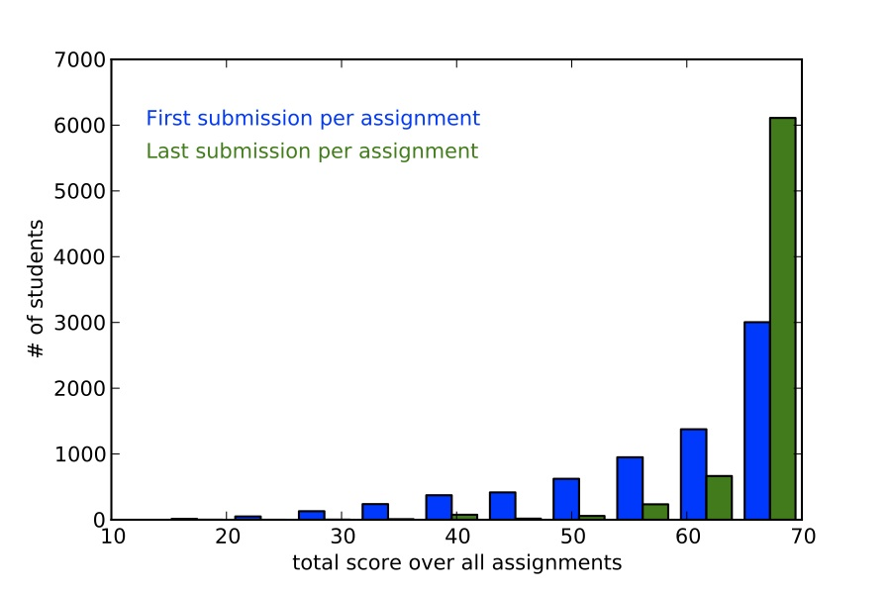
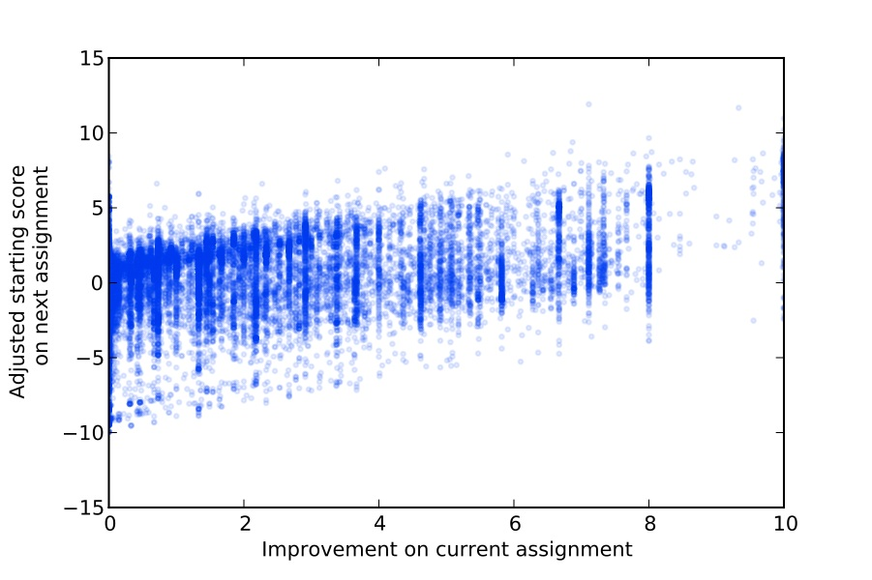
Mastery-based score improvements correlate with future performance
  3 points improvement ⇨ 1 point in next starting score
Martin Odersky
EPFL
Benefits of Mastery (Scala, EPFL)

Slide 23
“The Impact of Self-and Peer-Grading on Student Learning”.
P. Sadler, E. Good. Educational Assessment (2006).
Student Grade
Peer Grade
Self Grade
Teacher Grade
Open-Ended Work

Slide 24

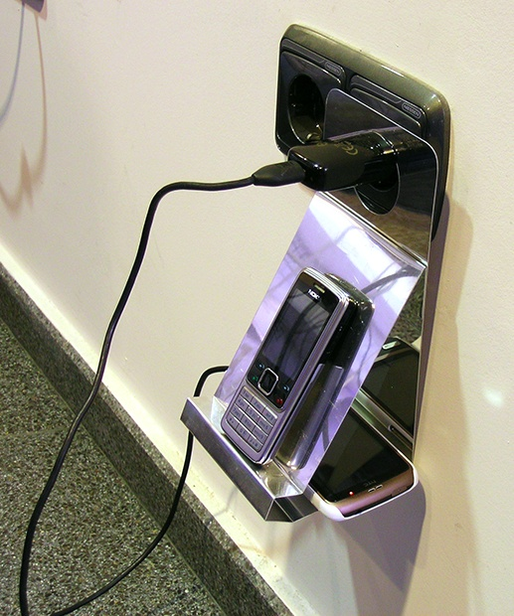

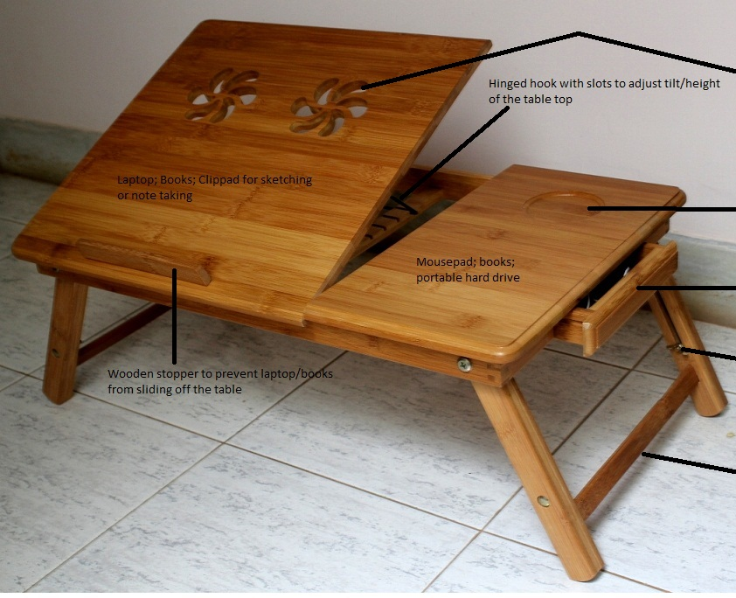
Karl Ulrich
Wharton, UPenn
LaPtabel
laptop table
DuoSlim
portable device holder
Neo-WD
space-efficient workdesk
Ramaswamy Venkatachalam
Gujarat, India
Aranzazu Hurtado Ruiz
Madrid, Spain
Paul Mendoza
Manila, Philippines
Creative, open-ended homework via peer grading
Notes:
Add design class logo, student acks

Slide 25
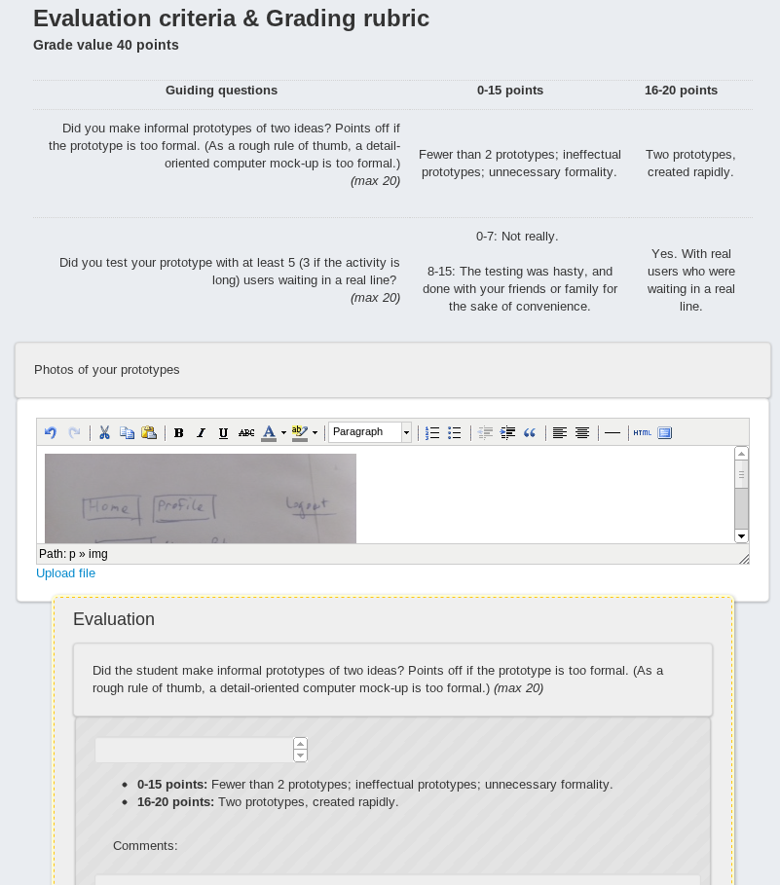
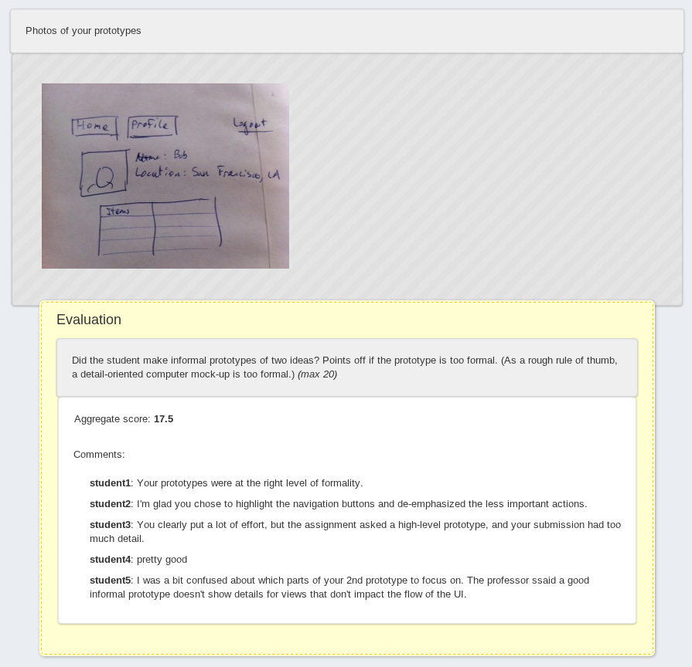
Peer Grading

Slide 26

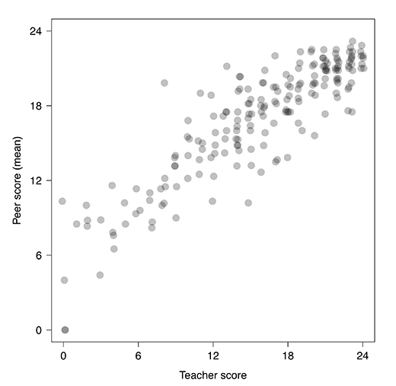
Mitch Duneier
Princeton
Analysis by:
Matthew Salganik & Mitch Duneier
Princeton University Sociology Dept.
Peer Grading Accuracy (Soc101, Princeton)

Slide 27
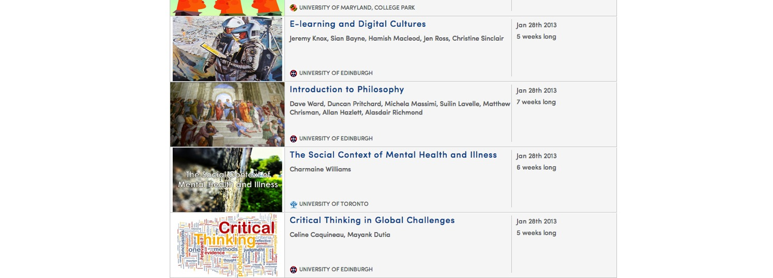
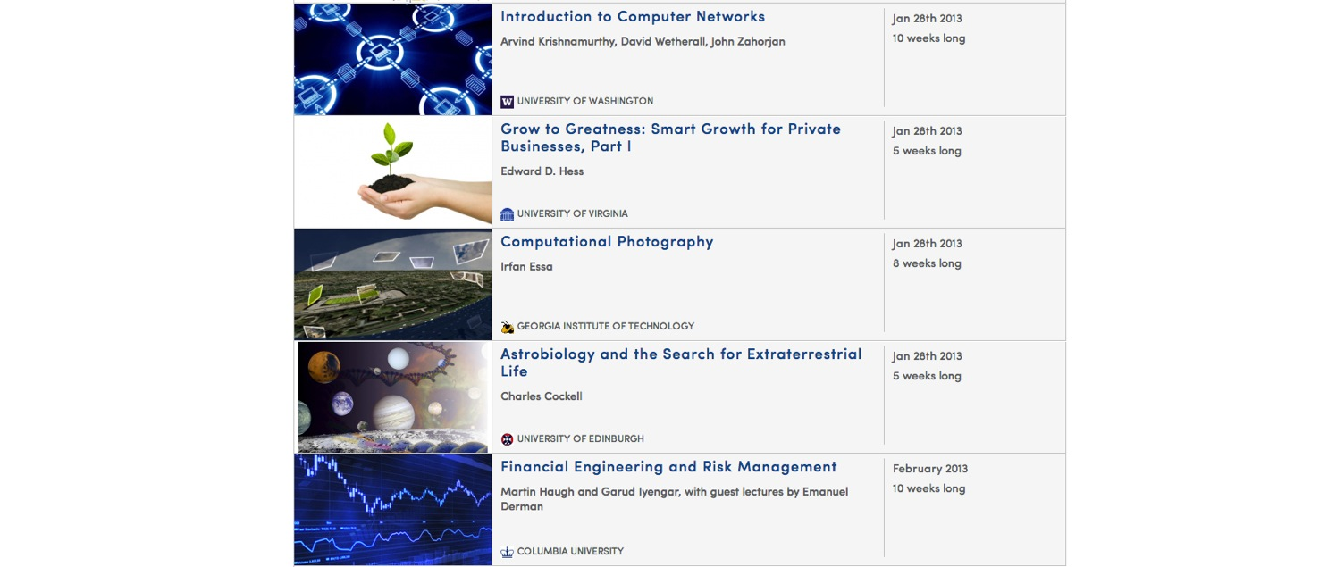
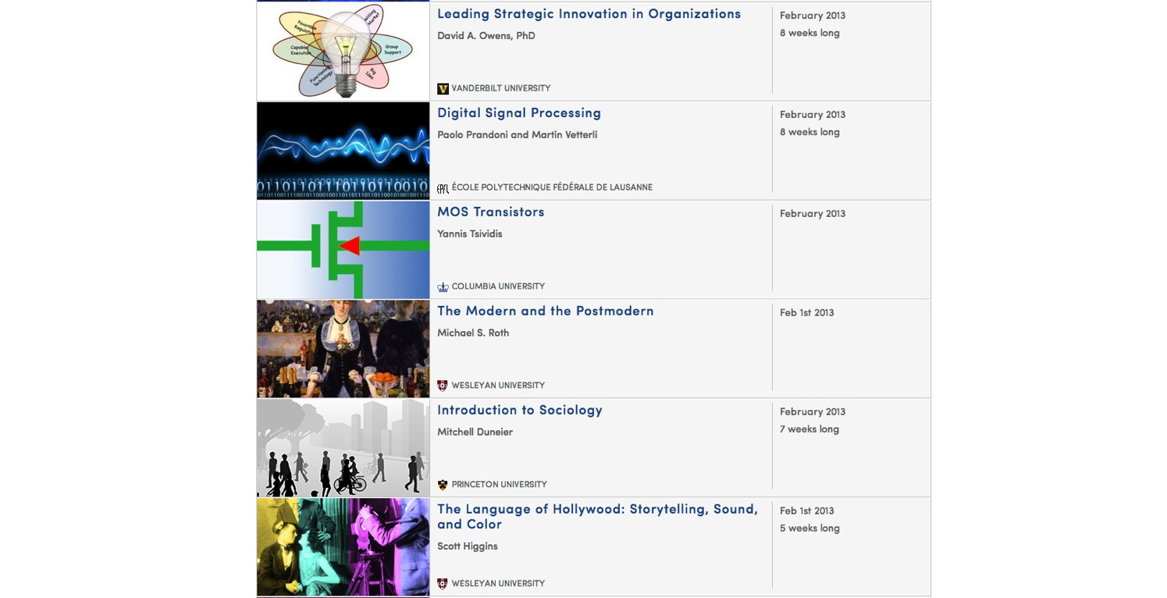
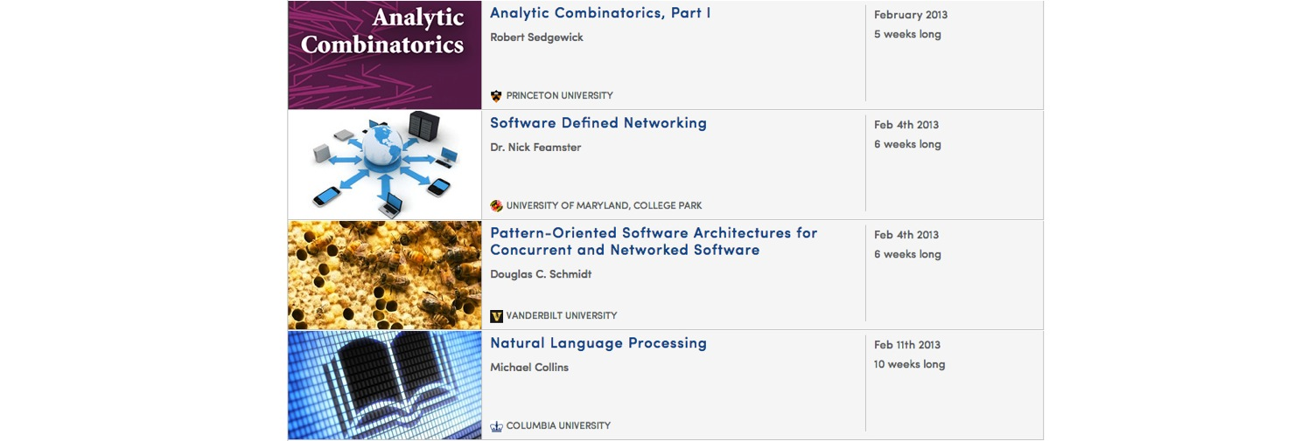
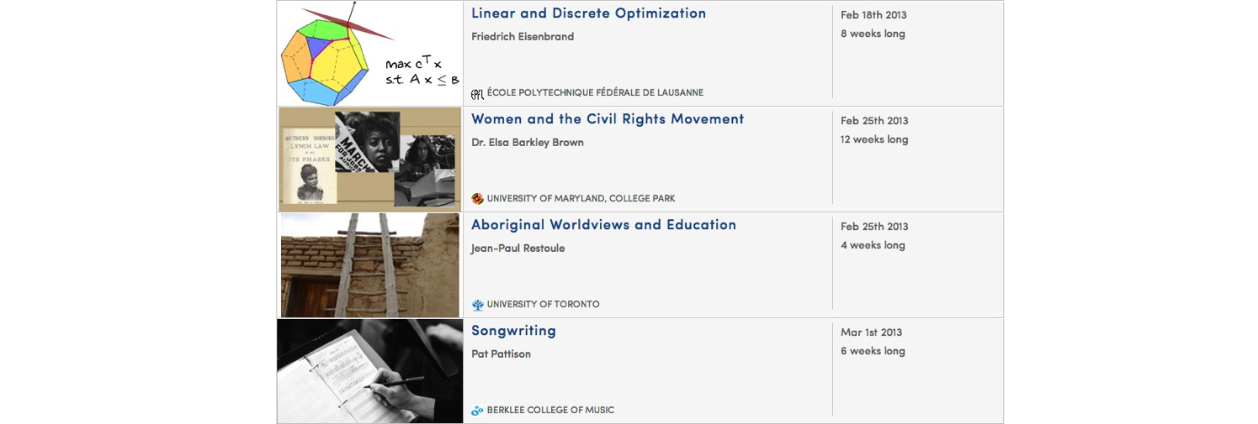
The Humanities, Sciences, Engineering, Business, ….

Slide 28
Non-Traditional Population
Notes:
Pie charts need to be redone

Slide 29
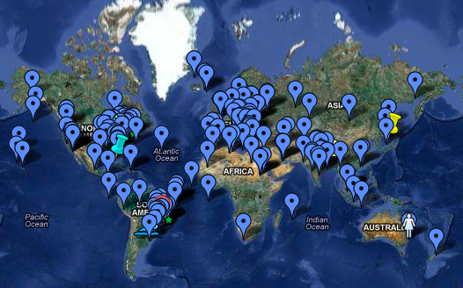
Sociology 101 Student Map
Global community of learners

Slide 30
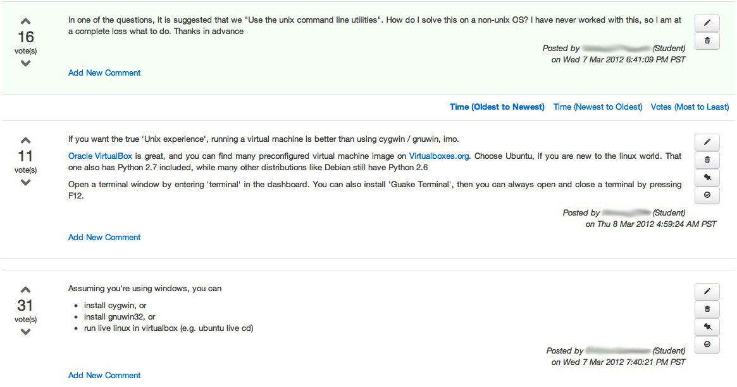
Students
Discussions

Slide 31
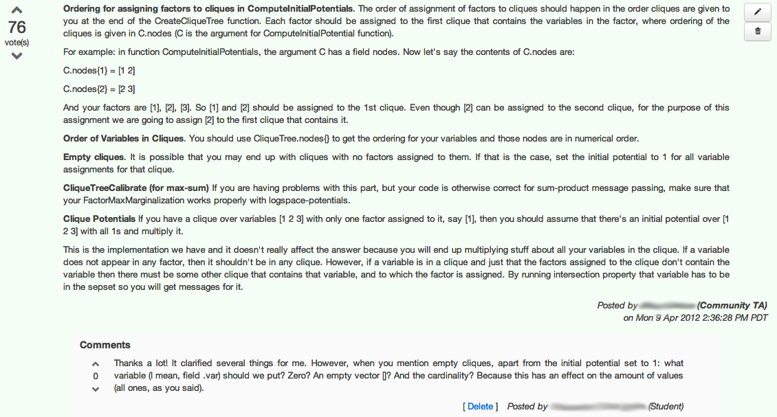
Community TA
Class re-runs and Community TAs

Slide 32
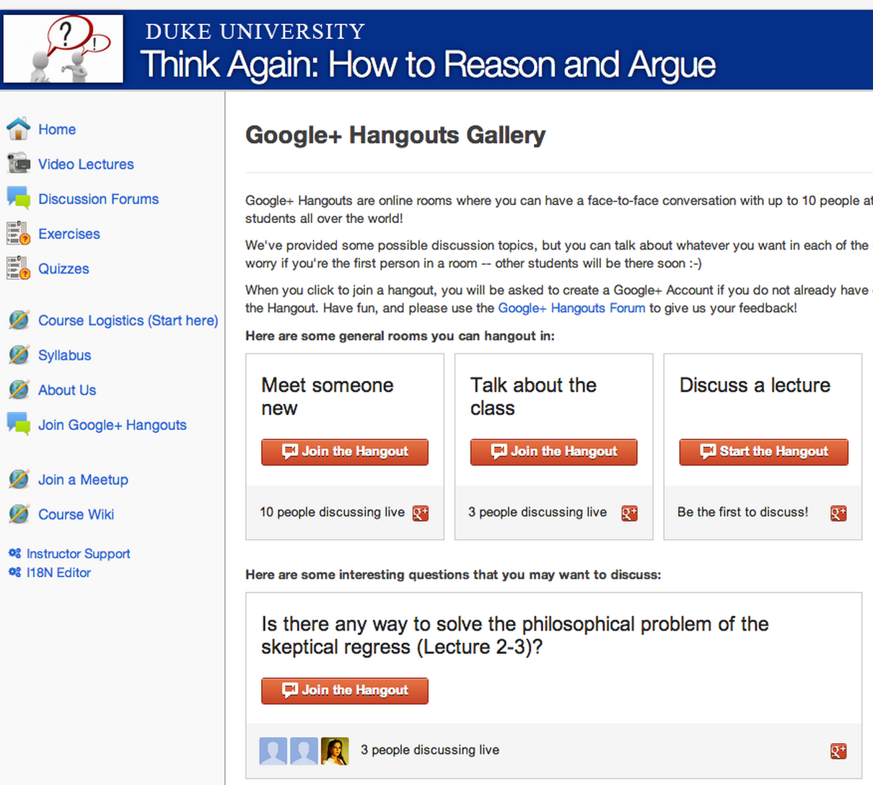
Live Video Chat

Slide 33
San Francisco HCI-Class Study Group
Student Study Groups

Slide 34
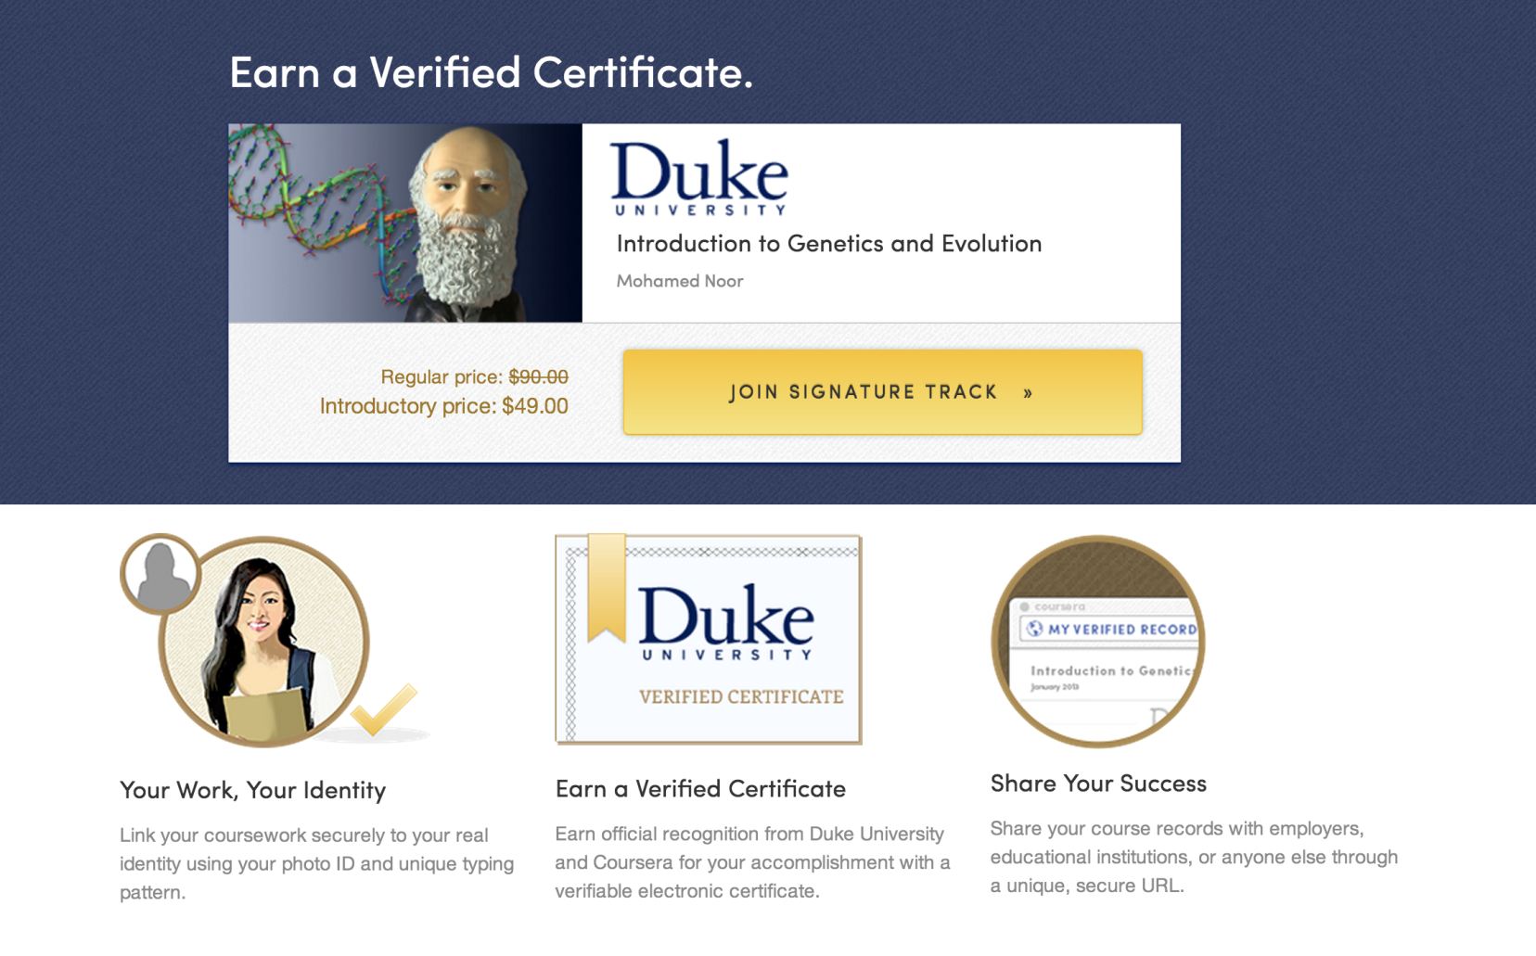
Signature Track Courses

Slide 35
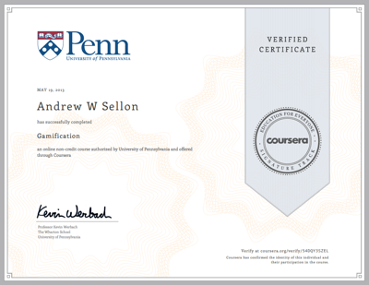
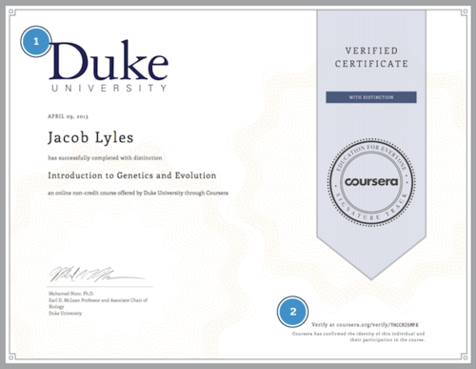
Signature Track

Slide 36
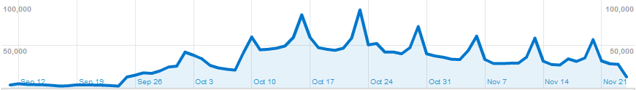
STATISTICS
& Analytics
First lectures
posted

Slide 37

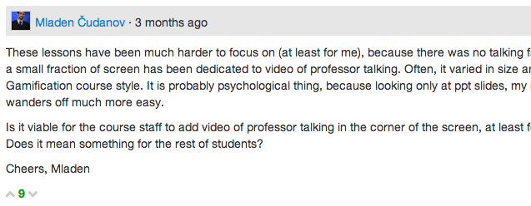

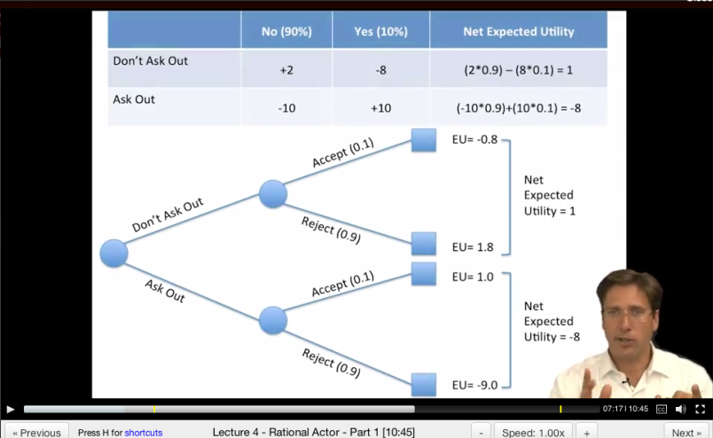
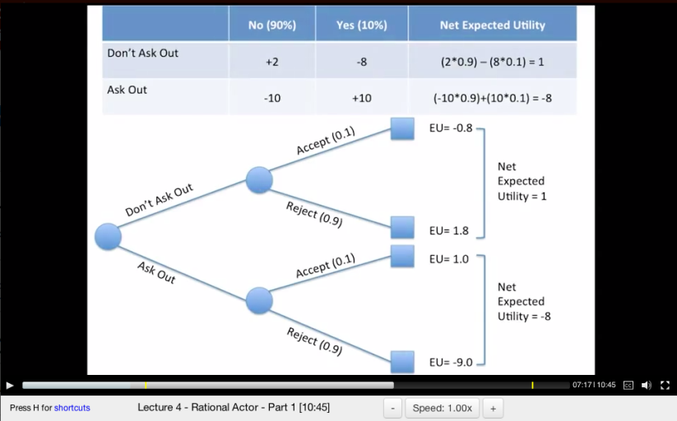
“These lessons have been much harder to focus on (at least for me), because there was no talking face.”
Dan MacFarland
https://class.coursera.org/organalysis-2012-001/forum/thread?thread_id=117&post_id=914
Student Group A
Student Group B
Data: Learn how students learn

Slide 38
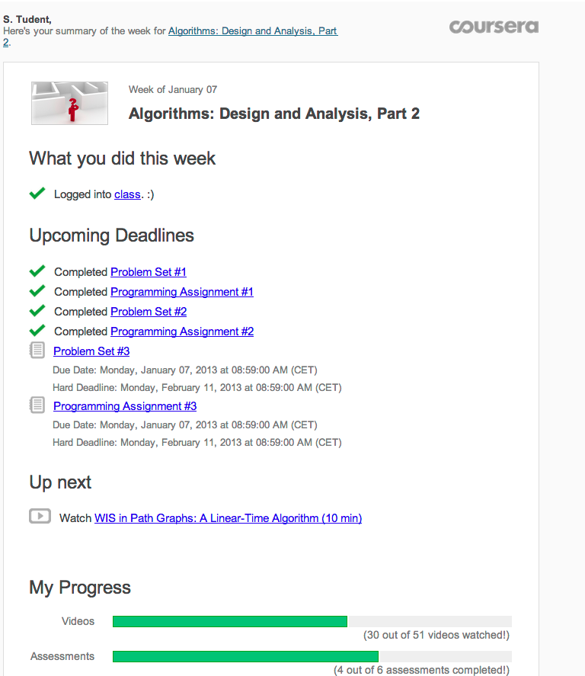
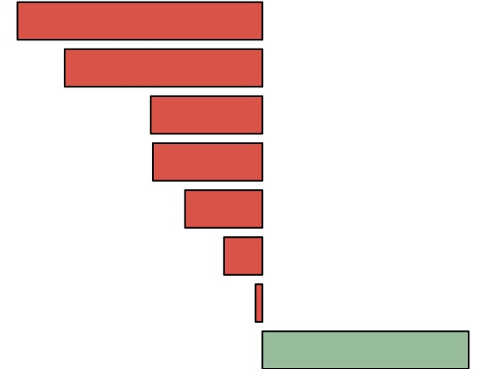
deadlines only
deadlines+activity+infographic
Data: Learn how students learn

Slide 39
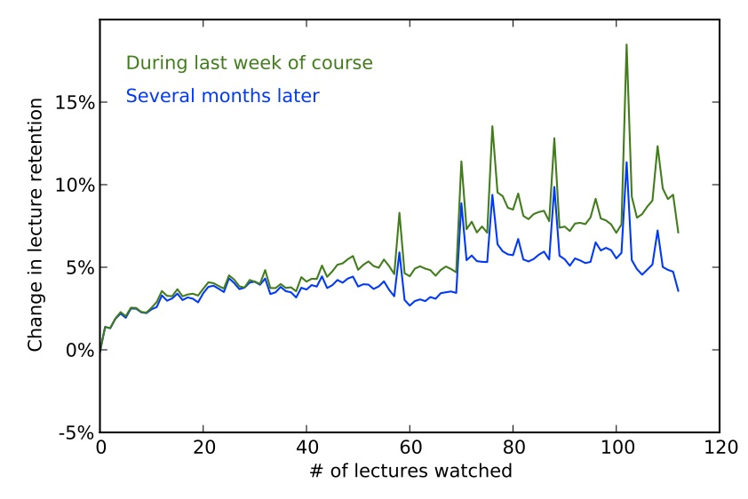
But some of the effect wears off

Slide 40
Identify the forum discussion thread which is most likely to cause a student to correct misconception.
Experimental setup:
“incorrect” submission
“incorrect” submission
Final “correct” submission
Submission timeline
Forum visits
[Jon Huang]
New Window into Human Learning

Slide 41
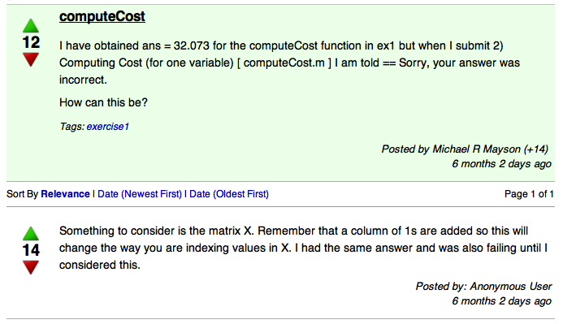
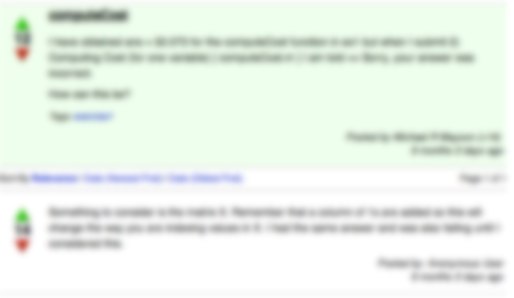
Most helpful forum discussion thread:
- Chance of correcting misconception if viewed: 64%
- Chance of correcting misconception if not viewed: 34%
- Improvement by viewing: 30%
[Jon Huang]
What helped the most?

Slide 42
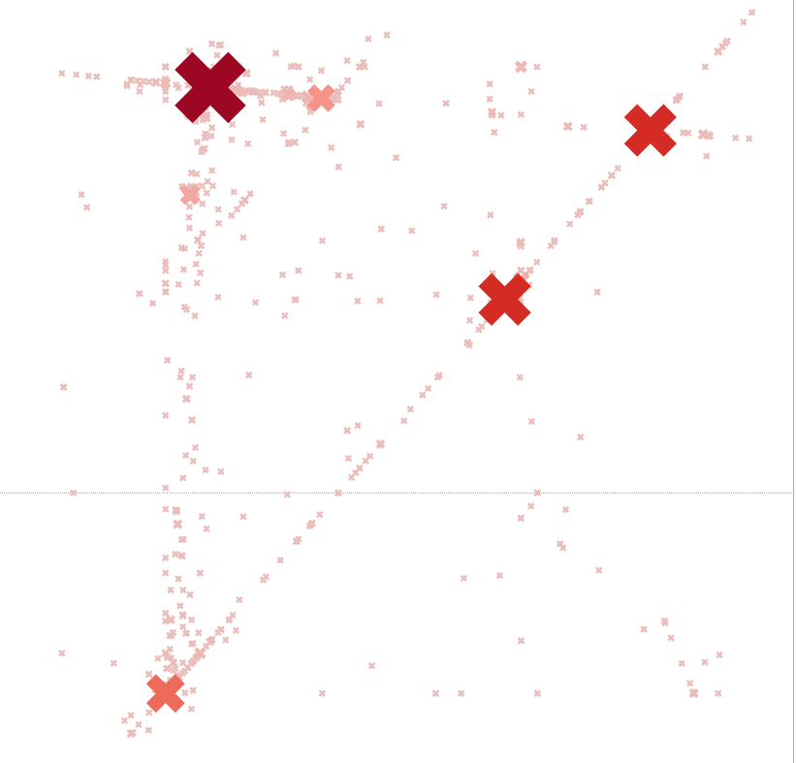
Wrong answers submitted for machine learning class
programming assignment
New Window into Human Learning
Notes:
ON HOLD

Slide 43
Individual
Tutoring
Mastery Learning
Lecture
Achievement Score
"The 2 Sigma Problem: The Search for Methods of Group Instruction as Effective as One-to-One Tutoring." B. Bloom, Educational Researcher (1984).
The 2 Sigma Problem

Slide 44
Instructor
INTERFACEs

Slide 45
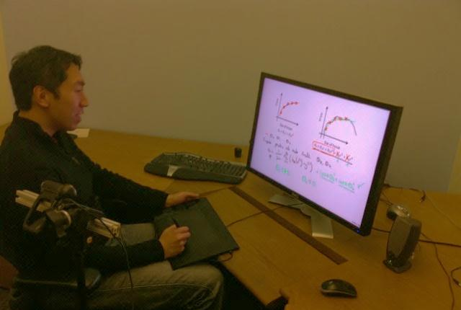
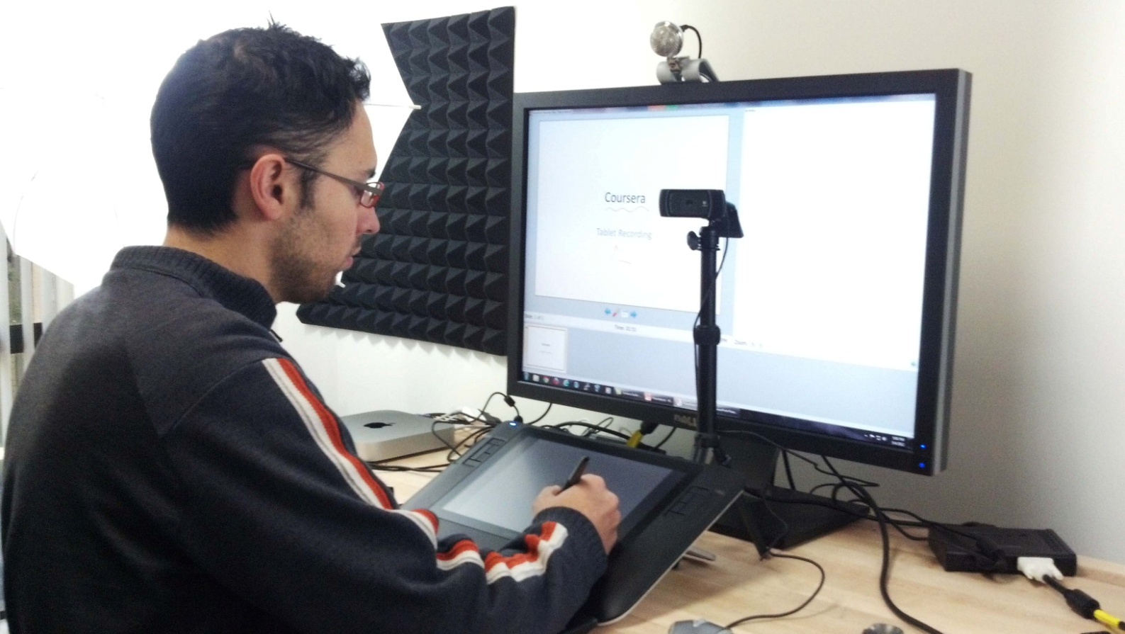
Writing on tablet appears on monitor
Webcam to record instructor
Lecture Recording

Slide 46
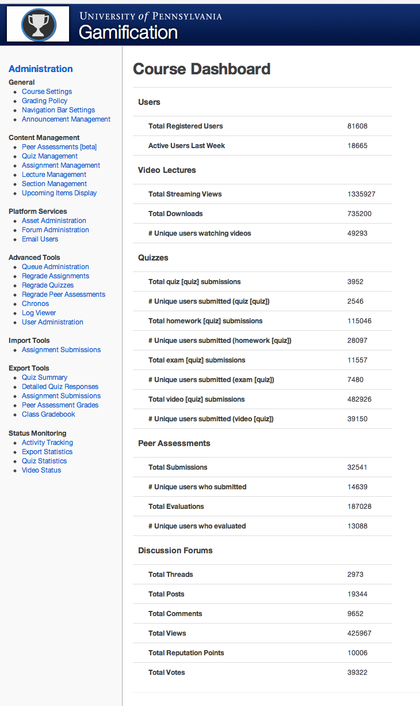
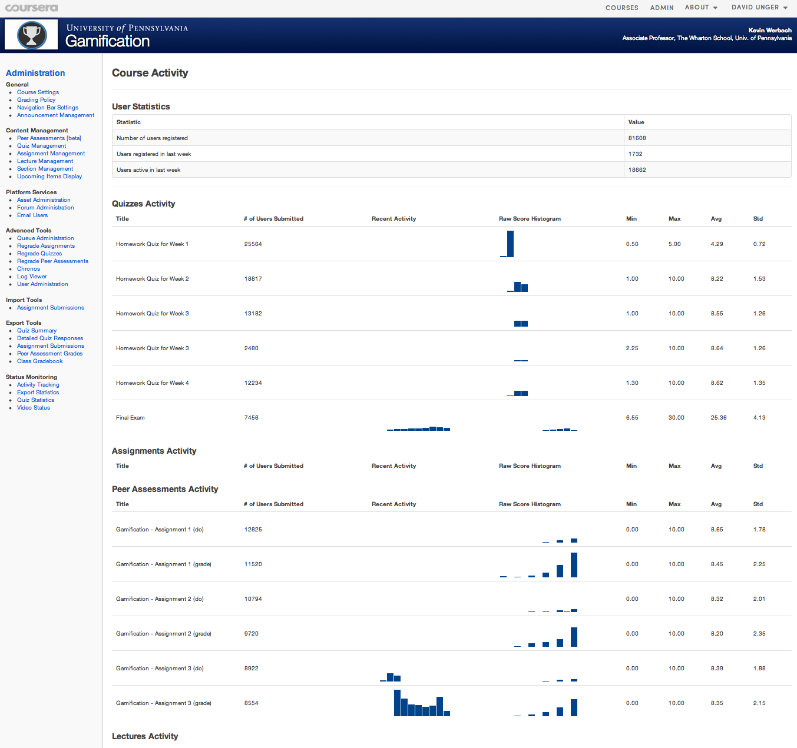
Instructor Interfaces: Course Dashboards

Slide 47
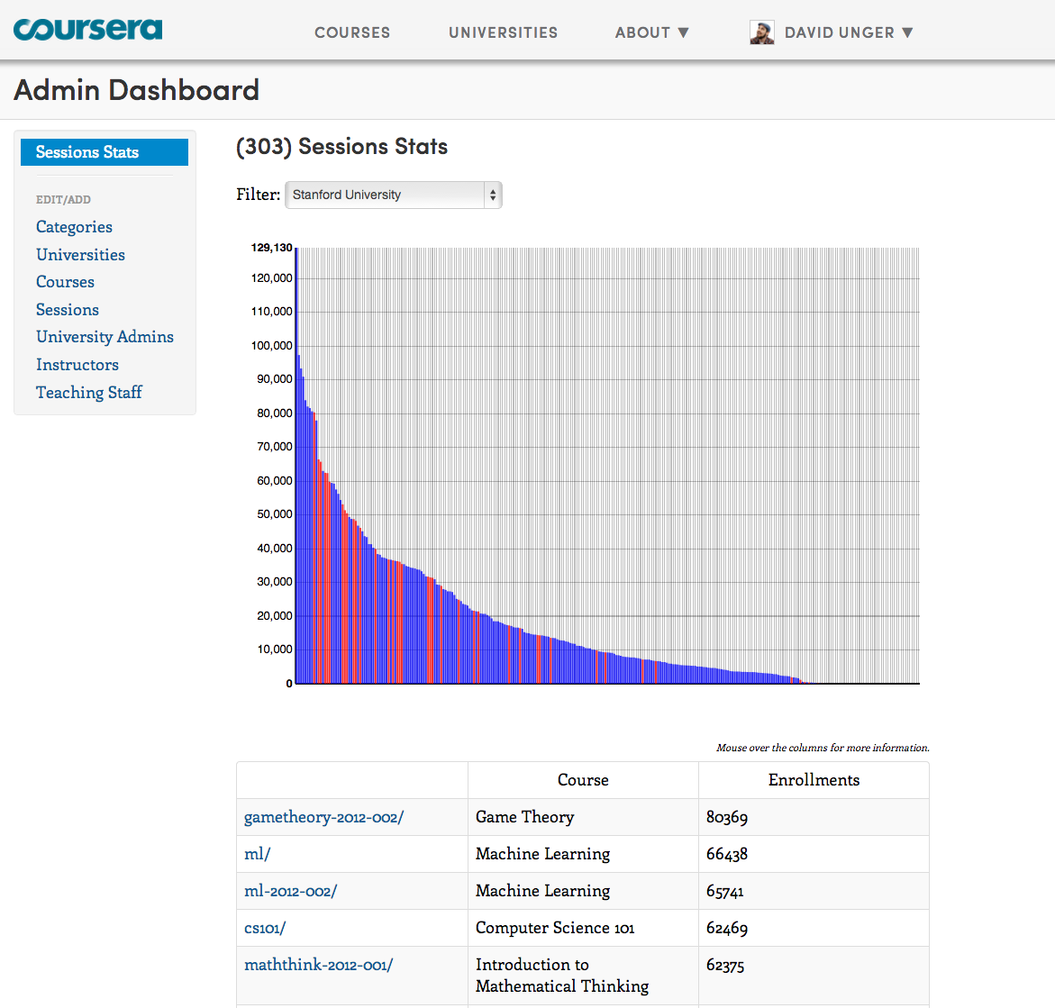
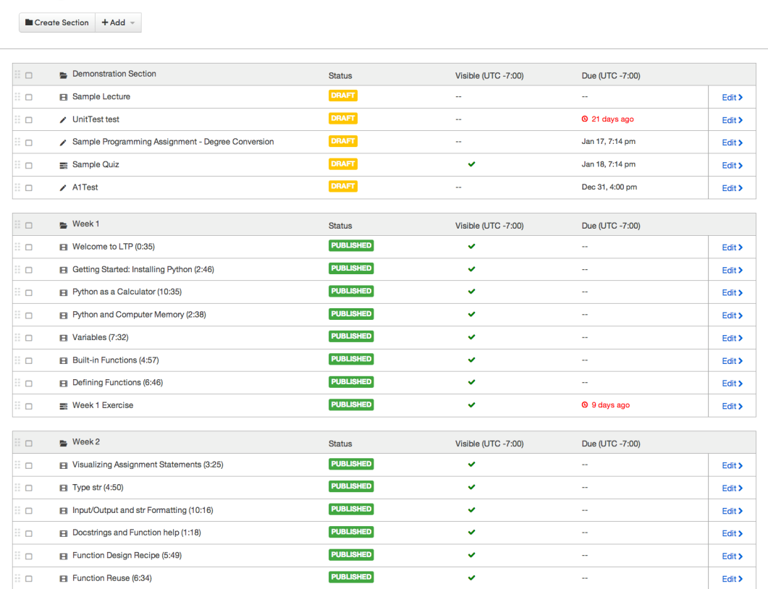

Instructor Interfaces: Course Dashboards

Slide 48

Instructor Interfaces: Course Dashboards

Slide 49
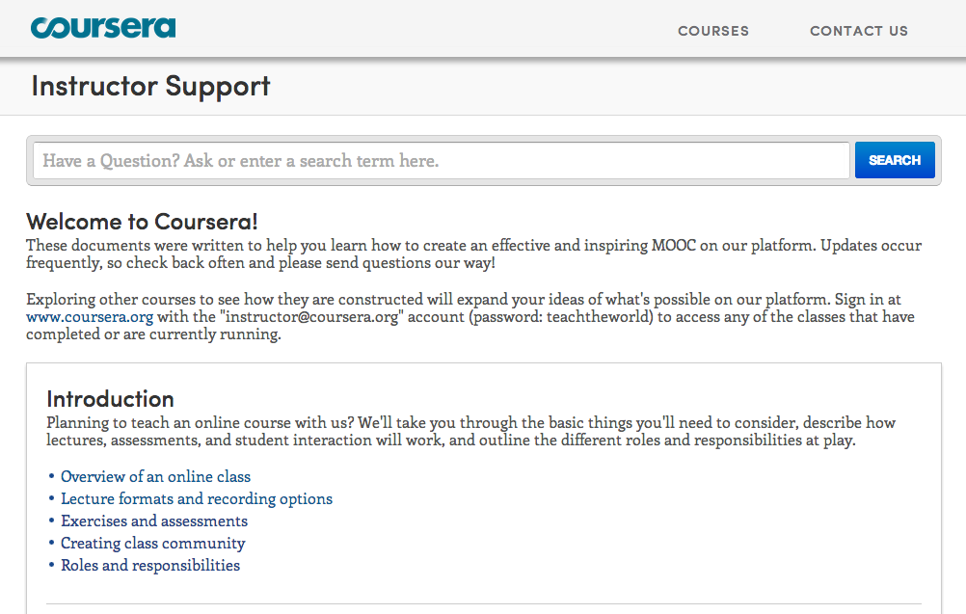
Instructor support

Slide 50


Enables rich ecosystem of educational apps, with shared data model
  Physics simulators
  Multi-student games
  Note taking tools, student organization tools, ….
  Advanced auto-graders, adaptive learning software, ….
Seamless integration
  Integration via APIs
  We help scale up from 1 to 100,000 students
Supports experimentation
  Instructors can build their own tools for their class
Coursera App Platform (coming soon)

Slide 51

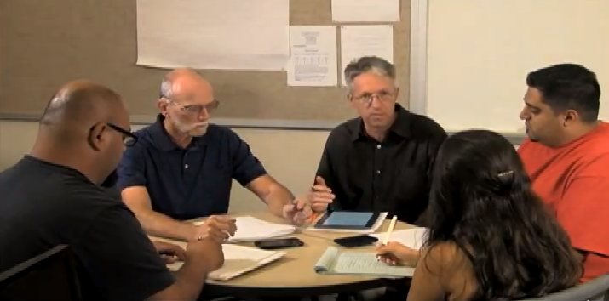
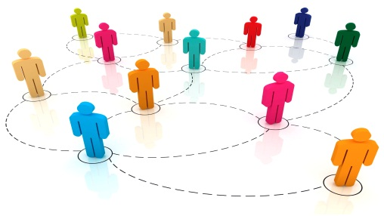
Lawrence Barkley and Ted Blake
Support small, closed study groups within a larger course:
  On-campus class announcements
  Closed forums
  Notes and note-taking tools
  Instructor access to grades for the students in the section
Facilitate closer interactions between instructors, TAs and students
… while benefiting from the richness of interaction in a larger community
Small Group Sections (coming soon)

Slide 52
The mind is not a vessel that
needs filling, but wood that
needs igniting.
—Plutarch
from Ian Kidd's translation of Essays
Notes:
To wrap up….
I’ve often been asked: If anyone can now take online Princeton courses for free, why would anyone still pay for a Princeton degree? I think the value of a Princeton education isn’t just the content—instead it’s the interactions with the professors and with other equally bright students. To quote Plutarch: The mind is not a vessel that needs filling, but wood that needs igniting.
I think the value of a Princeton education isn’t just the content. Content is increasingly free on the web anyway. Instead, the real value of attending a top university is the interactions with the professors and with other equally bright students.

Slide 53
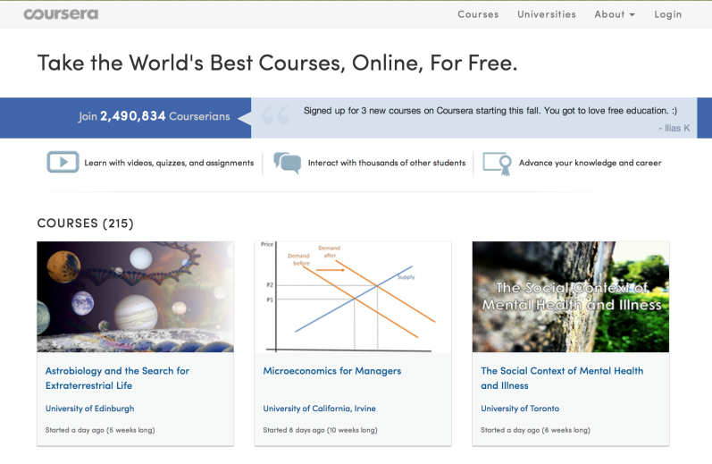

High-quality online content
Produced locally or adopted from another institution.
High-touch interaction with local instructor
Active learning, problem solving, personal attention to students
The Best of Both Worlds

Slide 54
"Improved Learning in a Large-Enrollment Physics Class."
L. Deslauriers, E. Schelew, and C. Wieman. Science (2011).
Lecture
Active
Learning
Attendance
Engagement
Learning
Igniting Minds

Slide 55

Education for Everyone
Notes:
What would we get if we could offer a free high-quality education to everyone? First, it establishes education as a basic human right, so that anyone with the motivation and the ability would have the opportunity to get the skills that they need to make a better life for themselves, their families and their communities. Second, it enables lifelong learning. It’s a shame that for most of us, learning stops when we finish our formal education. With these amazing courses, we would always have the opportunity to explore new directions, whether to expand our minds or to make a change in our livesk. Finally, it opens the door to a wave of innovation. Because talent can be found everywhere. Maybe the next Albert Einstein or the next Steve Jobs is living in some remote village in Africa. With access to education, he or she can come up with the next big idea, and help make the world a better place for all of us.

Slide 56

Just-in-time teaching
Team problem solving
Student presentations
Competitions, debates
Labs/simulations
Flipped classroom

Slide 57
有教无类。因材施教。
Notes:
What would we get if we could offer a free high-quality education to everyone? First, it establishes education as a basic human right, so that anyone with the motivation and the ability would have the opportunity to get the skills that they need to make a better life for themselves, their families and their communities. Second, it enables lifelong learning. It’s a shame that for most of us, learning stops when we finish our formal education. With these amazing courses, we would always have the opportunity to explore new directions, whether to expand our minds or to make a change in our livesk. Finally, it opens the door to a wave of innovation. Because talent can be found everywhere. Maybe the next Albert Einstein or the next Steve Jobs is living in some remote village in Africa. With access to education, he or she can come up with the next big idea, and help make the world a better place for all of us.

Slide 58



Does not confer Stanford credit.
Student identify not verified.
Statements of Accomplishment

Slide 59
Signature Track Courses

Slide 60

Financial Aid

