Slide 1

The Online Revolution:
Education for Everyone
Andrew Ng & Daphne Koller
Stanford University & Coursera
Twitter: @AndrewYNg
Notes:
I’m a Stanford professor, and Co-founder of Coursera. Most people today will never have access to a Stanford class. But we’re changing that.

Slide 2

Courses from Top Universities

Slide 3
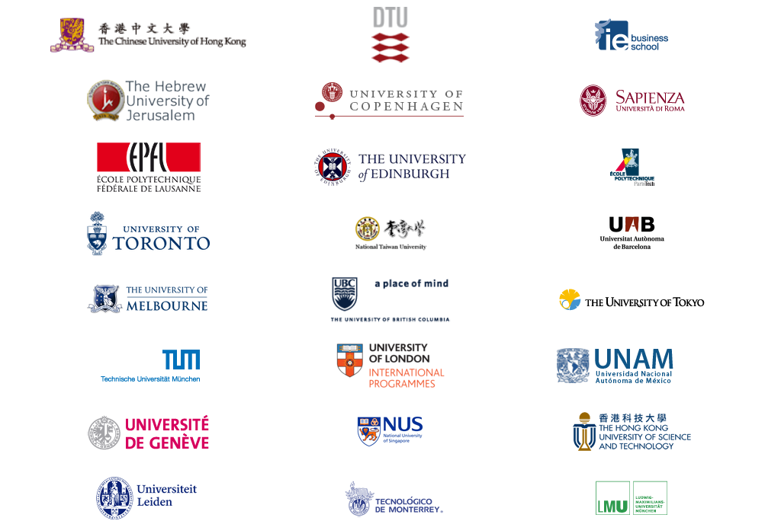
30 of the top 60 universities worldwide (Academic Ranking of World Universities)
The #1 or #2 ranked university in 14 countries.
Courses from Top Universities

Slide 4
400
100,000
Notes:
What is suddenly possible is to use technology to offer education at scale. This started with 3 courses that Stanford opened to the world in the fall. For example, the machine learning class was taught by my colleague Andrew Ng. Andrew’s ML class is one of the larger at Stanford, with 400 students. Andrew’s public machine learning class had an enrollment of over 100K students. So for Andrew to reach the same audience by teaching his Stanford class, he would have to teach it for … 250 years.

Slide 5
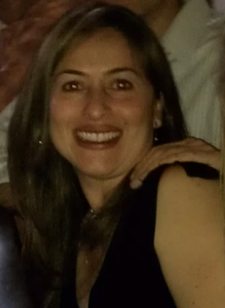
I'm a single mom 39 years old with two college boys... I've been trying to get back to college for my masters and want to learn more about computers. Looking forward to this class!
(Jenny Ramirez)

Slide 6
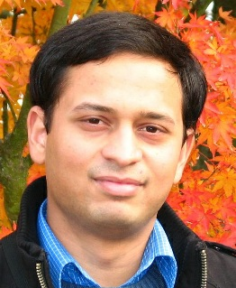
Coming from a middle class family from a small town in India. Never had the luck and guidance to reach Stanford for education. Guess what? God has sent the opportunity right across my door step! Heartfelt thanks to the great team and teachers who made this happen! (Akash Goswami)

Slide 7
190 countries
Discussion forum
90 Universities
Video lectures
1.25 million
448 courses
Community
14 million enrollments
5.0 million students
Assessments

Slide 8
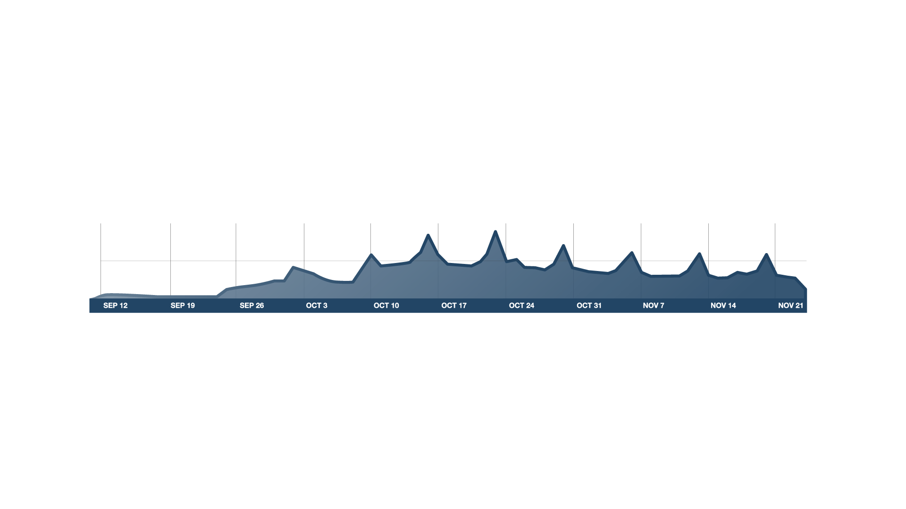

Course Begins
100K
# users on site
50K
v
Timeline
Real Course

Slide 9

Video-Based Instruction
Notes:
ADD GRAPH?

Slide 10
Basic Genetics
Refresher (OPTIONAL)
Modern Genomics
Genes and alleles (10 min)
Modern sequencing methods (11 min)
Commercial Genomics
(OPTIONAL)
Mendelian
inheritance
(13 min)
History: The Human Genome Project (12 min)
Genetic testing in the commercial world (11 min)
What is DNA?
(12 min)
Genomic economics (8 min)
Protecting privacy (9 minutes)
Personalized medicine (13 min)
Case study: direct-to-consumer genetics (12 min)
Case study: family planning (13 min)
Personalized Learning
Notes:
Let’s talk about some of the key elements that went into these courses. First, when we designs content for the online environment, we can remove the constraints of classroom scheduling, and abandon the monolithic 1hr lecture. The content can be divided into short, coherent modules of 8-12 minutes each, which can be traversed in different ways by different students. Some students might benefit from some additional preparation. Others might want go into depth in certain topics. So we can finally move away from the one-size-fits-all model of education into a much more personalized experience.

Slide 11
Retrieval Practice Improves Learning
"Retrieval Practice Produces More Learning than Elaborative Studying with Concept Mapping."
J. Karpicke, J. Blunt. Science (2011).
Study
Repeated Study
Retrieval
Practice
Practice is Critical

Slide 12
Interactive Video

Slide 13
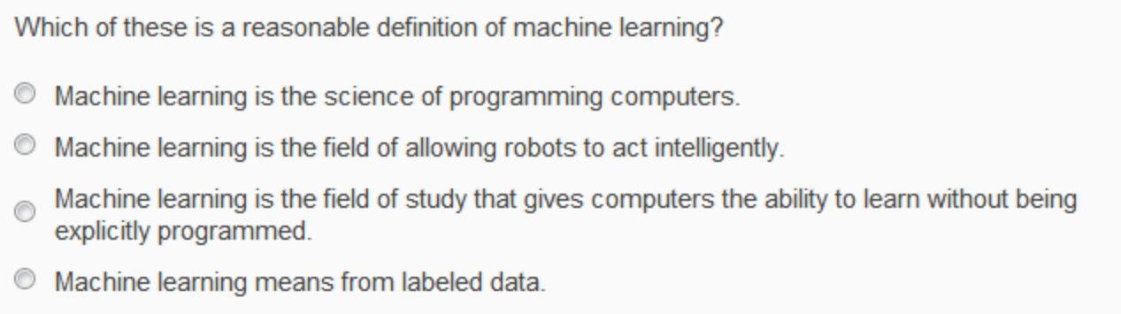
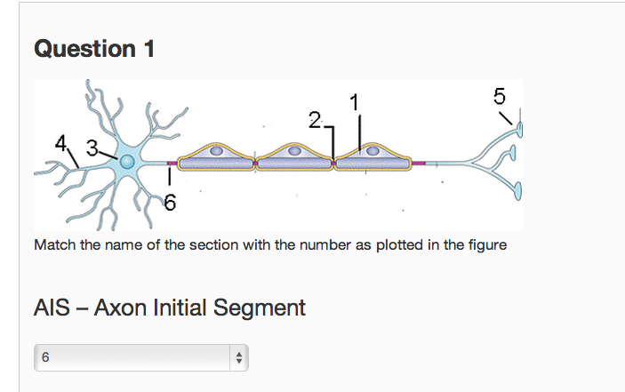
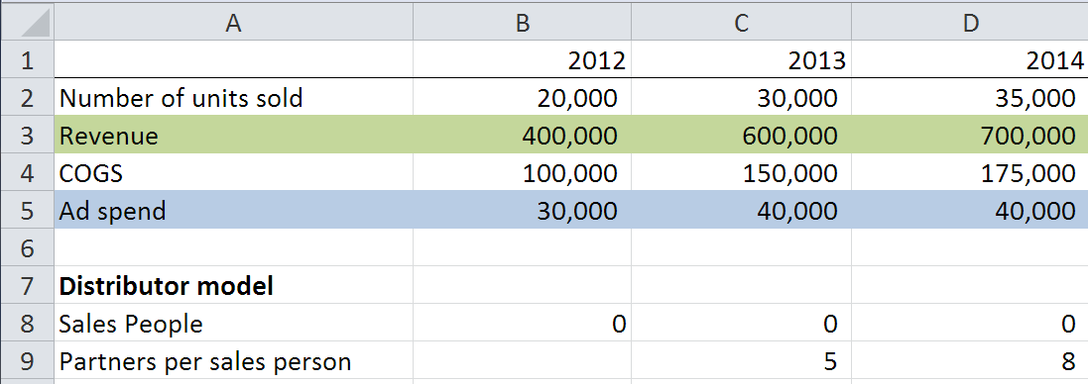
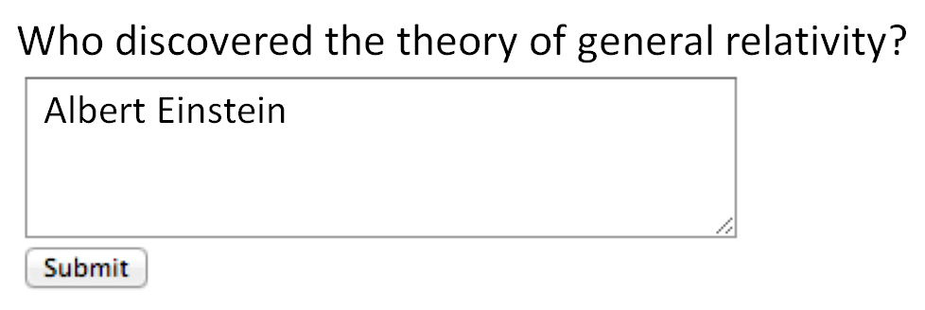
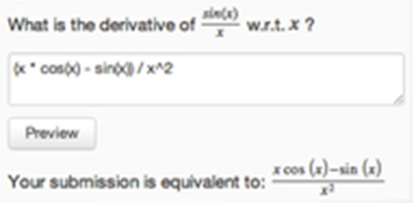
Multiple choice
Short answer (regular expression)
Math expressions
Autograded Homeworks and Exercises

Slide 14
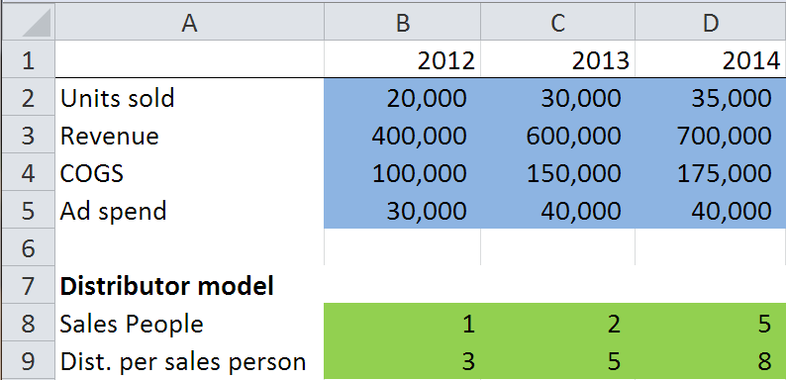
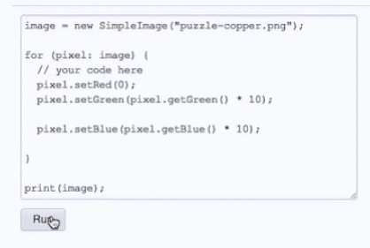
Structured data
Computer programs
Autograded Homeworks and Exercises

Slide 15
In-Depth Exercises

Slide 16
Which of the following statements are true? Check all that apply.
Archduke Franz Ferdinand of Austria started WWII.
The allied troops landed in Normandy on D-Day.
WWII started in 1939
Trench warfare was invented during WWII.
Personalization and Mastery

Slide 17
Which of the following statements are true? Check all that apply.
WWII started in 1939
The allied troops landed in Normandy on D-Day.
Archduke Franz Ferdinand of Austria started WWII.
Trench warfare was invented during WWII.
Which of the following statements are true? Check all that apply.
Correct options:
WWII started in 1939
WWII lasted about 6 years
Many troops from the UK fought in WWII.
The allied troops landed in Normandy on D-Day.
Incorrect options:
WWII ended in 1944
Many troops from Switzerland fought in WWII.
Archduke Franz Ferdinand of Austria started WWII.
Trench warfare was invented during WWII.
Which of the following statements are true? Check all that apply.
Many troops from the UK fought in WWII.
WWII ended in 1944
The allied troops landed in Normandy on D-Day.
Trench warfare was invented during WWII.
Which of the following statements are true? Check all that apply.
Many troops from Switzerland fought in WWII.
WWII started in 1939
WWII lasted about 6 years
Archduke Franz Ferdinand of Austria started WWII.
Randomization and Mastery

Slide 18
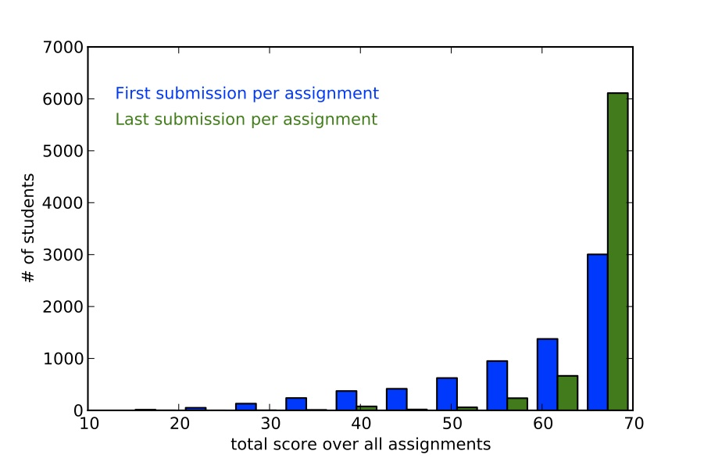
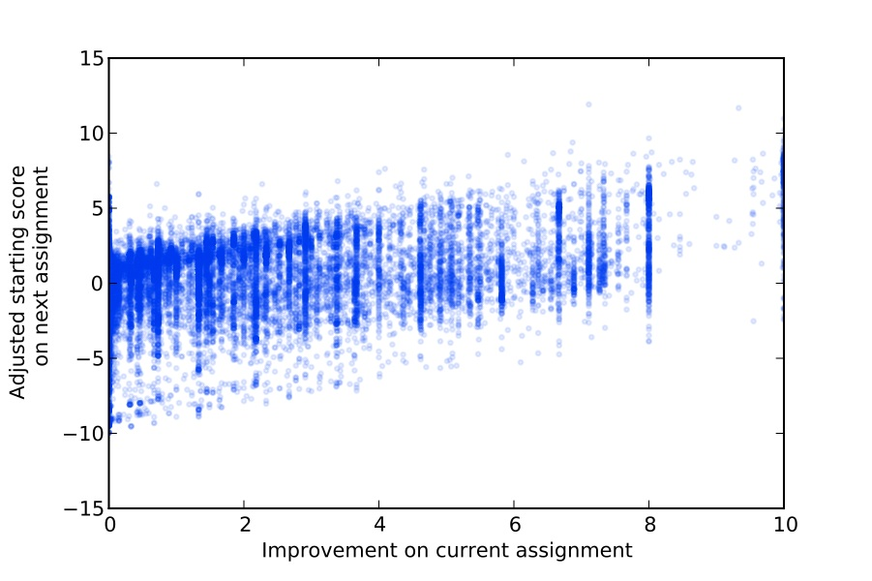
Mastery-based score improvements correlate with future performance
  3 points improvement ⇨ 1 point in next starting score
Martin Odersky
EPFL
Benefits of Mastery (Scala, EPFL)

Slide 19
“The Impact of Self-and Peer-Grading on Student Learning”.
P. Sadler, E. Good. Educational Assessment (2006).
Student Grade
Peer Grade
Self Grade
Teacher Grade
Open-Ended Work

Slide 20



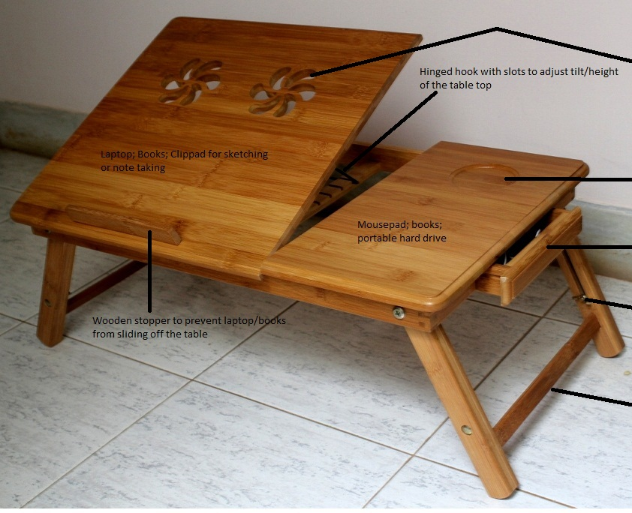
Karl Ulrich
Wharton, UPenn
LaPtabel
laptop table
DuoSlim
portable device holder
Neo-WD
space-efficient workdesk
Ramaswamy Venkatachalam
Gujarat, India
Aranzazu Hurtado Ruiz
Madrid, Spain
Paul Mendoza
Manila, Philippines
Creative, open-ended homework via peer grading
Notes:
Add design class logo, student acks

Slide 21

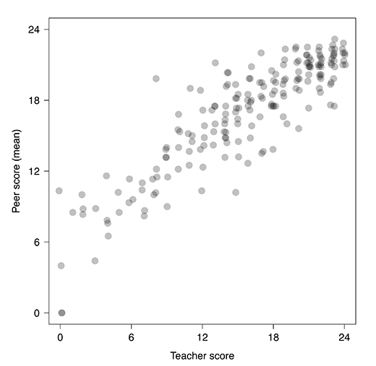
Mitch Duneier
Princeton
Analysis by:
Matthew Salganik & Mitch Duneier
Princeton University Sociology Dept.
Peer Grading Accuracy (Soc101, Princeton)

Slide 22
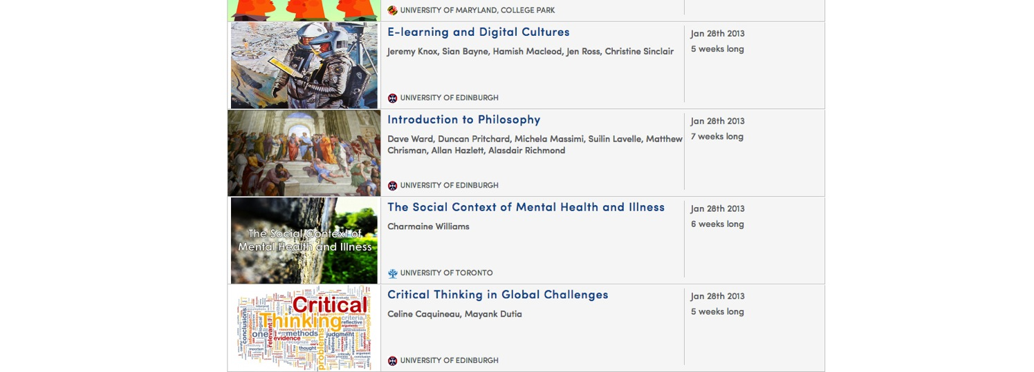
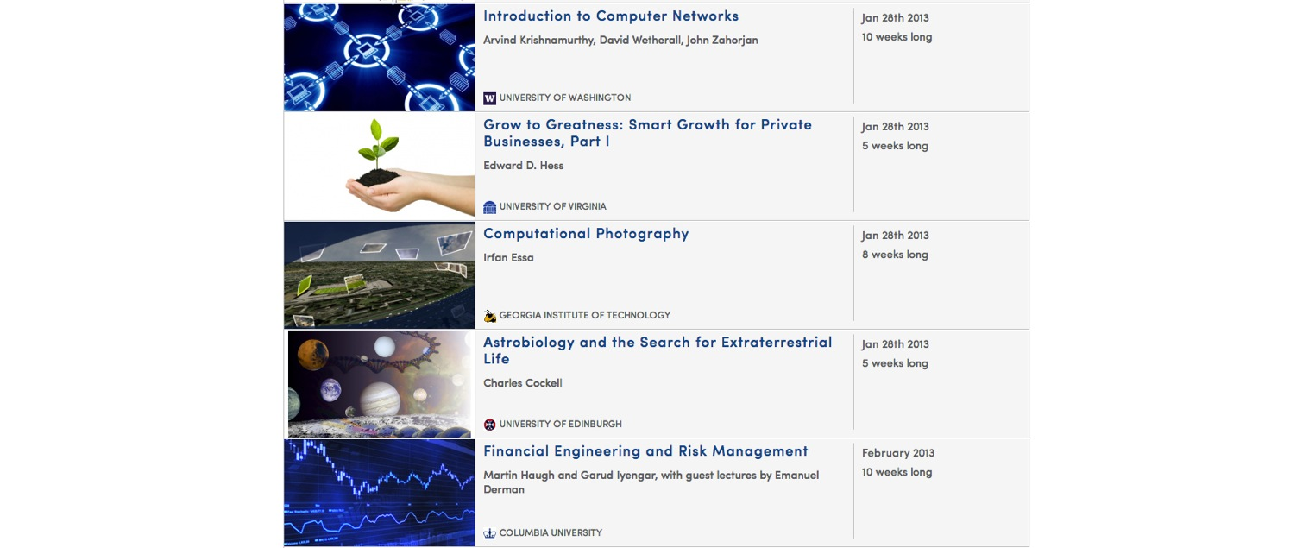
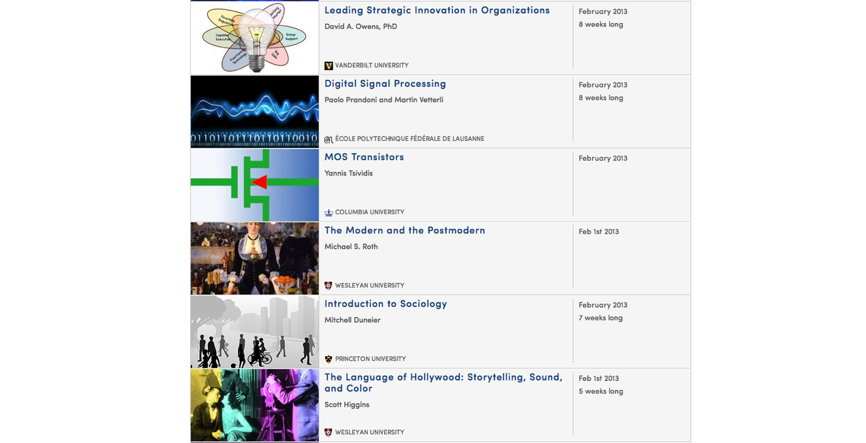
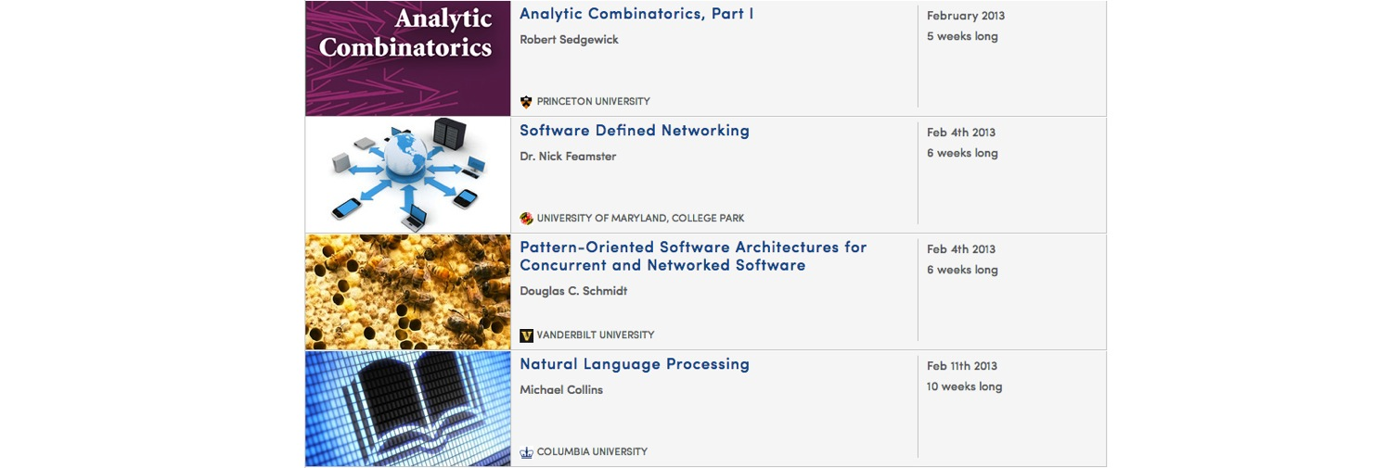
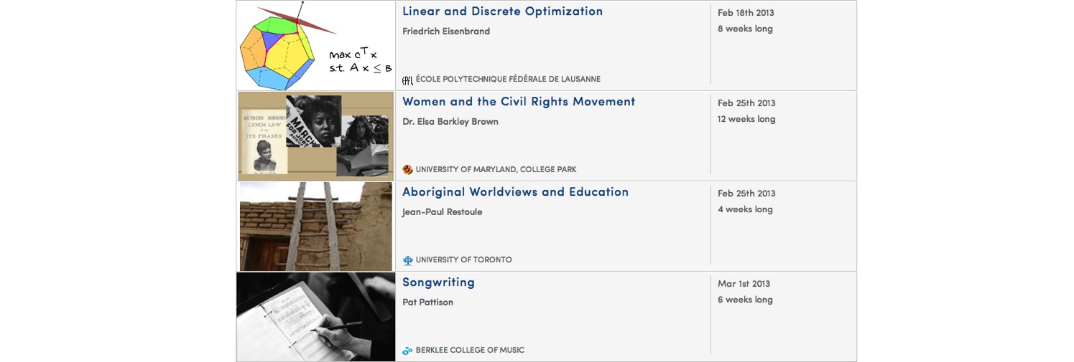
The Humanities, Sciences, Engineering, Business, ….

Slide 23
Non-Traditional Population
Notes:
Pie charts need to be redone

Slide 24
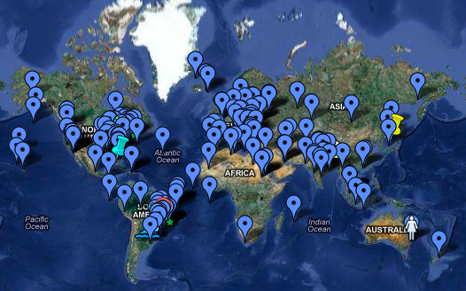
Sociology 101 Student Map
Global community of learners

Slide 25
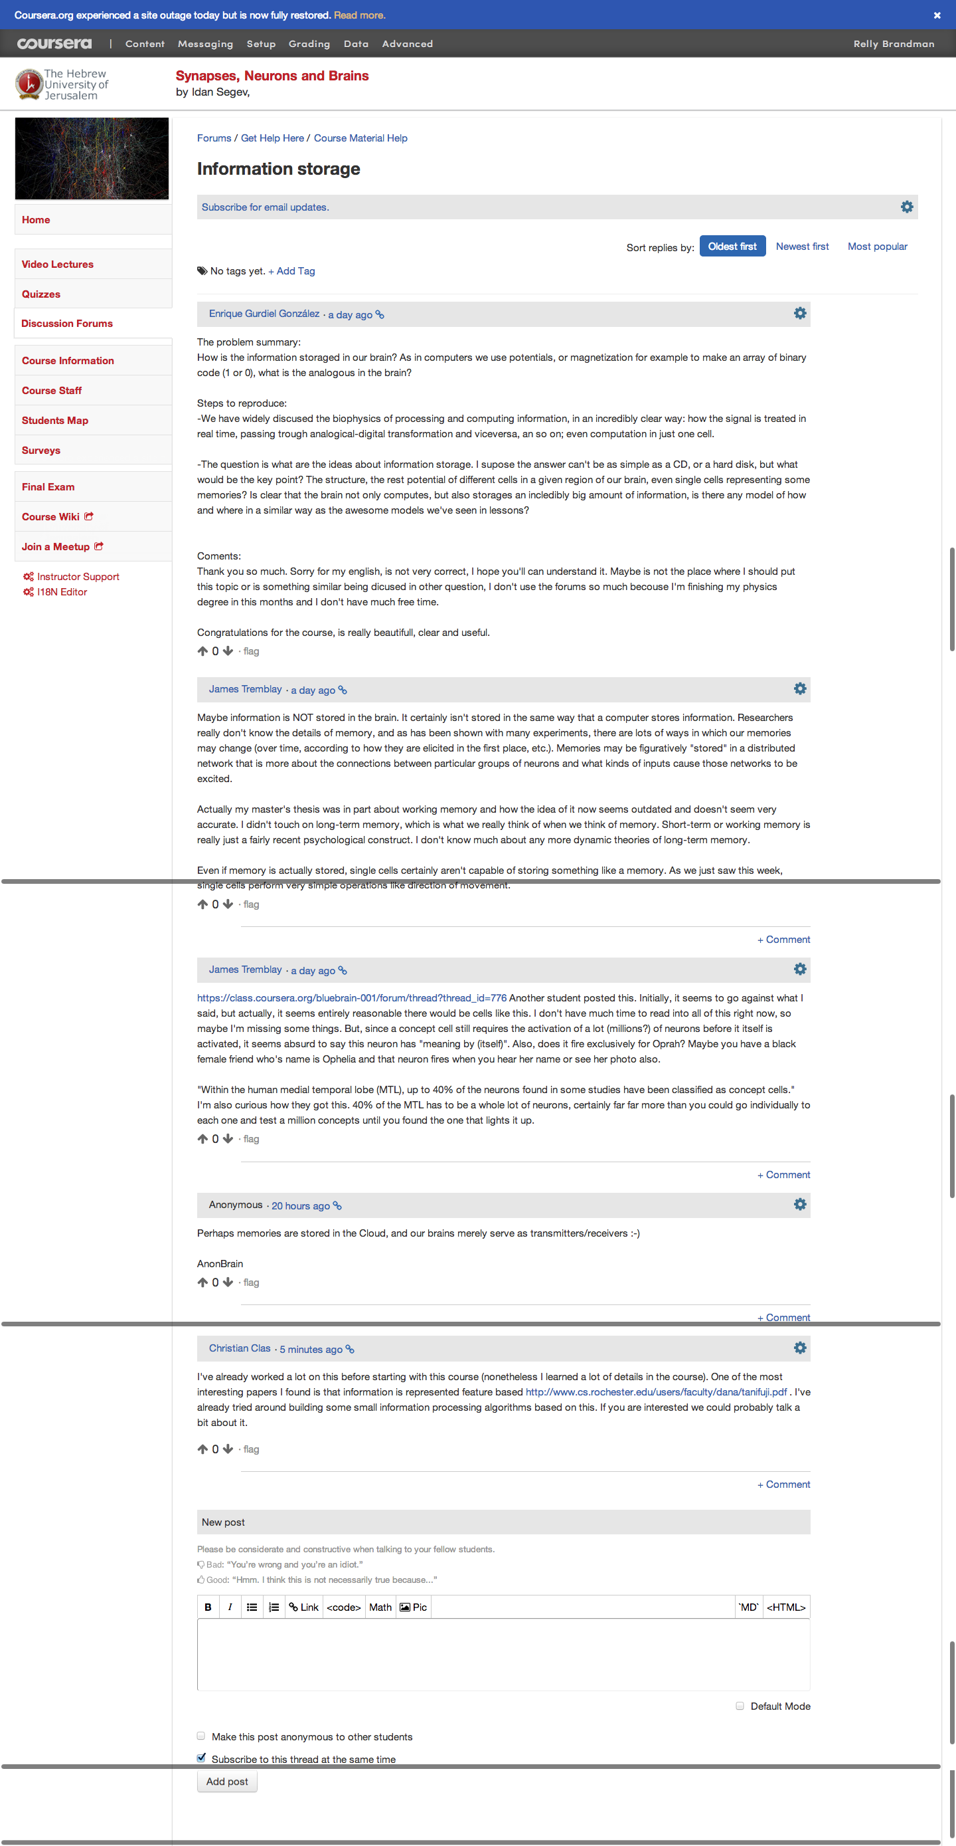
Student 1
Student 2
Student 3
Student 4
Community

Slide 26
San Francisco HCI-Class Study Group
Student Study Groups

Slide 27
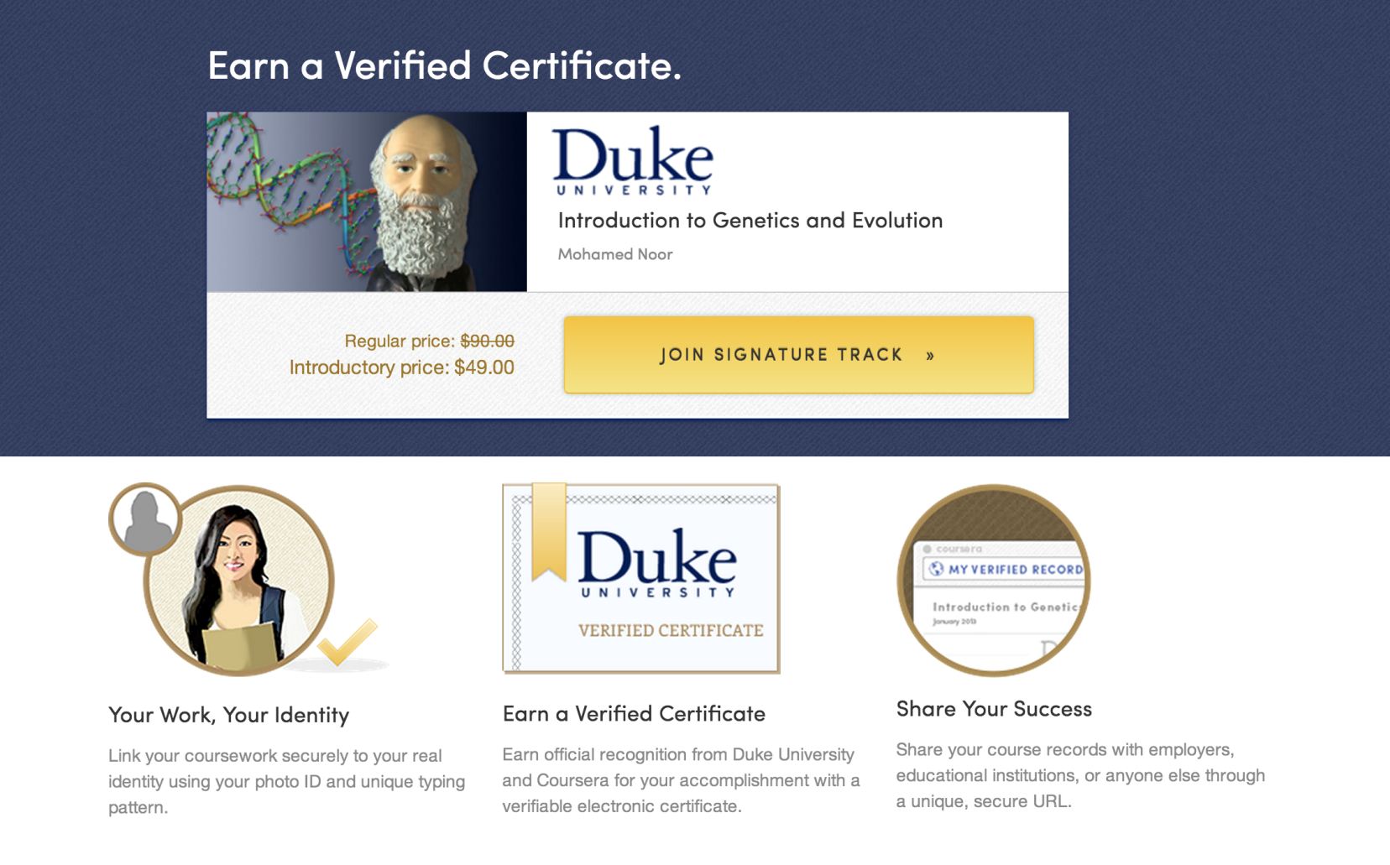
Signature Track Courses

Slide 28
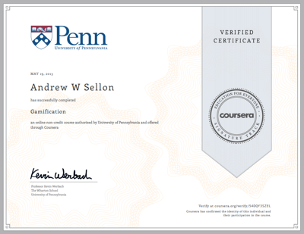
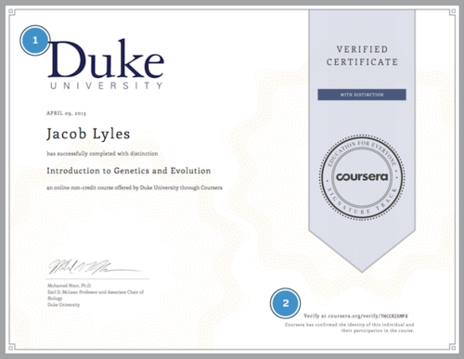
Signature Track

Slide 29
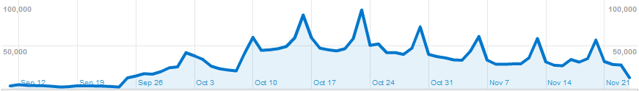
STATISTICS
& Analytics
First lectures
posted

Slide 30

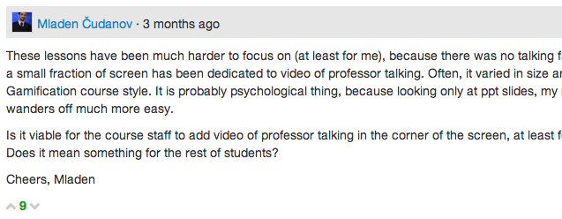

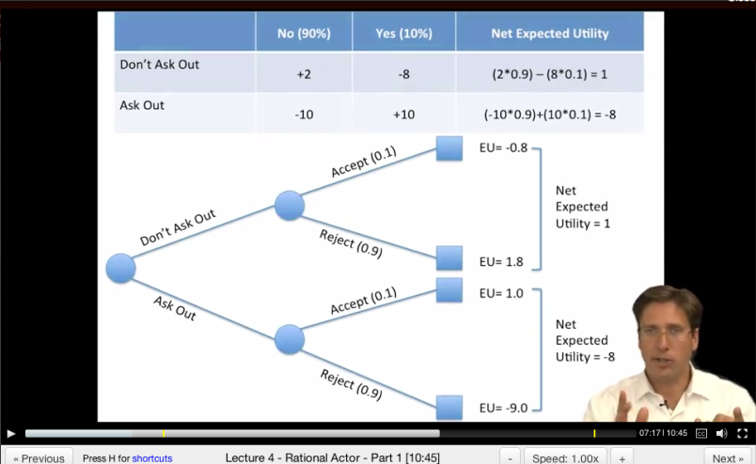
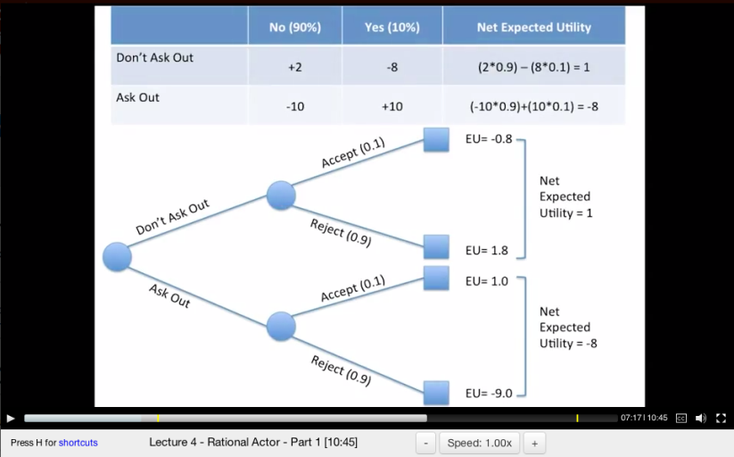
“These lessons have been much harder to focus on (at least for me), because there was no talking face.”
Dan MacFarland
https://class.coursera.org/organalysis-2012-001/forum/thread?thread_id=117&post_id=914
Student Group A
Student Group B
Data: Learn how students learn

Slide 31
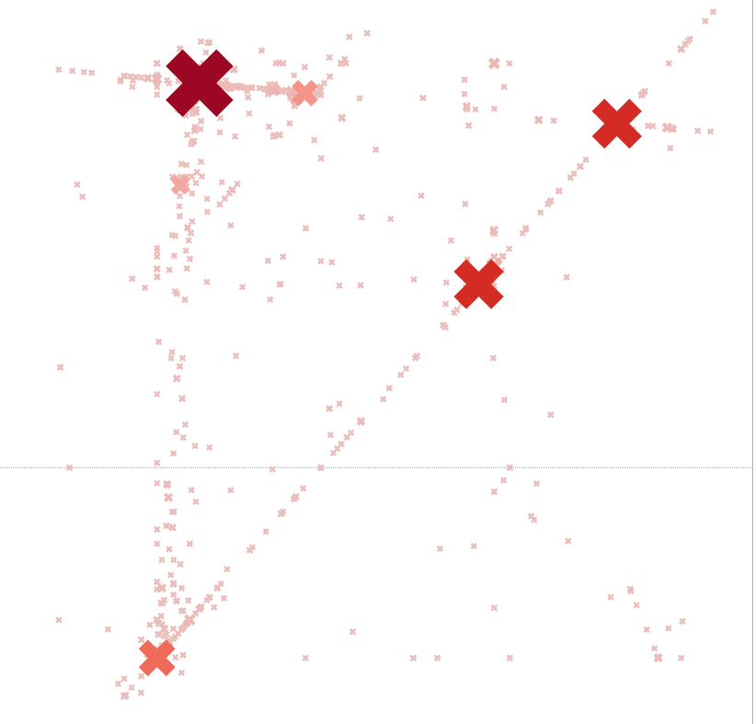
Wrong answers submitted for machine learning class
programming assignment
New Window into Human Learning
Notes:
ON HOLD

Slide 32
The mind is not a vessel that
needs filling, but wood that
needs igniting.
—Plutarch
from Ian Kidd's translation of Essays
Notes:
To wrap up….
I’ve often been asked: If anyone can now take online Princeton courses for free, why would anyone still pay for a Princeton degree? I think the value of a Princeton education isn’t just the content—instead it’s the interactions with the professors and with other equally bright students. To quote Plutarch: The mind is not a vessel that needs filling, but wood that needs igniting.
I think the value of a Princeton education isn’t just the content. Content is increasingly free on the web anyway. Instead, the real value of attending a top university is the interactions with the professors and with other equally bright students.

Slide 33
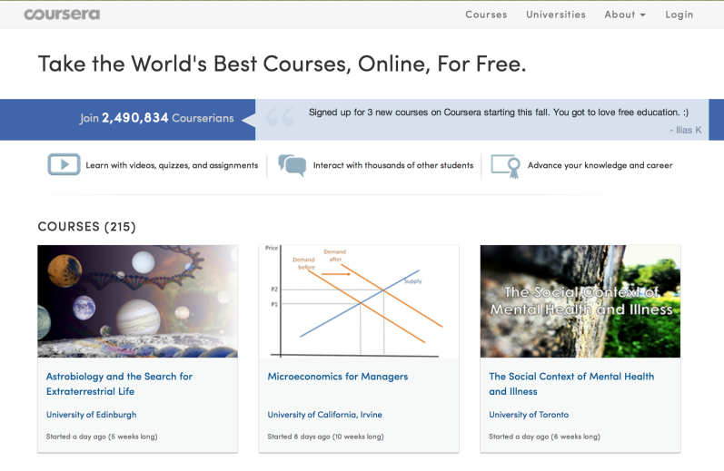

High-quality online content
Produced locally or adopted from another institution.
High-touch interaction with local instructor
Active learning, problem solving, personal attention to students
The Best of Both Worlds

Slide 34
"Improved Learning in a Large-Enrollment Physics Class."
L. Deslauriers, E. Schelew, and C. Wieman. Science (2011).
Lecture
Active
Learning
Attendance
Engagement
Learning
Igniting Minds

Slide 35
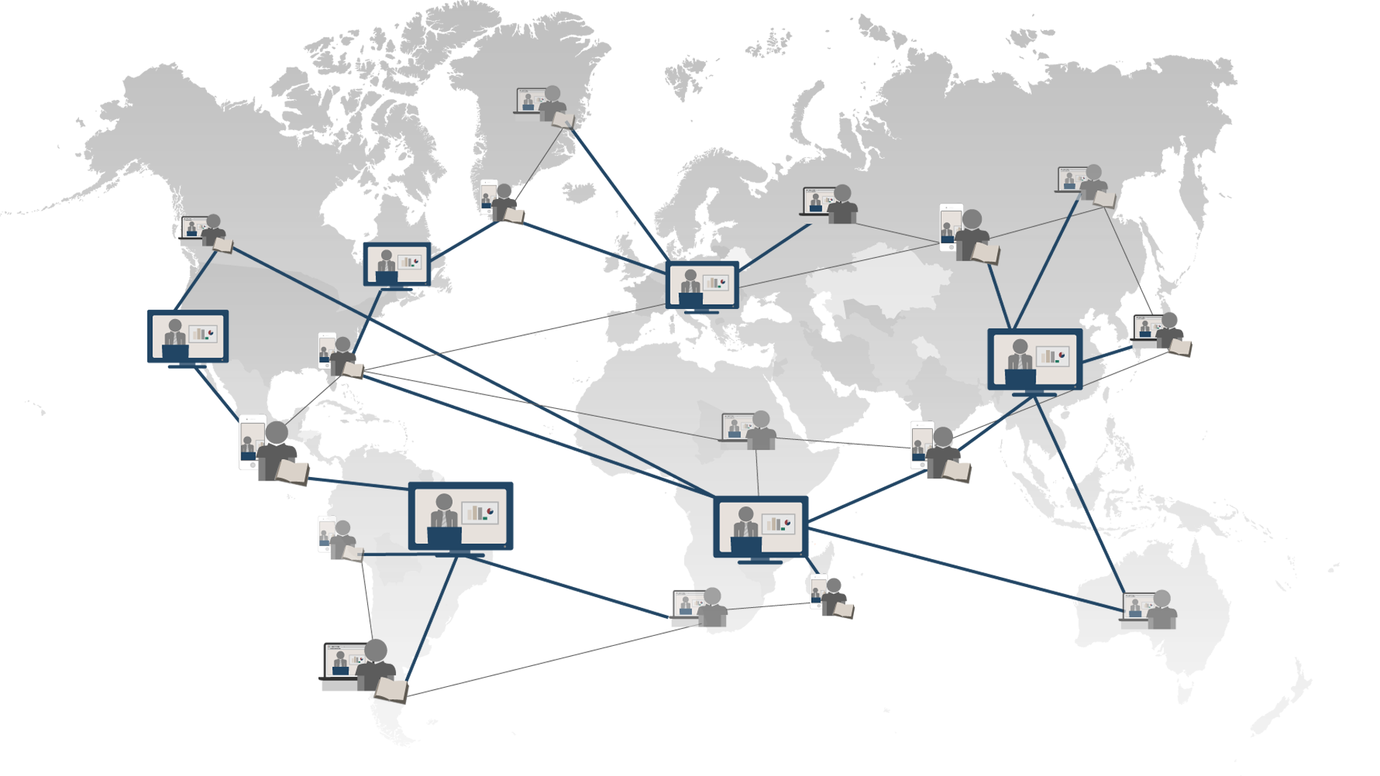
Education for Everyone
Twitter: @AndrewYNg
Notes:
What would we get if we could offer a free high-quality education to everyone? First, it establishes education as a basic human right, so that anyone with the motivation and the ability would have the opportunity to get the skills that they need to make a better life for themselves, their families and their communities. Second, it enables lifelong learning. It’s a shame that for most of us, learning stops when we finish our formal education. With these amazing courses, we would always have the opportunity to explore new directions, whether to expand our minds or to make a change in our livesk. Finally, it opens the door to a wave of innovation. Because talent can be found everywhere. Maybe the next Albert Einstein or the next Steve Jobs is living in some remote village in Africa. With access to education, he or she can come up with the next big idea, and help make the world a better place for all of us.

