Slide 1
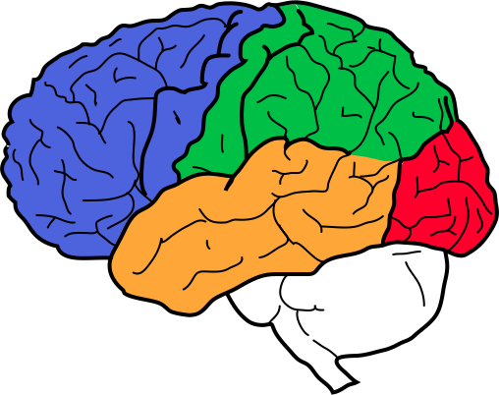
DistBelief:
Large Scale Distributed Deep Networks
Quoc V. Le
Google & Stanford
Joint work with:
Kai Chen, Greg Corrado, Jeff Dean,
Matthieu Devin, Rajat Monga, Andrew Ng,
Marc’Aurelio Ranzato, Paul Tucker, Ke Yang
Thanks: Samy Bengio, Geoff Hinton,
Andrew Senior, Vincent Vanhoucke, Matt Zeiler

Slide 2
Deep Learning
Most of Google is doing AI. AI is hard
Deep Learning:
Work well for many problems
Focus:
Scale deep learning to bigger models
Paper at the conference: Dean et al, 2012.
Now used by Google VoiceSearch, StreetView, ImageSearch, Translate…

Slide 3
Deep Learning
Use very large scale brain simulations
automatically learn high-level representations from raw data
can learn from both labeled and unlabeled data
Recent academic deep learning results improve on state-of-the-art in many areas:
images, video, speech, NLP, ...
... using modest model sizes (<= ~50M parameters)
We want to scale this approach up to much bigger models
currently: ~2B parameters, want ~10B-100B parameters
general approach: parallelize at many levels

Slide 4
Hypothesis
Useful high-level representations arise from:
Very large models, trained on very large amounts of data
But we are impatient..
Want to train such models quickly
Faster progress, easier to try out new ideas, etc.
Parallelism is our friend!

Slide 5
Model
Training Data

Slide 6
Model
Machine (Model Partition)
Training Data

Slide 7
Model
Machine (Model Partition)
Training Data
Core

Slide 8
Basic DistBelief Model Training
Model
Unsupervised or Supervised Objective
Minibatch Stochastic Gradient Descent (SGD)
Model parameters sharded by partition
10s, 100s, or 1000s of cores per model
Training Data
Quoc V. Le

Slide 9
Basic DistBelief Model Training
Model
Making a single model bigger and faster was the right first step.
But training is still slow with large data sets if a model only considers tiny minibatches (10-100s of items) of data at a time.
Training Data
How can we add another dimension of parallelism, and have multiple model instances train on data in parallel?

Slide 10
Two Approaches to Multi-Model Training
(1) Downpour: Asynchronous Distributed SGD
(2) Sandblaster: Distributed L-BFGS

Slide 11
Asynchronous Distributed Stochastic Gradient Descent
p’ = p + ∆p
Parameter Server
p’’ = p’ + ∆p’
∆p
∆p’
p’
p
Model
Data

Slide 12
Asynchronous Distributed Stochastic Gradient Descent
Parameter Server
p’ = p + ∆p
∆p
p’
Model
Workers
Data
Shards

Slide 13
Asynchronous Distributed Stochastic Gradient Descent
Parameter Server
Will the workers’ use of stale parameters to compute gradients mess the whole thing up?
Model
Workers
Data Shards
From an engineering standpoint, this is much better than a single model with the same number of total machines:
Synchronization boundaries involve fewer machines
Better robustness to individual slow machines
Makes forward progress even during evictions/restarts

Slide 14
Asynchronous Distributed Stochastic Gradient Descent
A few recent papers...
A neural probabilistic language model
Y. Bengio, R. Ducharme, P. Vincent, C. Jauvin, JMLR 2003
Slow Learners are Fast
John Langford, Alexander J. Smola, Martin Zinkevich NIPS 2009
Distributed Delayed Stochastic Optimization
Alekh Agarwal, John Duchi NIPS 2011
Hogwild!: A Lock-Free Approach to Parallelizing
Stochastic Gradient Descent
Feng Niu, Benjamin Recht, Christopher Re, Stephen J. Wright NIPS 2011
Only bound badness for convex problems, and we’re far from convex.
In practice, works quite well on many of our applications

Slide 15
L-BFGS: a Big Batch Alternative to SGD.
Async-SGD
first derivatives only
many small steps
mini-batched data (10s of examples)
tiny compute and data requirements per step
theory is dicey
at most 10s or 100s of model replicas
L-BFGS
first and second derivatives
larger, smarter steps
mega-batched data (millions of examples)
huge compute and data requirements per step
strong theoretical grounding
1000s of model replicas

Slide 16
L-BFGS: a Big Batch Alternative to SGD.
Leverages the same parameter server implementation as Async-SGD, but uses it to shard computation within a mega-batch.
Coordinator
(small messages)
Parameter Server
Some current numbers:
20,000 cores in a single cluster
up to 1 billion data items / mega-batch (in ~1 hour)
Model
Workers
Data
More network friendly at large scales than Async-SGD.
The possibility of running on multiple data centers...

Slide 17
Key ideas
Model parallelism via partitioning
Data parallelism via Downpour SGD (with asynchronous communications)
Data parallelism via Sandblaster LBFGS
Quoc V. Le

Slide 18
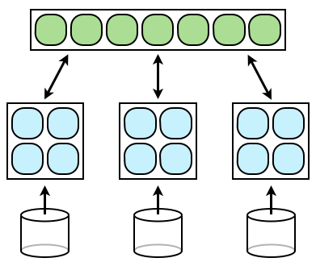
Applications
Acoustic Models for Speech
Unsupervised Feature Learning for Still Images
Neural Language Models
Quoc V. Le

Slide 19
Acoustic Modeling for Speech Recognition
8000-label Softmax
One or more hidden layers
of a few thousand nodes each.
11 Frames of 40-value Log Energy Power Spectra and the label for central frame
label

Slide 20
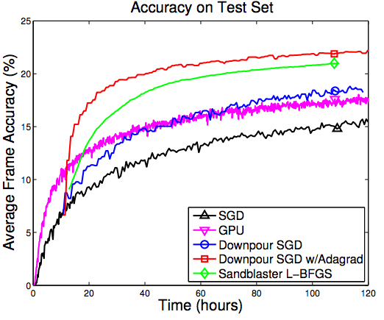
Acoustic Modeling for Speech Recognition
Async SGD and L-BFGS
can both speed up model training.
Results in real improvements in final transcription quality.
Significant reduction in Word Error Rate
To reach the same model quality
DistBelief reached in 4 days
took 55 days using a GPU...
DistBelief can support much larger models than a GPU, which we expect will mean higher quality

Slide 21
Applications
Acoustic Models for Speech
Unsupervised Feature Learning for Still Images
Neural Language Models
Quoc V. Le

Slide 22
Purely Unsupervised Feature Learning in Images
Deep sparse auto-encoders (with pooling and local constrast normalization)
1.15 billion parameters (100x larger than largest deep network in the literature)
Data are 10 million unlabeled YouTube thumbnails (200x200 pixels)
Trained on 16k cores for 3 days using Async-SGD
Quoc V. Le

Slide 23
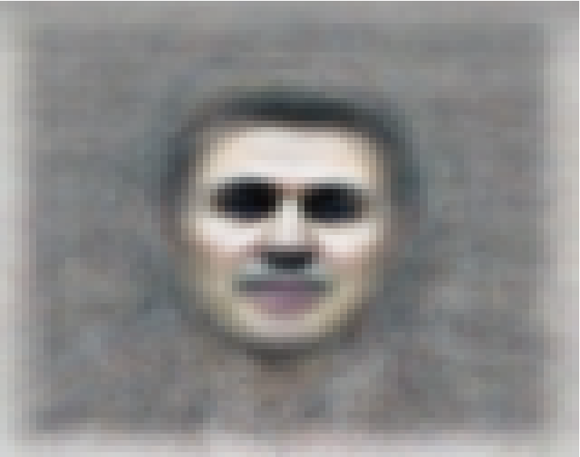
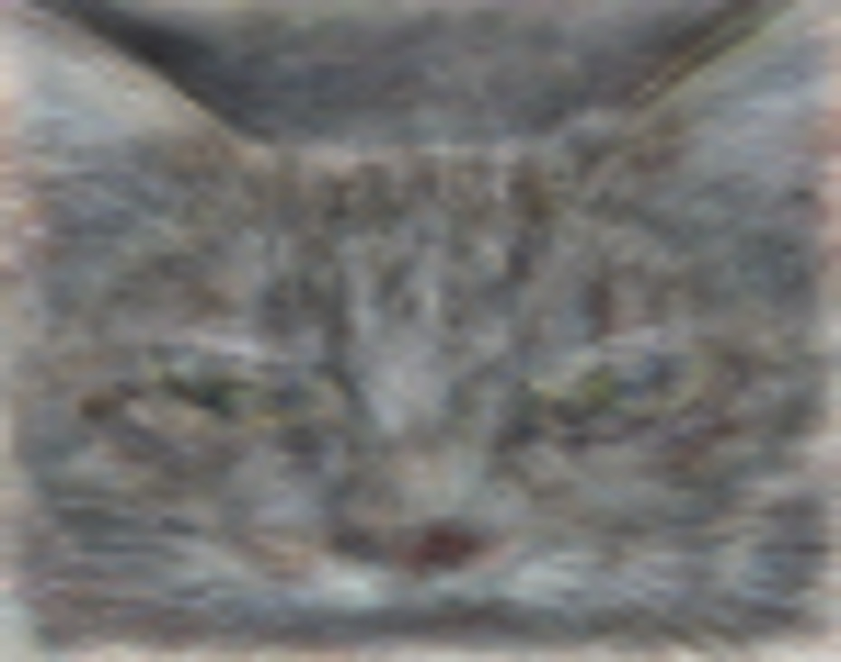
Optimal stimulus for face neuron
Optimal stimulus for cat neuron
Quoc V. Le

Slide 24
A Meme

Slide 25
Semi-supervised Feature Learning in Images
But we do have some labeled data, let’s fine tune this same network for a challenging image classification task.
ImageNet:
16 million images
20,000 categories
Recurring academic competitions

Slide 26
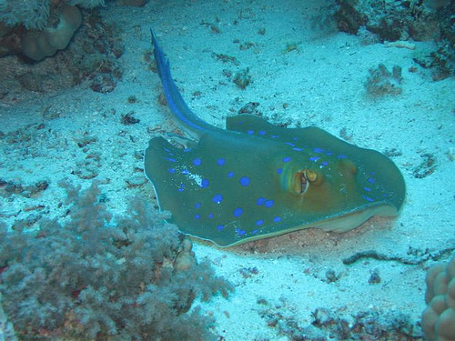
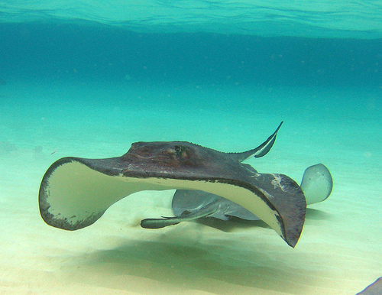
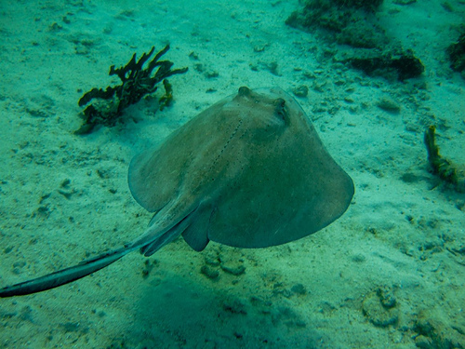
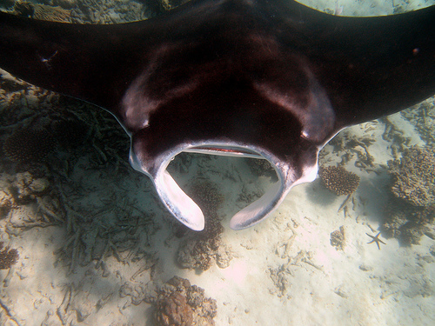
22,000 is a lot of categories…
…
smoothhound, smoothhound shark, Mustelus mustelus
American smooth dogfish, Mustelus canis
Florida smoothhound, Mustelus norrisi
whitetip shark, reef whitetip shark, Triaenodon obseus
Atlantic spiny dogfish, Squalus acanthias
Pacific spiny dogfish, Squalus suckleyi
hammerhead, hammerhead shark
smooth hammerhead, Sphyrna zygaena
smalleye hammerhead, Sphyrna tudes
shovelhead, bonnethead, bonnet shark, Sphyrna tiburo
angel shark, angelfish, Squatina squatina, monkfish
electric ray, crampfish, numbfish, torpedo
smalltooth sawfish, Pristis pectinatus
guitarfish
roughtail stingray, Dasyatis centroura
butterfly ray
eagle ray
spotted eagle ray, spotted ray, Aetobatus narinari
cownose ray, cow-nosed ray, Rhinoptera bonasus
manta, manta ray, devilfish
Atlantic manta, Manta birostris
devil ray, Mobula hypostoma
grey skate, gray skate, Raja batis
little skate, Raja erinacea
…
Stingray
Mantaray

Slide 27
Semi-supervised Feature Learning in Images
Example top stimuli after fine tuning on ImageNet:
Neuron 6
Neuron 7
Neuron 8
Neuron 9
Neuron 5

Slide 28
Semi-supervised Feature Learning in Images
Example top stimuli after fine tuning on ImageNet:
Neuron 10
Neuron 11
Neuron 12
Neuron 13
Neuron 5

Slide 29
Semi-supervised Feature Learning in Images
ImageNet Classification Results:
ImageNet 2011 (20k categories)
Chance: 0.005%
Best reported: 9.5%
Our network: 20% (Original network + Dropout)
Quoc V. Le

Slide 30
Applications
Acoustic Models for Speech
Unsupervised Feature Learning for Still Images
Neural Language Models
Quoc V. Le

Slide 31
Embeddings
~100-D joint embedding space
Paris
Obama
SeaWorld
dolphin
porpoise
Quoc V. Le

Slide 32
Neural Language Models
Hinge Loss // Softmax
Hidden Layers?
Word Embedding Matrix
E
E
E
E
the
cat
sat
on
the
E
}
is a matrix of dimension ||Vocab|| x d
100s of millions of parameters,
but gradients very sparse
Top prediction layer has ||Vocab|| x h parameters.
Most ideas from Bengio et al 2003, Collobert & Weston 2008

Slide 33
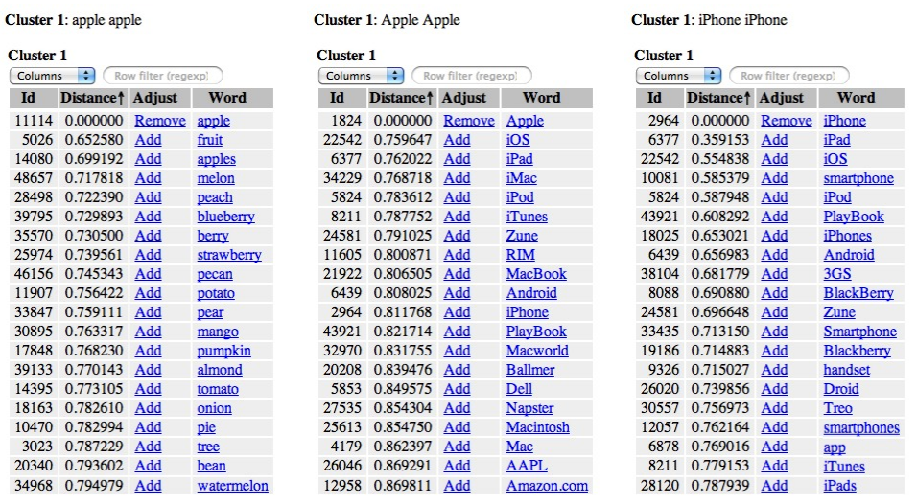
Visualizing the Embedding
Example nearest neighbors in 50-D embedding trained on 7B word Google News corpus
apple
Apple
iPhone

Slide 34
Summary
DistBelief parallelizes a single Deep Learning model over 10s -1000s of cores.
A centralized parameter server allows you to use 1s - 100s of model replicas to simultaneously minimize your objective through asynchronous distributed SGD, or 1000s of replicas for L-BFGS
Deep networks work well for a host of applications:
Speech: Supervised model with broad connectivity, DistBelief can train higher quality models in much less time than a GPU.
Images: Semi-supervised model with local connectivity, beats state of the art performance on ImageNet, a challenging academic data set.
Neural language models are complementary to N-gram model -- interpolated perplexity falls by 33%

